Slide 1

University of Belgrade – Faculty of Forestry
Multi-criteria decision analysis for sub-watersheds ranking via the Promethee method
Tijana Vulević, Nada Dragović

Slide 2
Objective
To rank delineated sub-watersheds in Topčiderska river
according to vulnerability to soil erosion using multi-
criteria decison analysis method – PROMETHEE II.

Slide 3
Soil erosion by water is an environmental problem
Consequences
Prevention/Mitigations
soil loss
increase risk of flooding
siltation of accumulation
water pollution etc.
reforestation, technical object construction, and other measures.
On the watershed, sub-watershed scale
Which part of the watershed has a priority for human reaction?
Notes:
It is important due to importans of financial and human resources planning

Slide 4
Study area
Topčiderska river watershed
northen part of Serbia
147km2
Sub-watershed delineation
Method: Automatic (DEM based), ArcHydro (Terrain Processing toolset)
Requirements:
DEM (grid cell size = 25m
HYDROLOGY (stream network in shape file format)
Notes:
Topčiderska river watershed,
located in the northern part
of Serbia
between 44°34’N-44°48’ lat.
and 20°25’E-20°34’E long.
147km2
Sub-watersheds boundaries - generated using DEM with a grid cell resolution of 25m.
Arc Hydro is used to delineate 9 sub-watersheds (Terrain Processing toolset) .
Firstly, streams are defined, using a threshold of 10km² and then sub-watersheds are delineated. DEM based (Automatic delineation)

Slide 5
Multi-criteria decision analysis (MCDA)
Decision making using
expert judgement and knowledge
in the case of more, usually conflicting criteria and finite set of alternatives or actions
handling with qualitative
and quantitative data
making the right decision
even in the case of missing
data and lack of field research.
AHP
Analytical Hierarchy Process
ELECTRE
ELimination and Choice Expressing
REality
PROMETHEE
Preference Ranking Organisation
METHod for Enrichment Evaluations
Notes:
One option is to calcuulate soil erosion rate, apply same physical model, but also we can rest on the expert judgement and knowledge which have same adventages sush as:GAIA : Graphical Analysis for Interactive Assistance (for PROMETHEE) selection of the best actions from a set of alternatives, each of which is evaluated against multiple,and often conflicting criteriađ
ELimination and Choice Expressing REality

Slide 6
PROMETHEE method
The Preference Ranking Organization METHod for Enrichment
Evaluations
Promethee I
Promethee II
Partial ranking
Compleate ranking
Qualities: clear method with simple conception and possibilities to check the stability of the results (Brans et al, 1986).

Slide 7
PROMETHEE method
Application:
Topics: environmental management, hydrology and water management, transportation, energy management, finance, chemistry etc.

Slide 8
Problem solving:
1) Establish decision objective (goal)
PROMETHEE method
2) Identify the Actions (alternatives)
3) Identify the criteria
4) Construct an evaluation matrix
Evaluation matrix
Sub-watershed | Soil erodibility [10⁻²] | Land cover [10⁻²] | Rainfall erosivity | Topography
1 | 2.65 | 0.22 | 868.49 | 2.03
2 | 2.85 | 0.43 | 888.97 | 2.20
3 | 3.20 | 3.27 | 900.52 | 1.55
4 | 3.49 | 8.94 | 902.77 | 1.75
5 | 3.17 | 10.12 | 904.09 | 1.85
6 | 3.28 | 6.35 | 914.25 | 2.32
7 | 3.04 | 4.76 | 918.36 | 2.61
8 | 3.84 | 11.78 | 910.10 | 1.92
9 | 3.45 | 10.68 | 914.63 | 2.08
Evaluations
Notes:
Rank sub-watersheds according to soil erosion vulnerability

Slide 9

PROMETHEE II
Application steps
Express weights of decision criteria wj
Express preference function Pj(a,b) for each criterion, based on the deviations dj(a,b)
Calculate global preference index π(a,b)
Calculate positive outranking flow ϕ⁺(a) and negative outranking flow ϕ⁻(a)
5. Calculate net outranking flow ϕ(a)
Notes:
2. Express preference function for each criterion, using values from interval 0-1,
based on the difference between evaluations of actions a and b (deviations) – dj(a,b) on all considered criterion j (j=1,..,4)

Slide 10
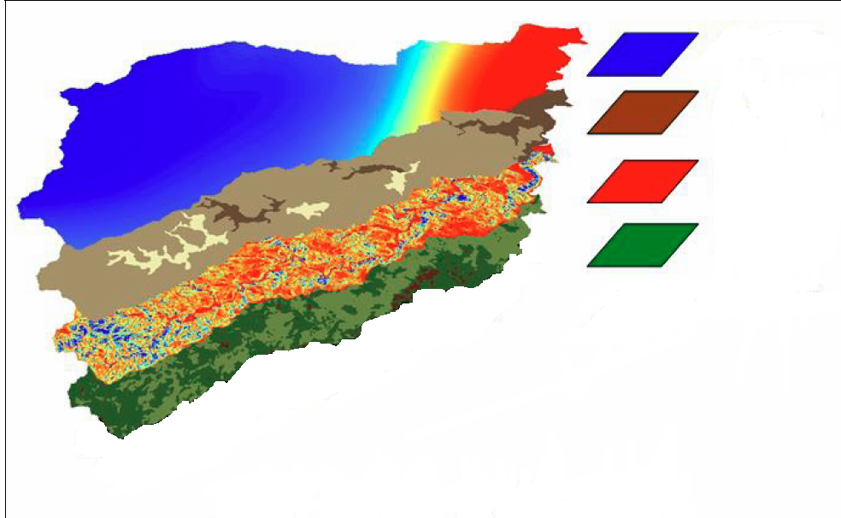
Results and disscusions
GIS results
Creating layers in GIS
Four layers (maps) are created
rainfall erosivity layer
soil erodibility layer
topographic layer,
land cover type layer
The mean value of all layers is obtained using the statistics option in ArcMap = inputs of the evaluation matrix
Notes:
for the entire watershed, and then for the delineated sub-watersheds

Slide 11
Topography factor
(Slope length and steepness factor, LS-factor in USLE/RUSLE)
Calculated using: Desmet and Govers (1996) equation (include-contributing area, slope lenght for grid cell, grid cell size)
Estimated mean value:
1.55-2.67 (SW-3 and SW-7)
Notes:
This indicates that the LS –factor in sub-watershed 7 has the greatest influence on soil erosion.

Slide 12
Rainfall erosivity factor ( R- factor)
Calculated using:
Grimm et al. (2003) and Van der Knijff et al. (2000) equation (inputs - average annual precipitation)
Estimated mean value
for precipitation: 644.71 - 725.89mm
for rainfall erosivity factor: 847.61-921.57
Spatial interpolation of precipitaion - using the IDW interpolation technique.
Notes:
The precipitation increase with increasing altitude, so the highest value is registered in the sub-watersheds 6,7,8 and 9 (Table 1, column 4).

Slide 13
Soil erodibility factor (K-factor)
Calculated using: equation from EPIC model (Williams et al., 1983)
(inputs: soil texture and organic carbon content)
Estimated value:
for soil type: 0.021-0.045
for sub-watersheds: 0.026-0.038
Spatial distribution of soil
(Source: Institute of Soil Science, Serbia)

Slide 14
The land cover factor (C-factor)
Calculated using: CORINA methodology and
value of C –factor is adopted from: Panagos et al. (2015), Belanovic et al. (2013) and Diodato et al. (2011)
Estimated value:
for land cover type: 0-0.30
for sub-watersheds: 0.0022-0.12
artificial surfaces 28.37%,
agriculture areas 46.77%,
forest 24.73%
the rest - water bodies

Slide 15
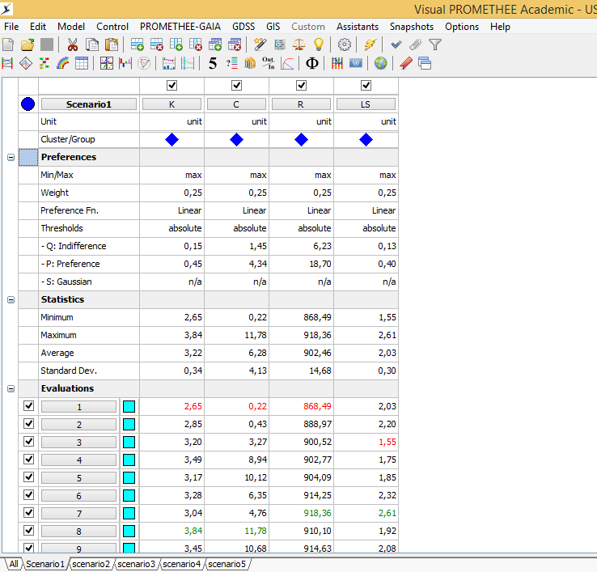
RESULTS of the application of the PROMETHEE II
Visual Promethee 1.4 Academic Edition software

Slide 16
RESULTS of the application of the PROMETHEE II
We defined/determined:
Type of criterion (maximum or minimum)
Criterion weights (relative importance)
- using AHP method
- through pairwise comparisons
- are in the interval [0-1] and ∑wij=1
- if the weight is higher (closer to 1), the criterion is more important
-the decrease in value of one criterion increases the value of other

Slide 17
3. Preference function and thresholds
When we compared two actions a and b, we must be able to express the results of comparison in terms of preference = preference function Pj(a,b)
Pj(a,b)=0 indifference
Pj(a,b)~0 weak preference a over b
Pj(a,b)~1 strong preference a over b
Pj(a,b)=1 strict preference a over b
Q
P
Usual
« U » shape
« V » shape
Q
P
Q
P
S
Level
Linear
Gaussian
Preference functions (Brans, 1986)
linear preference (V shape ) for all criterion

Slide 18
Linear preference function
Preference score
1
Q
d(a,b)
P
0
Linear
This preference function serves to transform deviations into preference score between 0 and 1.
Notes:
This preference function serves to transform deviations into preference score between 0 and 1,
using indifference and preference threshold (defined by soil erosion expert).
When the difference between evaluations is negligible the score is 0, otherwise, the intensity of preference increases
linearly until this deviation reaches the value of preference threshold, when it is strict (Brans & Vincke, 1985).
For each criterion and all pairs of actions (sub-watershed) preference function is estimated [Eq.1]
and used to calculate the global preference index given in Equation 2. In the final step using positive and negative outranking flow
(given in Equation 3 and Equation 4),
the net flow is calculated and used to rank sub-watersheds.

Slide 19
4. Calculate global preference index π(a,b)
using criterion weights and preference function
higher preference index=higher the strenght of the preference a over b
5. Calculate positive outranking flow ϕ⁺(a) and negative outranking flow ϕ⁻(a)
6. Calculate net outranking flow ϕ(a)
difference between positive and negative outranking flow
b
b
a
a
Notes:
The node of the graphs represent the alternatives under consideration, and arcs represents preference of alternative a over b. Each arc is associated with flow representing the preference index. The sum of dlow living the a node a is colling positive outranking flow, and sum of flow entering a node a is colling a negative outranking flow.

Slide 20
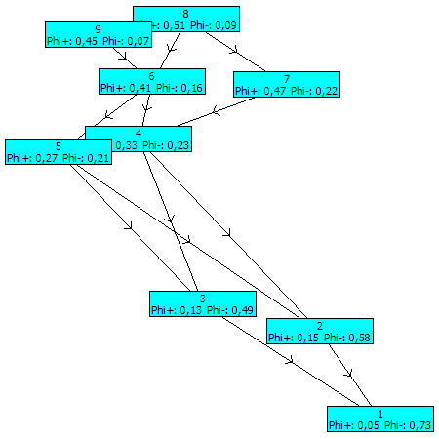
PROMETHEE I network
PROMETHEE II Flow Table
Rank | action | Phi | Phi+ | Phi-
1 | 8 | 0.4245 | 0.5129 | 0.0884
2 | 9 | 0.3825 | 0.4515 | 0.0690
3 | 6 | 0.2541 | 0.4120 | 0.1579
4 | 7 | 0.2448 | 0.4695 | 0.2248
5 | 4 | 0.0948 | 0.3262 | 0.2314
6 | 5 | 0.0614 | 0.2722 | 0.2109
7 | 3 | -0.3571 | 0.1300 | 0.4871
8 | 2 | -0.4325 | 0.1464 | 0.5789
9 | 1 | -0.6725 | 0.0544 | 0.7269
Notes:
A network representation of the Promethee I partial rankiing , where we do not have information on complete ranking of alternatives, but if we performed promethee II we hae complete ranking as it is showen in table on the right

Slide 21
Sensitivity analysis
Five scenarios:
1) equal weights of all factors,
2) week preference given to K-factor (wk=0.40, wls=wc=wr=0.20)
3) week preference given to the C – factor (wc=0.40, wk=wls=wr=0.20)
4) week preference given to R-factor (wr=0.40, wk=ls=wc=0,20)
5) week preference given to the LS - factor. (wls=0.40, wk=wc=wr=0,20)
Ranking - using the net outranking flow:
Scenario 1: 8>9>6>7>4>5>3>2>1
Scenario 2: 8>9>6>4>7>5>3>2>1,
Scenario 3: 8>9>6>4>5>7>3>2>1
Scenario 4: 8>9>7>6>4>5>3>2>1
Scenario 5: 7>9>6>8>5>4>2>3>1.
Notes:
Sensitivity analysis based on changing weights of criterion is performed considering 5 scenarios:
Sub-watershed are ranked using the net outranking flow that varies between -1 and 1, which is presented on the vertical green/red line in Fig. 8.
Of the highest priority are sub-watershed with the maximal value of net outranking and positive outranking flow. The ranking is similar for all scenarios except for the last one, where the preference is given to the topography factor.
In this case, sub-watershed 7 is the highest priority, due to the high value of slope length and steepness factor and the huge amount of precipitation in this part of the watershed.

Slide 22
Sensitivity analysis shows that the most erodible is sub-watershed 8:
located in the upper part of the Topčiderska river watershed
the average amount of annual precipitation is 700.08mm
the mean value of R-factor is estimated to be 910.10 MJ mm ha⁻¹ h⁻¹ y⁻¹
land cover:
LS-factor varies from 0.03 to 13.74, with the mean value of 1.92.
Notes:
Around 60% of this sub-watershed is occupied by land cover where soil erosion process could progress: non-irrigated arable land (20%),
complex cultivation patterns (24.31%), land principally occupied by agriculture with significant areas of natural vegetation (18.75%).

Slide 23
Multiplying R, K, C and LS factors the erosion vulnerability (EV) index is obtained and used to identify the critical area under sub-watershed 8.
EV index isclassified into four categories:
low (53.77%),
moderate (29.26%),
high (13.03%)
severely vulnerable areas (3.94%)
Around 15% of the area of sub-watershed 8 are high and extreme vulnerable zone, with a priority for implementation of soil erosion and torrent control measures.

Slide 24
5. Conclusions
Based on the results, we can conclude that:
PROMETHEE II outranking method provides a complete ranking of sub-watersheds according to soil erosion vulnerability
Considered criterion was: land cover, rainfall, soil erodibility and topography
Using ArcHydro and ArcMap sub-watersheds are generated, layers are produced as well as inputs for evaluation matrix
Mapping erosion vulnerability using GIS enabled identification of conservation priority area.
Using AHP method criterion weights are determined
Sensitivity analysis is performed to test the stability of the results of the ranking via PROMETHEE method
Potential changes of topography factor weights led to rank changes
Potential changes of other considered criterion weights showed stable ranking results.

Slide 25
THANK YOU

