Slide 1
Comparative Study of Methods for Automatic Identification and Extraction of Terraces from High Resolution Satellite Data (China-GF-1)
Wang Xiaojing¹,Zhang Yi²,Zhao Xin¹ ,Luo Zhidong³
¹Beijing Datum Technology Development CO.,LTD.
²Beijing Forestry University
³Monitoring Centre of Soil and Water Conservation, Ministry of Water Resources
August 2016
wangxiaojing@dtgis.com
Notes:
1.Mr.Chairman,Honorable guest,Ladies and gentlemen,good morning ,It's very great pleasure for me to attend this meeting.
2.Today I would like to present my paper“ Comparative Study of Methods for Automatic Identification and Extraction of Terraces from High Resolution Satellite Data (China-GF-1)”.

Slide 2
Contents
1
Introduction
2
Terraces Interpretation Characteristics
3
Automatic Identification and Extraction Method
4
Results Comparison and Discussion
5
Conclusions
Notes:
I'm going to begin with a few general comments concerning
1.the Introduction
2.Terraces Interpretation Characteristics on high resolution image
3. Automatic Identification and Extraction Method of Terraces based on High Resolution Satellite
4. Results Comparison and Discussion
5.Last, Conclusions.

Slide 3
1.Introduction
  Importance of Terraces
  Effective measures / Long history / Large area / Heavy investment
  Application of Remote Sensing Technology in Terraces
    Lack of new technology-computer automatic identification and extraction of terraces.
Issues to be studied
  Urgent business needs
  Research area：Hengshan County 4000km²
  Data: China GF-1 satellite
Notes:
Importance of Terraces['tereisis]
Effective measures：controlling farmland soil and water loss , Ensure food security, ecological security, promote ecological restoration and rehabilitation['riːhə,bɪlɪ'teɪʃən].
History：thousands of year history in China
Area：over 20 million hm² terraces and expanding continuously
Investment：over 19 billion yuan RMB every year
Issues to be studied
Urgent business needs: quickly acquire the number, distribution and dynamic[daɪ'næmɪk] construction of terraces in a large extent.
Research area: Hengshan County, Yulin of Shanxi Province, 4000km2.
Data: China GF-1 satellite (China high resolution earth observation system)

Slide 4
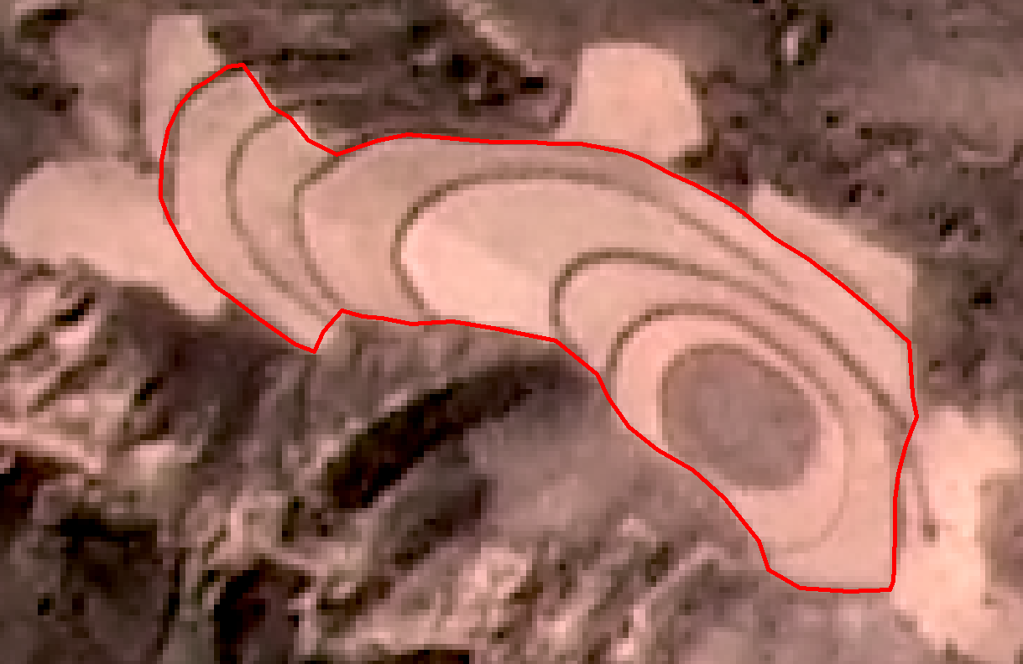
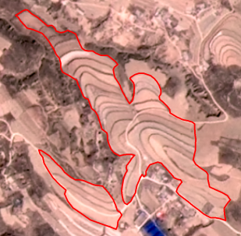
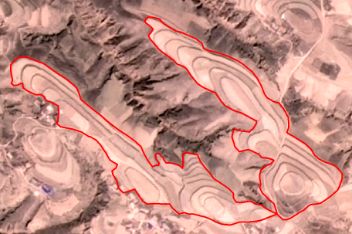
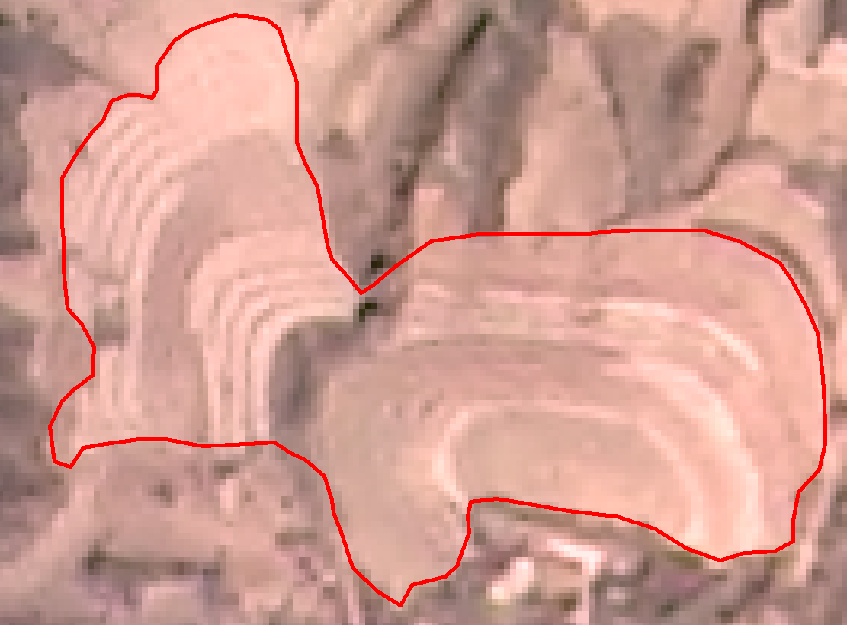
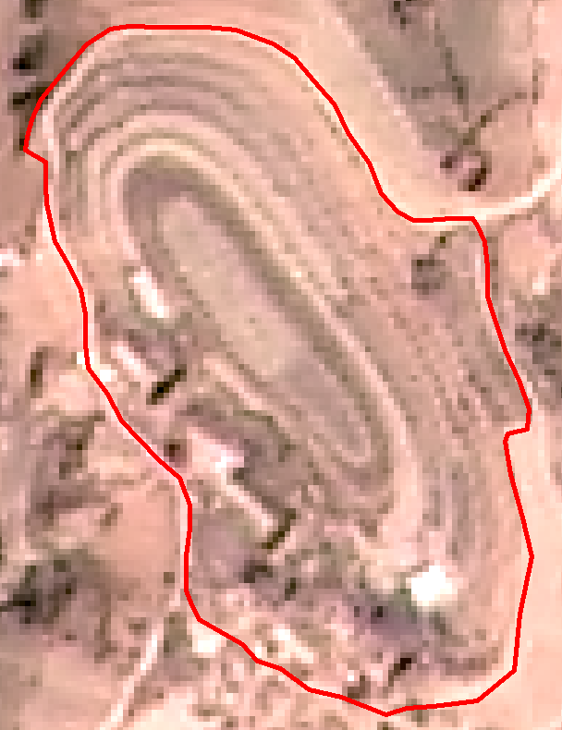
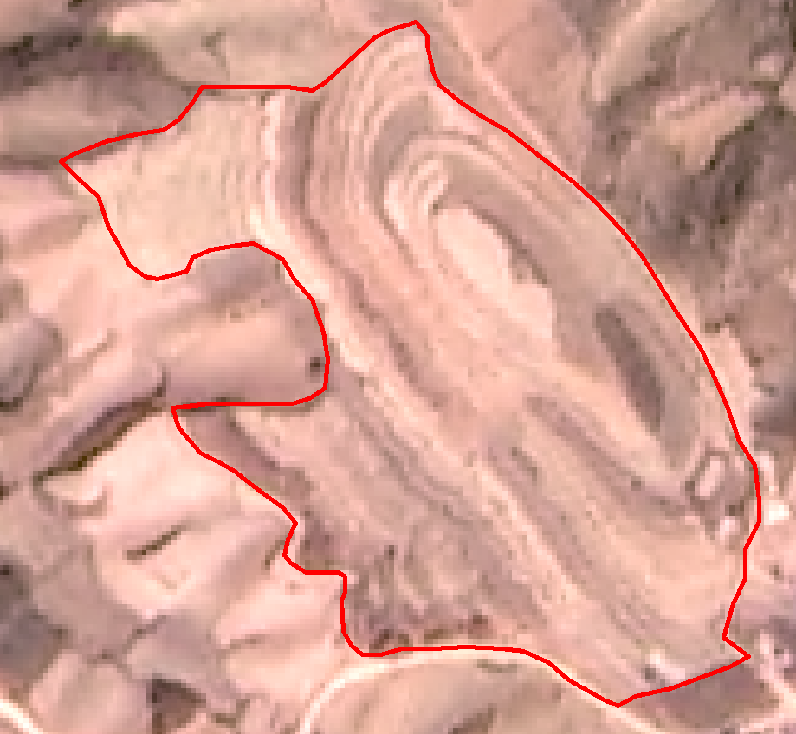
2.Terraces Interpretation Characteristics
Table 2 Terraces Interpretation Characteristics on GF-1 Satellite
type | geometry | spectrum | texture | boundary
Typical terrace | field: certain width field ridge: narrow, line features- straight line, arc or closed curve | field: higher reflectivity field ridge: low reflectivity with dark color | smooth repeatedly and alternatively | Complicated near ridge: clear near hill foot: confused
Atypical terrace | field: narrow field ridge: cannot be seen | field: higher reflectivity field ridge: cannot be seen | fuzzy | Same as Typical terrace
Typical Terrace Sample on GF-1 2m/8m Fused Image
Atypical Terrace Sample on GF-1 2m/8m Fused Image
Notes:
basis['beɪsɪs] of classification ：Based on the terrace features on the high-resolution remote sensing image, it can be classified into two types: typical terrace and atypical [eɪ'tɪpɪk(ə)l; æ-] terrace. The algorithm['ælgə'rɪðəm] research has been carried out on the basis of gray and texture features of terraces.
It is very important step here to summarize the features.

Slide 5
3.Automatic Identification and Extraction Method of Terraces based on High Resolution Satellite
3.1 Edge Characteristics Statistics Algorithm
3.2 Template Matching Algorithm
3.3 Fourier Transformation Algorithm
Notes:
So on the basis of classification there have 3 Algorithms ['ælgərɪð(ə)m] :
1. Edge Characteristics[,kærəktə'rɪstɪks] Statistics[stə'tɪstɪks] Algorithm, Template Matching Algorithm and Fourier['fʊriər] Transformation Algorithm.

Slide 6
3.Automatic Identification and Extraction Method of Terraces based on High Resolution Satellite
3.1Edge Characteristics Statistics Algorithm
Technical Route of Edge Characteristics Statistics for Terrace Identification
Notes:
1.The preprocessing has been carried out on high-resolution remote sensing image, as well as edge detection has been done to generate binary image.
2.The land-use type data has been applied to frame the interested area for terrace identification
3.Template training,here we get the parameters of template : size \vector\threshold. How to do?
(1)selecte training area artificially based on requirements. window search one by one,
(2) effective number of edge lines will be taken statistics.
window size and its feature threshold will be determined
So we establish the terrace identification template.
After that, the template was used to scan samples one by one on binary image to identify terraces and merge the terraces samples, and make shape optimization[,ɒptɪmaɪ'zeɪʃən], to complete automatic identification of terraces.

Slide 7
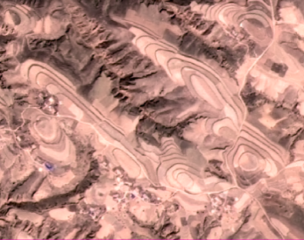
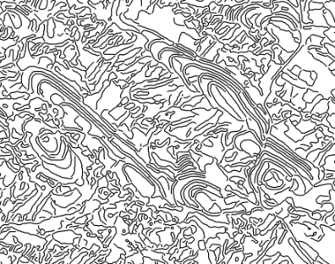
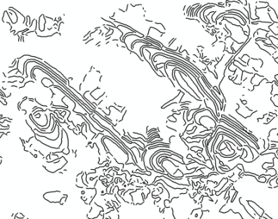
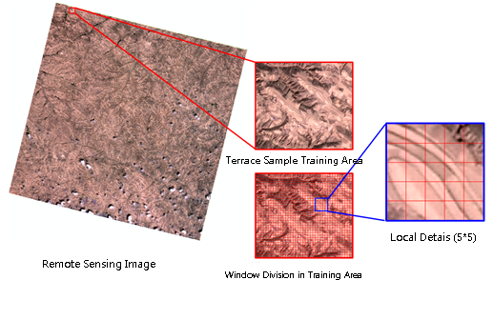
3.Automatic Identification and Extraction Method of Terraces based on High Resolution Satellite
3.1Edge Characteristics Statistics Algorithm
Image Edge Detection
GF-1 2m/8m Fused Image
Canny Edge Detection Result
Frame Result
Template Establishment
source
training area
size
threshold

Slide 8
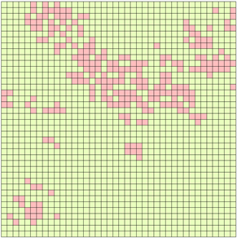
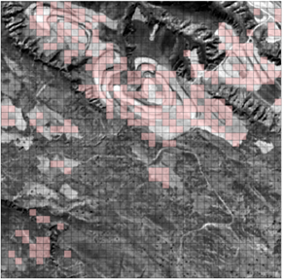
3.Automatic Identification and Extraction Method of Terraces based on High Resolution Satellite
3.1Edge Characteristics Statistics Algorithm
Terrace Identification and Shape Optimization
Shape Optimization
Judgement result of sample attribute
Overlapping RS image

Slide 9
3.Automatic Identification and Extraction Method of Terraces based on High Resolution Satellite
3.2 Template Matching Algorithm
Technical Route of Template Matching for Terrace Identification
Notes:
There are some differences between the two algorithm.
1.features on image : gray value- meanwhile vector
2.Template size and vector
3.Scanning pixel one by one
4. Template feature

Slide 10
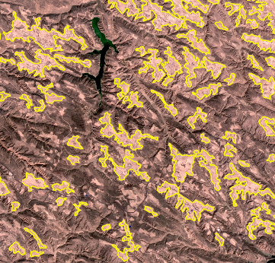
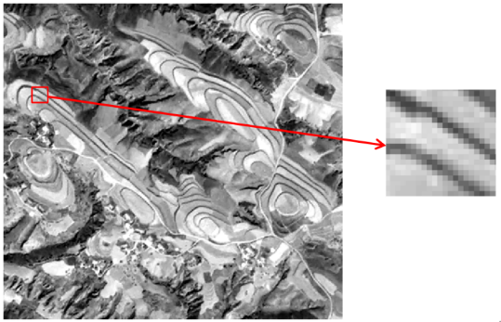
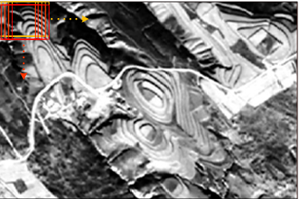
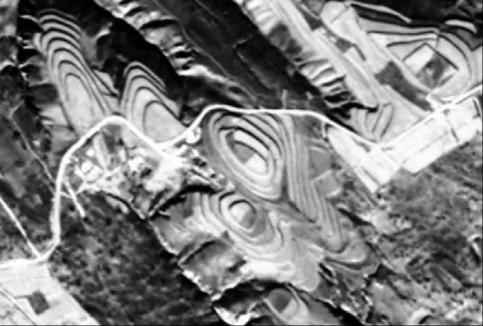
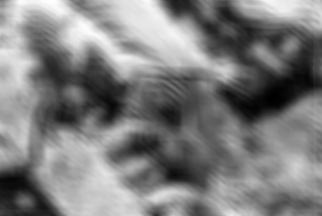
3.Automatic Identification and Extraction Method of Terraces based on High Resolution Satellite
3.2 Template Matching Algorithm
Template Selection Picture
Automatic Identification Effect Picture with Variance Threshold≤0.45
Template Scanning Pixel by Pixel Picture
Panchromatic image
Variance Picture of Search Image

Slide 11
3.Automatic Identification and Extraction Method of Terraces based on High Resolution Satellite
3.3 Fourier Transformation Algorithm
Technical Route of Terrace Identification by Fourier Transformation Algorithm
Notes:
['fʊriər]

Slide 12
4.Results Comparison and Discussion
Three Algorithms
Table 4 Comparison Table of Algorithm Accuracy
Algorithm | Overall Identification Accuracy | Typical Terraces Identification Accuracy | Atypical Terraces Identification Accuracy
Edge Characteristics Statistics | 55.19% | 80.85% | 51.34%
Template Matching | 95.54% | 97.18% | 95.38%
Fourier Transformation | 91.02% | 98.59% | 90.25%

Slide 13
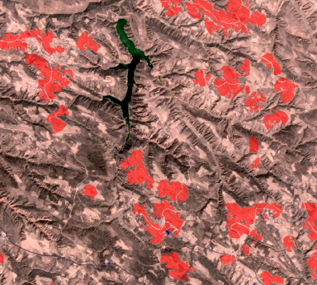
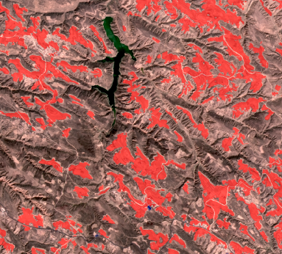
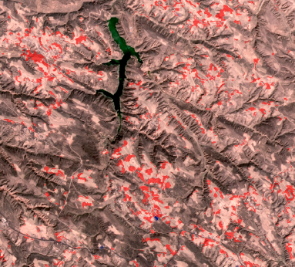
4.Results Comparison and Discussion
In accuracy
Completeness and boundary
Others
Edge Characteristics Statistics
Template Matching
Fourier Transformation
Notes:
In accuracy,
1.the overall identification accuracy of three algorithms all has shown well, especially the overall identification accuracy of Fourier transformation and template matching can reach over 91%.
2.All three algorithms have higher identification accuracy to typical terraces with obvious features. And for atypical terraces, the identification accuracy has shown lower, especially the edge characteristics statistics algorithm by terrace texture.
In completeness of terrace extraction and compliance to real terrace boundary
the template matching algorithm has shown best and its extracted boundary shape is normal, approximate to real terrace boundary.
While edge characteristics statistics algorithm has taken the second place, and its extracted boundary shape seems normal but has difference to real boundary.
In comparison, the extracted terraces by Fourier transformation has shown worst with fragmented map spot, almost without any complete terrace, not mentioned showing terrace boundary and shape.
In the condition that different objects have the same spectrum( namely gray and texture features of other objects are approximate to terrace feature)
edge characteristics statistics algorithm is better;,while there are more error terrace map spots when using template matching and Fourier transformation algorithms.
In addition, as for edge characteristics statistics and template matching algorithms, the terrace templates that exceed the range of template vector and characteristics value. As for Fourier transformation algorithm, all the terraces can’t be extracted when exceeding the window characteristics value.

Slide 14
5.Conclusions
Propose two kinds of new algorithms for automatic identification and extraction of terraces. Verify one algorithm on large extent area.
It has laid basis for temporal and spatial extension of algorithm, to provide technical support for rapid terrace extraction in a large scale.
Deficiency
For further study, more features and vectors, self-adaptive template can be tried.
Notes:
algorithm evaluation Verify ['vɛrɪfaɪ]
1.template matching algorithm is simple, easy to be realized by software engineering, and has higher identification and extraction accuracy, which is suitable for positioning and identification of terraces.
2.The edge characteristics statistics algorithm proposes a new template vector and characteristic threshold, although there is reduction of identification and extraction accuracy compared to template matching algorithm. However, edge characteristics statistics has over 80% accuracy in typical terraces identification and extraction.
3.The Fourier transformation algorithm is rather complicated for software engineering realization, although it has high identification and extraction accuracy. However, the extracted terraces are rather fragmented, not suitable for single use.
have been studied and tested
In this study, the template source, size, characteristics threshold concerning edge characteristics statistics and template matching algorithms have been studied and tested. It has laid basis for temporal and spatial extension of algorithm, to provide technical support for rapid terrace extraction in a large scale.
Deficiency [dɪ'fɪʃ(ə)nsɪ]
1. the template vector seem rather single, only considering terrace texture and gray features without other features(just like color \directivity
).
2. the template size is fixed and invariable

Slide 15
Thank You !

