Slide 1
Sediment deposition on terraced crop lands in Minchet catchment, Ethiopian Highlands
Alemtsehay Teklay Subhatu¹* Kaspar Hurni^{1, 2}, Tibebu Kassawmar^{1,3}, Brigitte Portner¹, Gete Zeleke^{3,}, Tatenda Lemann and Hans Hurni ¹
¹Centre for Development and Environment, Institute of Geography, University of Bern, Hallerstrasse 12, 3012 Bern, Switzerland.
² East-West Center, Honolulu, USA
³Water and Land Resource Centre, Addis Ababa, Ethiopia
alemtsehay.teklay.subhatu@cde.unibe.ch

Slide 2
Introduction
Land degradation in Ethiopia
Human and livestock pressure 57 to 152 persons/km2 in 1985 and 2015 (Teketay 2001)
Cultivated land from 39% in 1957 to 77 % in 1995
Since 1980s massive implementation of Soil and Water Conservation (SWC) Previous studies on- stone bund (Gebremichael et al. (2005)
Land suitability and crop cover 50% from less suitable to suitable.. Alemu et al. (2013)
Improvement in soil quality (Adgo et al. and Amare et al 2013).
Reductions in soil erosion (Herweg and Ludi, 1999),
Large amounts of sediment yields observed (Setegn et al., 2010)

Slide 3
Cont..
Present study
Measure on-site sediment deposition due to soil erosion by water;
Effect of slope length and gradient on the on-site sediment deposition;
Sediment deposition in relation to precipitation
Effectiveness of SWC technologies on net soil loss of crop lands.

Slide 4
Materials and Methods

Slide 5
Selection of sediment deposition measurement sites
Horse bean
Maize
To see the effect of slope gradient and slope length on sediment deposition
6 plots with two slope lengths - and three gradient categories; 8 -13 m and 14 m - 25 m and 4 % - 8 %, 8 % -13 %, and 13 % - 17 %

Slide 7
Data collection
Once in 24 hours from 8 to 12 am
Sediment was collected using spun to plastic bags, 100 g from each plot was oven dried for dry weight of the sediment deposition.
$Sd=Sp∗Ad$, Sp: Sediment deposition in the micro plot in kg per m2 and Ad: Area of the deposition zone per ha (m2 ha-1).

Slide 8
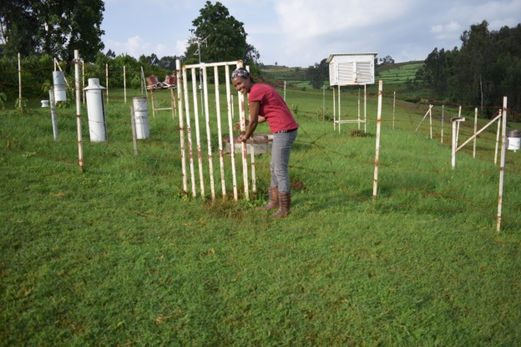
Soil erosion and net soil loss
$$A=RKLSCP$$
A: Soil loss t ha⁻¹y⁻¹, calculated as the multiplication of the five factors (R, K, LS,C an P),
K factor (Gete 2000),
R value from WLRC (2015),
$LS=(L⁄22.13)$^{0.3}$(S⁄9)$^{1.3} (Hurni 1985)
C factor 0.3 for maize and 0.4 horse bean;
P factor for contour ploughing 0.9, and 0.9 for drainage ditch, total p factor 0.81,

Slide 9
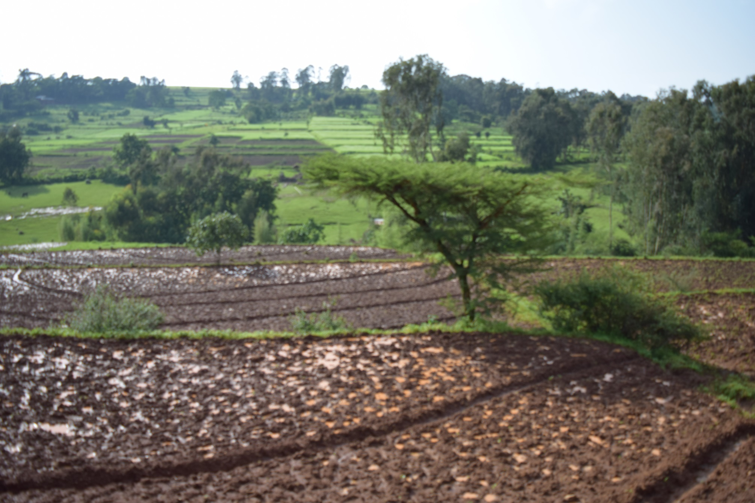
Drainage Ditch

Slide 10
Results Sediment deposition in the different slope gradient and slope length

Slide 11
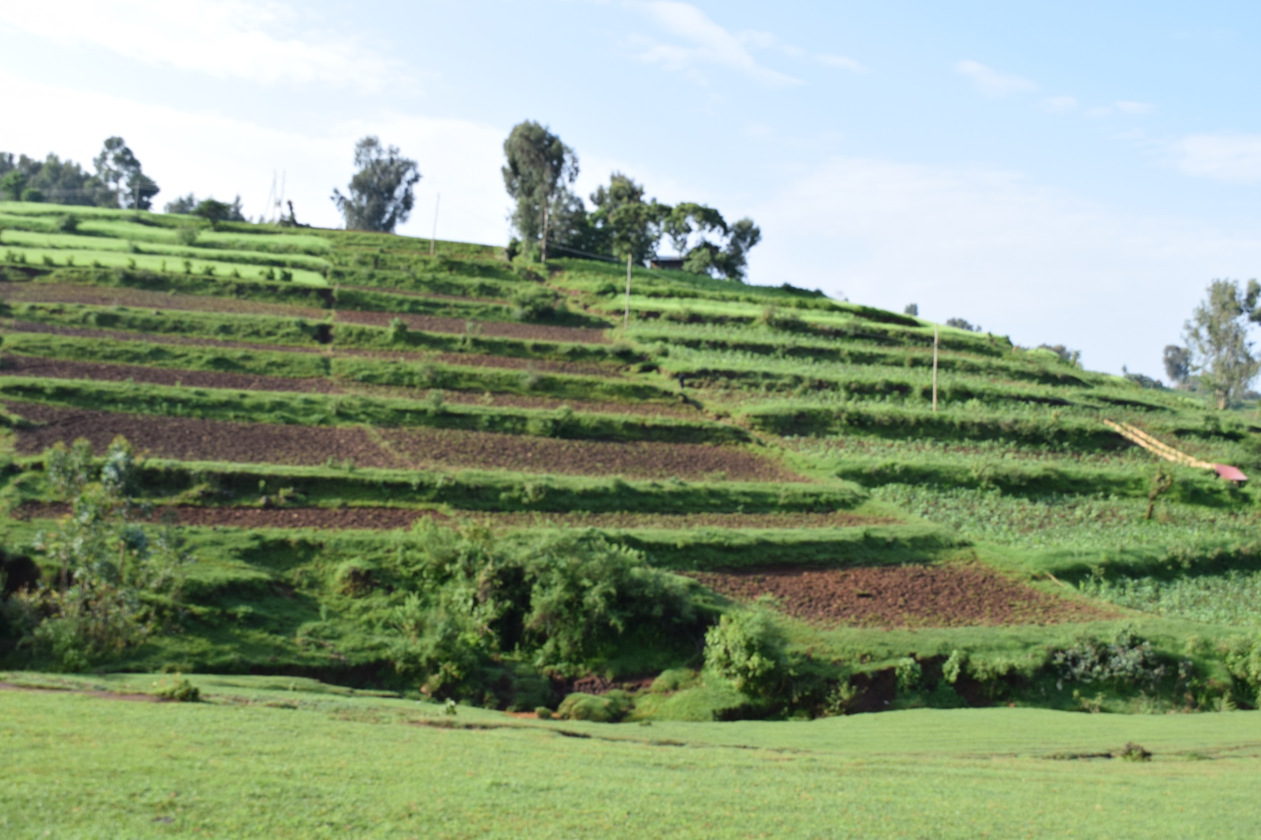

Slide 12
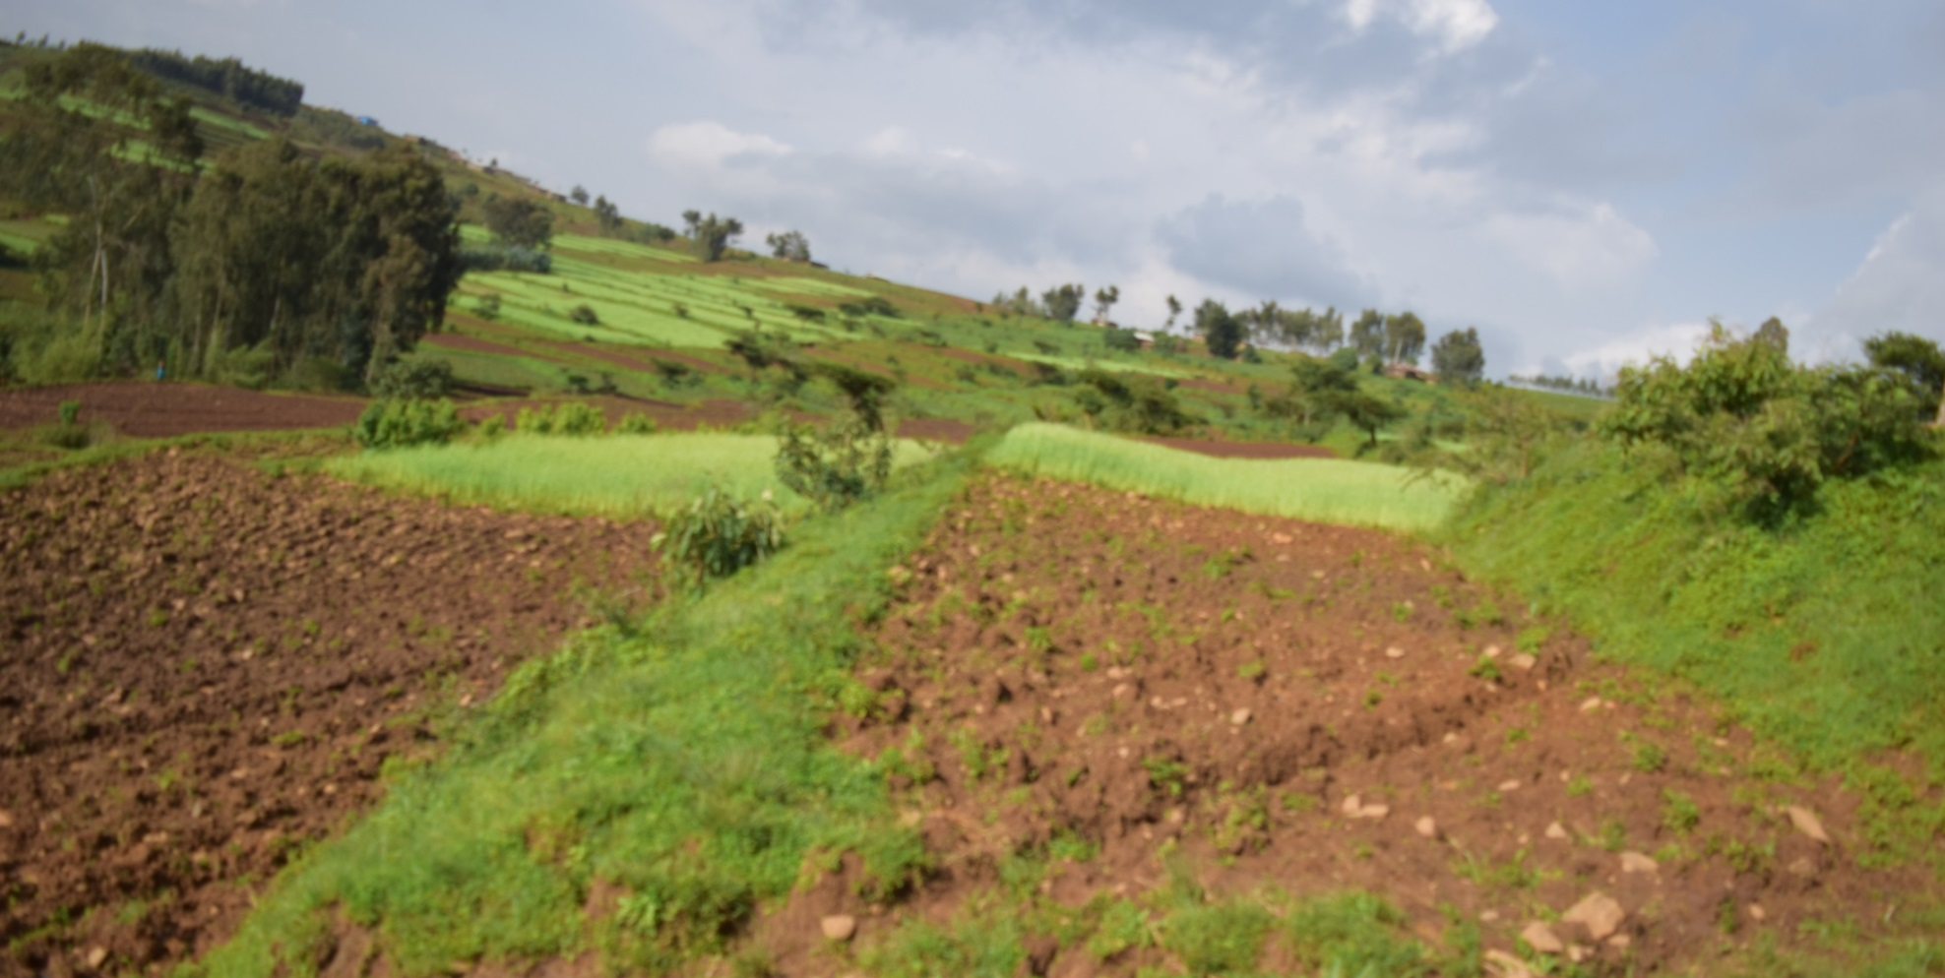

Slide 13
Sediment deposition and precipitation

Slide 14
Sediment deposition and precipitation

Slide 15
Conclusion
On-site sediment deposition decreases with slope length and increases with slope gradient, which implies more of the lost soil can be trapped in the crop lands by reducing the slope length.
54 t0 74 % total of soil erosion by water deposited on the terraced plot.
SWC in the study area develop a terraced landscape.
This reduces slope length as well as slope gradients, both of which could reduce soil erosion
The net soil loss in the shorter slope length and gentile slope shows limitation of USLE

Slide 16
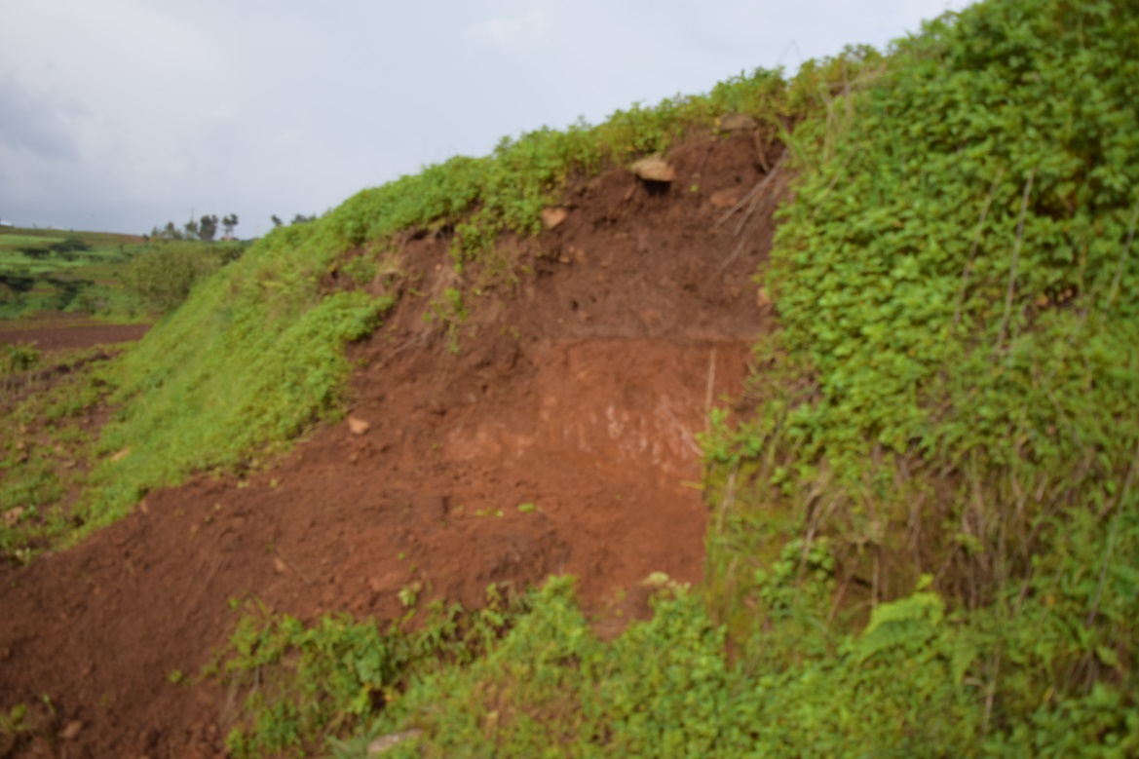
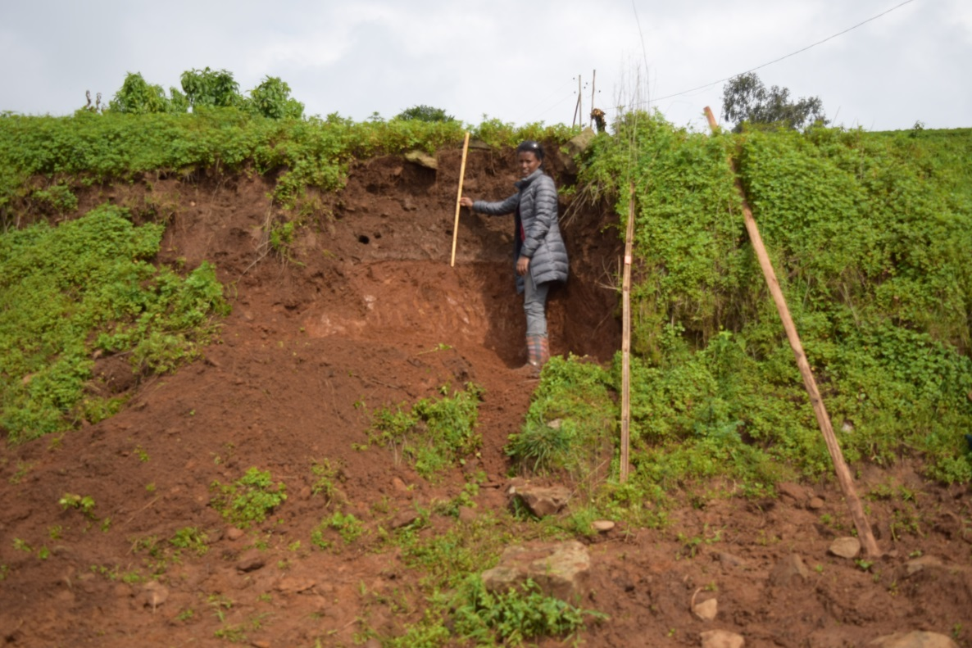
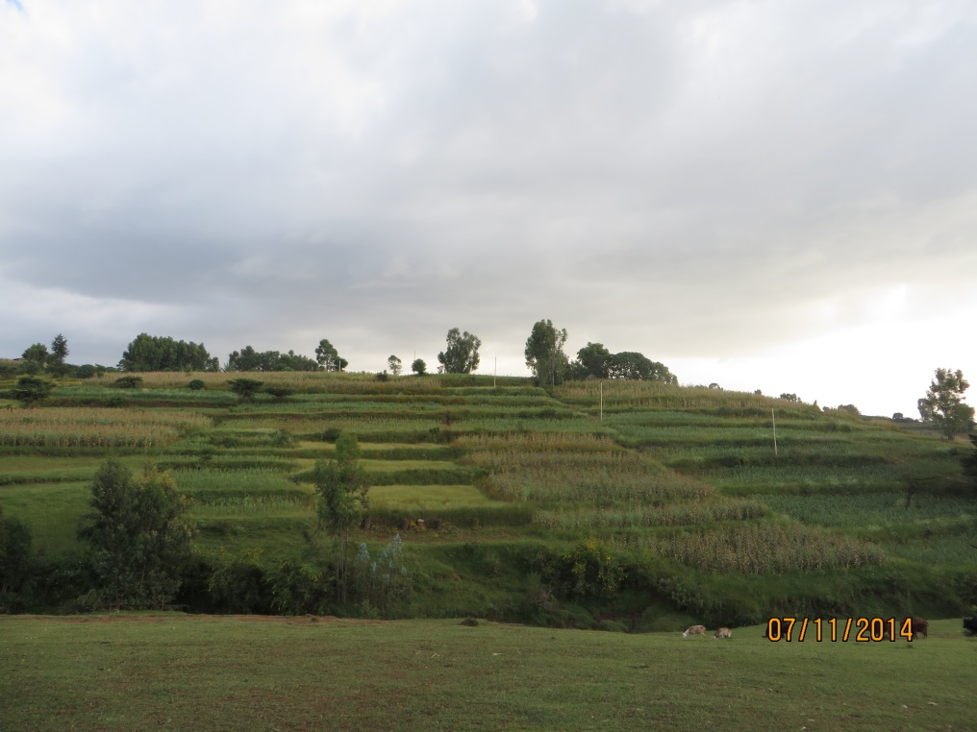

Slide 17
Acknowledgment

Slide 18
Thank you

