Slide 1

Measuring flow velocity on frozen and non-frozen slopes of black soil through leading edge method
Chen Chao, Ban Yunyun,Wang Xuefeng, Lei Tingwu
China Agricultural University, Beijing, China
WASWAC 2016 conference
2016-8-25

Slide 2
Content
Introduction
Significance of shallow water flow velocity
Methods measure shallow water flow velocity
Electrolyte tracer method
Methodology
Leading edge method
Experimental Materials and Methods
Results and Discussion
Leading edge method measure the velocity of shallow water over frozen and non-frozen slope, and the comparison
Effects of slope length on leading edge velocity
  Correction of velocity measured with leading edge method
  Coefficients to correct measured velocities by leading edge method
Conclusion

Slide 3
Significance of shallow water flow velocity
Shallow water flow velocity is a significant parameter
soil erosion
hydraulic process
Flow velocity of shallow water in soil erosion
particle detachment
sediment transportation
sediment deposition

Slide 4
Methods measure shallow water flow velocity
Trace method
Trace materials | researchers | limit
floating objects | Dunkerley et al., 2003 | too big for shallow flow water
salt | Olivier et al., 2005；Lei et. al., 2005 | correction coefficient uncertain
dyes | Katz et al., 1995；Zhang et al., 2010 | diffuse and disperse, error
Other methods
Infrared thermography (João et al. (2014))
large-scale particle image velocimetry (LSPIV)(Creutin et al. (2002) and Fujita et al. (2002))

Slide 5
Dye trace method
Dye has long been used
Difficult to measure velocity accurately
impact of diffusion and dispersion
dark-colored soil
error measured time by stopwatch
short distance produces high relative error

Slide 6
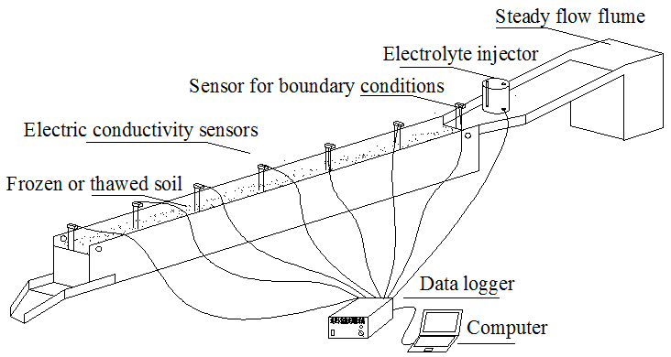
Electrolyte tracer method
The method can measure velocity accurately without calibration required

Slide 7
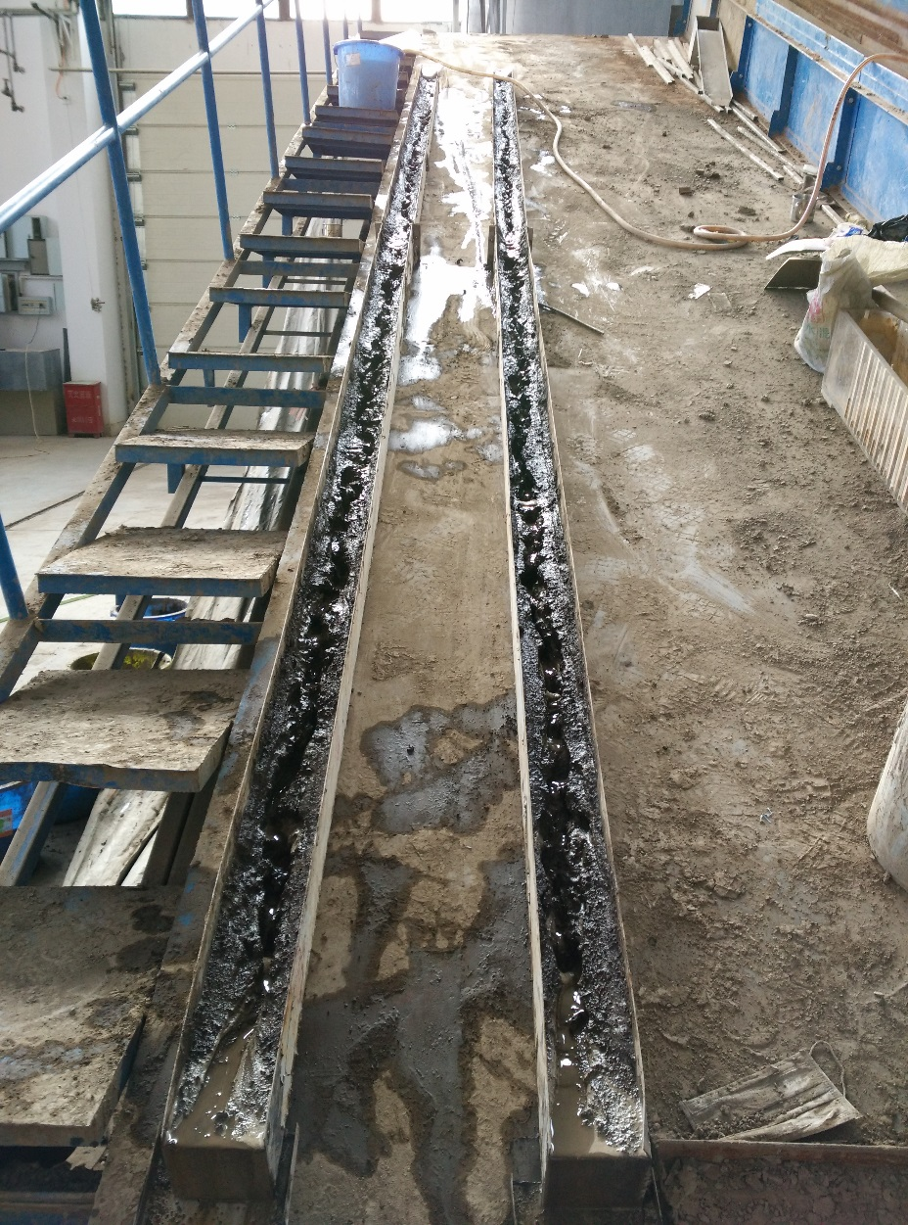
Methodology
Leading edge method
Leading edge flow velocity was measured with a stopwatch to measure the time for water flow to cover the whole rill length
well-defined distance reduce measurement error
Longer distance reduce relative error of measurement of time
Leading edge velocity need to be corrected
with accurate velocity, such as the one method with electrolyte trace method

Slide 8
Experimental Materials and Methods
Soil: black soil , 49.7% sand, 33.6% silt, and 16.7% clay particles
Flumes: 3 m long, 10 cm wide and 12 cm deep
Freezer: temperature between 0°C and −20 °C
Pump: flow rate of 1 L/min to 60 L/min
Experiment design
water temperature | 0°C
flow rate | 1、2、4 L/min
slope gradient | 5°、10°、15°、20°
slope length | 2、4、6 m
treatment | Frozen and non-frozen soil

Slide 9
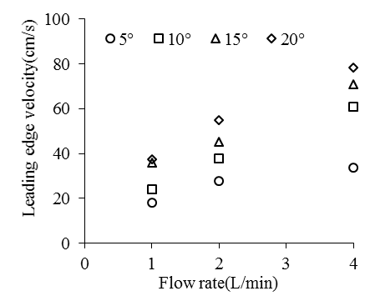
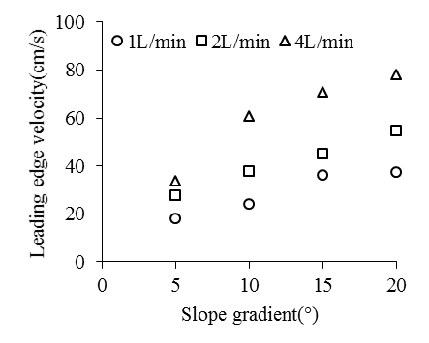
Result and Discussion
Velocity measured with Leading edge method over frozen slope
Flow rate and slope gradient are the key factor affect flow velocity
Over frozen slope, leading edge velocity increase with flow rate
Over frozen slope, leading edge velocity increase with slope gradient

Slide 10
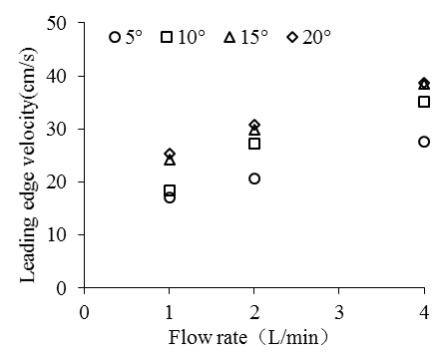
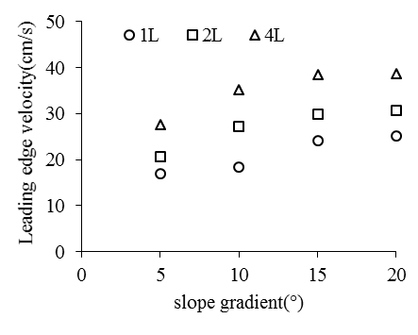
Velocity measured with Leading edge method over non-frozen slope
Over non-frozen slope, leading edge velocity increase with flow rate
Over non-frozen slope, leading edge velocity increase with slope gradient until to 15 degree.
The leading edge velocity stop to increase from 15 degree

Slide 11
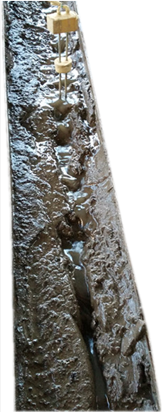
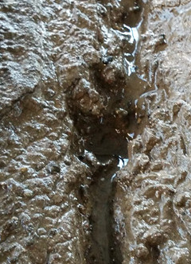
Velocity measured with Leading edge method over non-frozen slope
15°velocity stop increase
Headcuts appear on non-frozen soil
Headcut
gravitational potential
Head cuts
friction force
kinetic energies

Slide 12
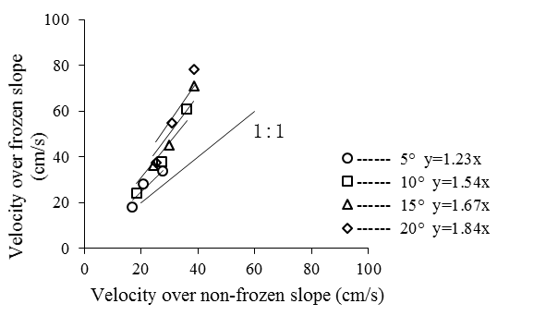
Comparison of leading edge velocities over frozen and non-frozen slope
leading edge velocity of different slope
leading edge velocity of different flow rates
The leading edge velocities over frozen slope were bigger than that over non-frozen slope
With increase of slope gradient and flow rate, the ratio velocity over frozen slope to non-frozen slope increased
In figure 2, that is represent that the velocity stop increase at 15°over non-frozen slope, meanwhile
the velocity over frozen slope increase fast.

Slide 13
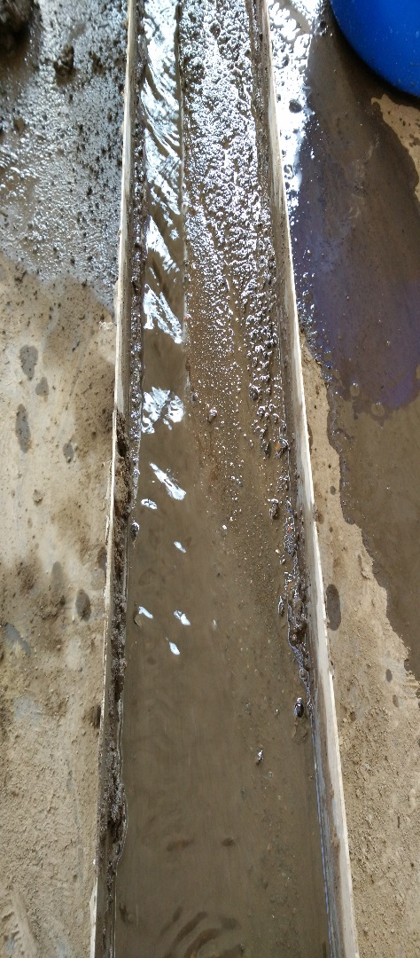
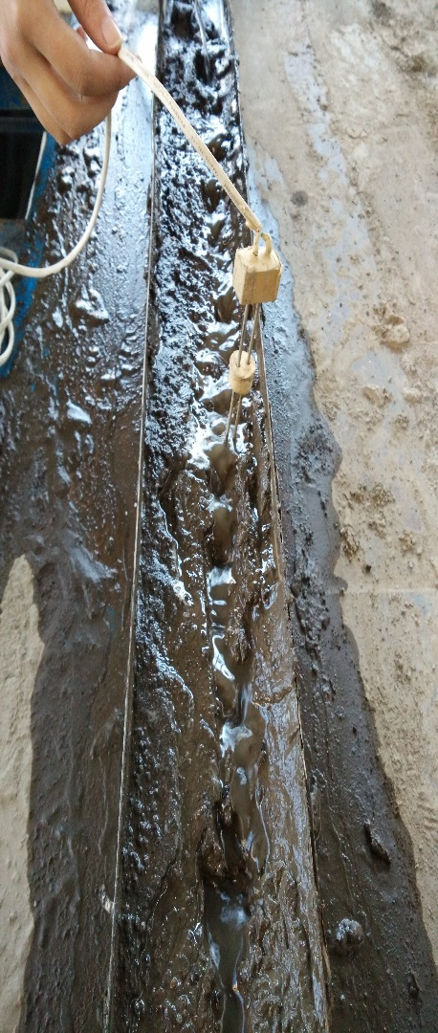
Comparison of leading edge velocities on frozen and non-frozen slope
Causes for the difference
surface conditions (friction force )
head cuts reduce velocity
more sediments in non-frozen rill to reduce velocity

Slide 14
Effects of slope length on leading edge velocity
Table 1 Leading edge velocity at different slope length
over frozen soil slopes
Slope | Flow rate | Slope length (m)
(°) | (L/min) | 2 | 4 | 6
5 | 1 | 18.54 | 18.13 | 18.01
 | 2 | 26.5 | 27.47 | 27.94
 | 4 | 32.65 | 33.7 | 33.83
10 | 1 | 23.54 | 23.7 | 24.08
 | 2 | 35.34 | 30.43 | 37.93
 | 4 | 57.85 | 59.72 | 60.82
15 | 1 | 31.95 | 33.86 | 36.06
 | 2 | 40.23 | 41.53 | 45.27
 | 4 | 58.57 | 67.06 | 70.98
20 | 1 | 33.94 | 36.02 | 37.49
 | 2 | 43.5 | 47.17 | 54.98
 | 4 | 66.17 | 70.08 | 78.25
At low slope, slope length have no significant effect on measured velocity
At deep slope, the longer slope length, the accelerate effect have a greater effect on velocity

Slide 15
Effects of slope length on leading edge velocity
Table 2 Leading edge velocity at different slope length
over non-frozen slopes
Slope | Flow rate | Slope length (m)
(°) | (L/min) | 2 | 4 | 6
5 | 1 | 17.78 | 16.51 | 16.99
 | 2 | 19.6 | 18.6 | 20.68
 | 4 | 30.78 | 28.27 | 27.6
10 | 1 | 21.4 | 19.49 | 18.38
 | 2 | 27.45 | 29.81 | 27.21
 | 4 | 37.94 | 37.37 | 35.12
15 | 1 | 27.95 | 26.59 | 24.24
 | 2 | 37.11 | 32.17 | 29.91
 | 4 | 43.59 | 42.28 | 38.49
20 | 1 | 29.85 | 26.84 | 25.26
 | 2 | 39.34 | 33.58 | 30.73
 | 4 | 48.38 | 42.74 | 38.76
At low slope, slope length have no significant effect on velocity
on non-frozen slope, longer slope covers more head cuts to produce lower velocity

Slide 16
  Correction of velocity measured with leading edge method on frozen slope
Flow velocity over frozen slope under different slope gradients
Flow velocity over frozen slope under different flow rates
The leading edge velocities were higher than the accurate velocities on frozen slope
Leading edge velocity are proportional to the accurate velocity
Leading edge velocity can be verified

Slide 17
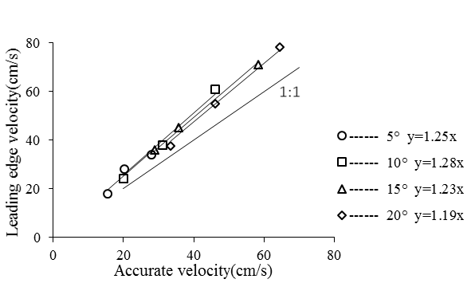
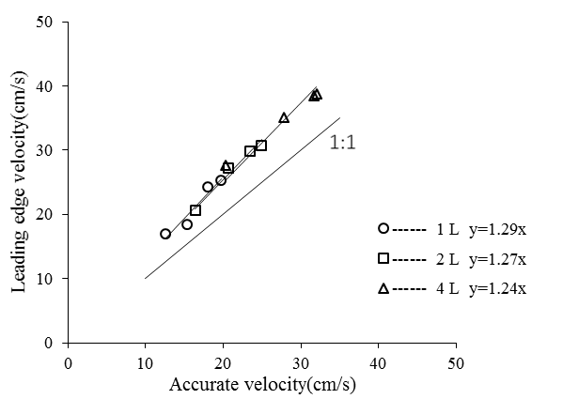
  Correction of velocity measured with leading edge method over non-frozen slope
Flow velocity over non-frozen soil under different slope gradients
Flow velocity over non-frozen soil under different flow rates
Over non-frozen slope, leading edge velocity were higher than accurate velocity
Over non-frozen slope, Leading edge velocity are also proportional to the accurate velocity

Slide 18
  Coefficients to correct measured velocities by leading edge method
Coefficient over frozen soil of different slope gradients
Coefficient over frozen soil of different flow rate

Slide 19
  Coefficients to correct measured velocities by leading edge method
Coefficient over non-frozen slope under different slope gradients
Coefficient over non-frozen slope under different flow rates

Slide 20
  Coefficients to correct measured velocities by leading edge method
Coefficient over non-frozen slope
Coefficient over frozen slope
Non-frozen slope , C=0.79
Frozen slope, C=0.81

Slide 21
Coefficients to correct measured velocities by leading edge method
Non-frozen slope
Frozen slope
Accurate velocity VS C*Leading edge velocity

Slide 22
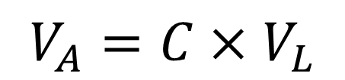
Conclusion
The flow velocities increased with slope gradient and flow rate
The velocities achieved a peak value at the slope gradient of 15°over non-frozen slopes
At higher slope, velocity over frozen slope increase with slope length increase, while over non-frozen slope, velocity decrease with slope length increase
At a slope length of 6 m, the coefficients on frozen slope and non-frozen slope were 0.81 and 0.79
With leading edge method, we can get accurate velocity convenient multiply by coefficient
$$V_{A}=C×V_{L}$$

Slide 23
Thank you

