Slide 1


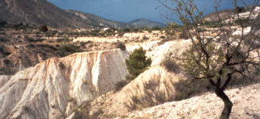
COMPLIANCE OF THE LEGAL FRAMEWORK OF SOIL AND WATER RESOURCES MANAGEMENT IN SERBIA AND SAME REGION COUNTRIES WITH EU LEGISLATIVE
Dragović Nada, Vulević Tijana, Zlatic Miodrag, Ristić Ratko, Todosijević Mirjana

Slide 2
The aim of this paper is to make a comparative analysis of the legislative framework for soil and water resource management in Serbia and some Balkan region countries with an established EU legislative framework and give recommendations to improve policy management in this area.

Slide 3
The most important document of the European Union related to water resources are:
Directive 2000/60/EC of the European Parliament and of the Council of 23 October 2000 establishing a framework for Community action in the field of water policy as amended by Decision 2455/2001/EC and Directives 2008/32/EC, 2008/105/EC, 2009/31/EC and 2013/39/EU (Water Framework Directive, WFD)
Directive 2006/118/EC of the European Parliament and of the Council of 12 December 2006 on the protection of groundwater against pollution and deterioration (OJ L 372, 27.12.2006, pp. 19-31).
Directive 2007/60/EC of the European Parliament and of the Council of 23 October 2007 on the assessment and management of flood risks (OJ L 288, 6.11.2007, pp. 27-34)

Slide 4
The Water Framework Directive provides an approach for water management based on river basins. It establishes innovative principles for water management, including public participation in planning and the integration of economic approaches.
The purpose of the Floods Directive is to establish a framework for the assessment and management of flood risks. It encourages setting targets and defining measures with a view of flood risk maps.

Slide 5
Beside the directives that are obligatory for the EU member states and candidate countries, important documents are:
Communication from the Commission to the European Parliament, the Council, the European Economic and Social Committee and the Committee of the Regions - A blueprint to safeguard Europe's water resources (COM(2012) 673 final of 14.11.2012).
Communication from the Commission to the European Parliament and the Council - The Water Framework Directive and the Floods Directive: Actions towards the ‘good status’ of EU water and to reduce flood risks (COM(2015) 120 final of 9.3.2015)

Slide 6
Legal framework of soil
In response to concerns about the degradation of soils in the EU the Commission published the Thematic Strategy for Soil Protection 2006, including an impact assessment and proposal for a Soils Framework Directive (SFD)
In the centre of the legislative process is the multifunctionality of soil where soil protection from the monofunctional perspective moving towards the wider dimensions of the environment and society
The Report on the implementation of the Soil Thematic Strategy was adopted in 2012. The proposal for the Directive which establishes the frameworks for soil protection was published together with the Thematic Strategy but has never been adopted.

Slide 7
Legislation in the field of water and land resources in some countries of the region and Serbia
For the analysis of the legal framework of soil and water resources, region countries, the republics of the former Yugoslavia, were selected: Bosnia and Herzegovina, Croatia, FYR Macedonia, Montenegro, and Serbia. From the selected countries, only Croatia is a member state of the EU, while all other countries, except Bosnia and Herzegovina, received the candidate status.

Slide 8
The mostly extreme flood disaster in the Sava catchment happened in the Western Balkans in May 2014. This resulted in a severe loss of human life, considerable damage to property, land, the economy and, consequently, economic loss in Bosnia and Herzegovina, Serbia and Croatia. The European Union supported a number of projects aimed at strengthening the organizational capacities and policies for natural resource management. Most of these projects are related to the harmonization of the Balkan countries’ legislation with the EU, especially with the WF Directive and the Flood Directive.

Slide 9
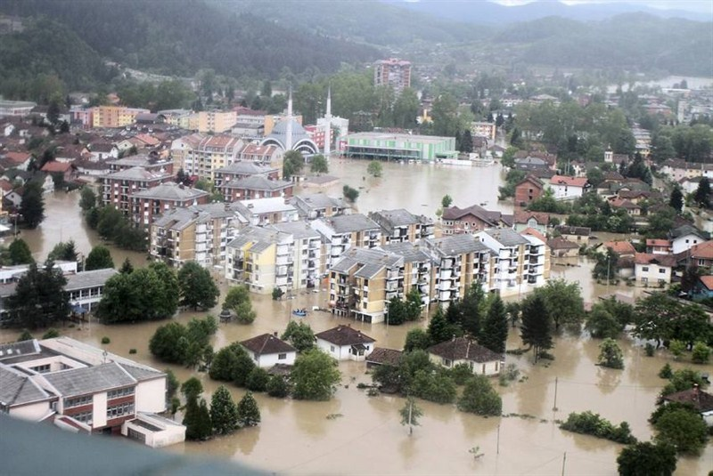
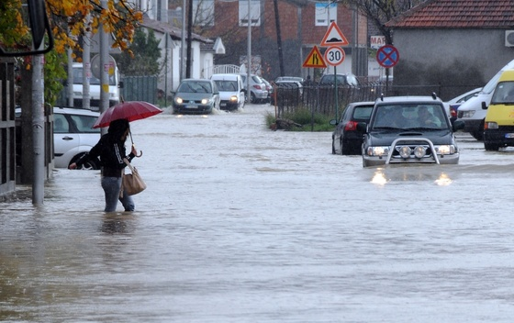
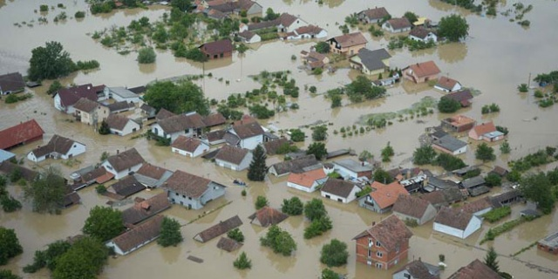
Floods in Bosnia and Herzegovina (the river Bosna, Maglaj) 2014
Floods in Montenegro (Podgorica) 2012
Floods in Croatia (the river Sava, Gunja, Est Slavonia) 2014

Slide 10
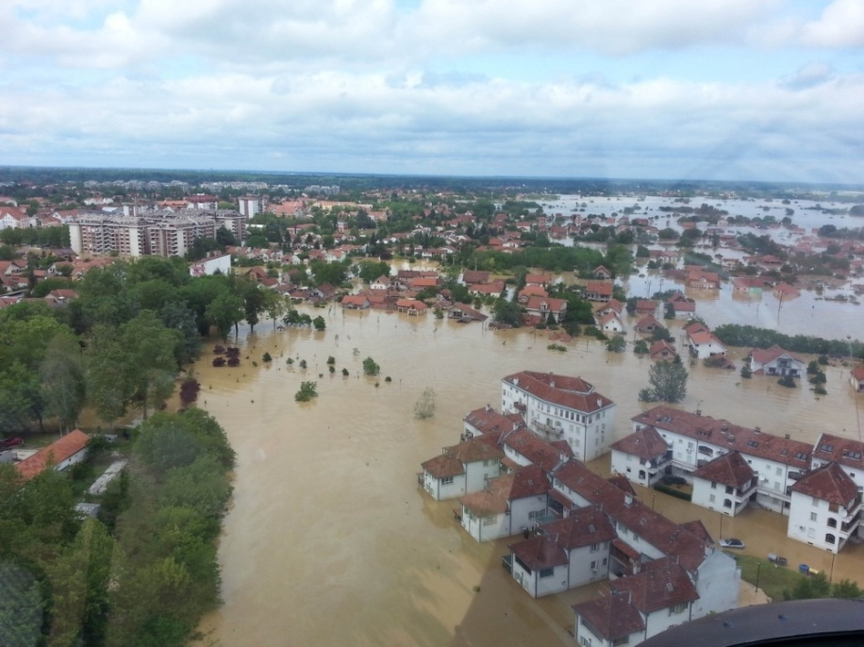
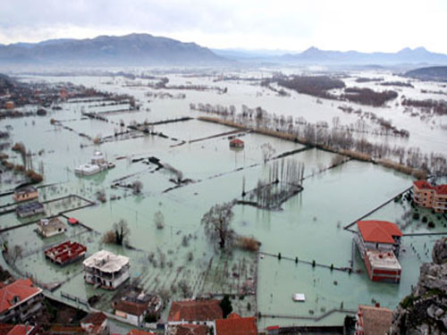
Floods in Serbia (the rivers Kolubara and Tamnava, Obrenovac) 2014
Floods in Macedonia (Skopje) 2016

Slide 11
Bosnia and Herzegovina
Republic of Srpska
Legal framework of water resources
The law concerning water resources in the Republic of Srpska is:
Law on Waters (Official Gazette of RS,50/06, 92/09)
The Republic of Srpska has developed and adopted the “Framework for the Development of Water Management”. This framework defines criteria, conditions and restrictions for the further development of the water infrastructure and water sector management.
Legal framework of soil resources
Republic of Srpska has no specific law to regulate the protection of land resources, but it is regulated by other laws:
Law on Agricultural Land (OG of RS 93/06, 86/07)
Law on Environmental Protection (OG of RS 71/12, 02/15)

Slide 12
Federation of Bosnia and Herzegovina
Legal framework of water resources
Like in the Republic of Srpska, the major basis for water management is the Law on Waters (OG of FB&H, No. 70/06).
Based on the Law on Waters, the Federal Water Management Strategy (2010-2022) defines the policy for water management.
Legal framework of soil resources
The protection of soil resources in the Federation of Bosnia and Herzegovina, as well as in the Republic of Srpska, is regulated by other laws, mostly by:
Law on Agricultural Land (OG of FB&H, No. 7/13)
Law on Environmental Protection (OG of B&H, No. 33/03)
In addition to these two laws, soil protection is covered by strategic documents:
Agricultural Land Management Strategy (2011)
Federal Environmental Protection Strategy 2008-2018

Slide 13
  Croatia
  Croatia’s accession to the status of the EU harmonized much of its legislation.
Legal framework of water resources
Water legislation and policy in Croatia include
Law on Waters RC (OG 4/14)
Law on Financing Water Management (OG 54/14)
Water Management Strategy (OG 91/08)
Water Management Plan 2016-2021
Legal framework of soil resources
The laws covering the protection of soil in Croatia are:
Agricultural Land Act (OG 39/13)
Environmental Protection Act (OG 78/15),
and regulations:
Regulations on the Methodology for the Monitoring of Agricultural Land, OG 43/14
Regulation on the Protection of Agricultural Land from Pollution, OG 9/14

Slide 14
  Macedonia
Legal framework of water resources
The laws of some of the regulations that directly regulate the field of water are:
Law on Waters (OG 51/11)
Law on Water Management (OG 103/08)
Rulebook on the Content and Method of Preparing Management Plans for River Basins (OG 148/09)
Regulation on Methodology for Assessment of River Basins (OG 148/09)
Legal framework of soil resources
Soil protection in the Republic of Macedonia is regulated by several laws:
Law on Agricultural Land (OG 135/07)
Law on Environment (OG 53/05, 81/05)

Slide 15
Montenegro
Legal framework of water resources
The basic laws in the context of water resources in Montenegro are:
Law on Waters (OG of RM, No. 48/15)
Law on the Financing of Water Management (OG of RM, No. 40/11)
The Water Management Strategy of RM (draft)
Regulation on the Content and Method of Preparation of Water Management Plan for Water Area of the River Basin or for its related Rection (2009)
Legal framework of soil resources
Montenegro, like most countries in the region, does not have a uniform law for land protection. The field of land protection is covered by several laws:
Law on Agricultural Land (OG of RM, No. .32/11)
Environmental Law (OG of RM, No. 48/08)

Slide 16
Serbia
Legal framework of water resources
The basic legal and strategic documents in the field of water are:
Law on Water (Official Gazette of RS, No. 30/2010, 93/12)
Law on Emergency Situation(Official Gazette of RS, No. 93/12),
National Water Management Strategy
National Program for Disaster Risk Management
Rules for determining the methodology for the preparation of the preliminary flood risk assessment.

Slide 17
Legal framework of soil resources
The laws covering the protection of soil in Serbia are:
Law on Soil Protection (OG of RS, No. 112/15),
Law on Agricultural Land (OG of RS, No. 41/2009),
Law on Environmental Protection (OG of RS, No. 14/2016),
and regulations
Regulations of National list of Envronmental Indicators (OG of RS, No. 37/11)
Regulations on the Keeping of Information System for Environmental Protection (OG of RS, No. 112/09)
Regulations on the Programm for the Systematic Monitoring of Soil Quality, Soil Degradation Risk Assessment Indicators and Methodology for the Development of Remediation Programms (OG of RS, No. 88/10)

Slide 18
Croatia, as an EU member, has the highest compliance of legislative regulations related to soil and water resources with the EU legislation. All the analyzed countries have a Law on Water. In addition to the Law on Water, Croatia and Montenegro have adopted the Law on financing water management. The compliance of legislation with WFD and other EU directives differs by country. The area of soil protection is not legally regulated in all countries, except in Serbia. Only Serbia has adopted a law on the protection of land, while in other countries, this area is regulated by the Law on Agricultural Land and Environmental Law.

Slide 19
Legal framework of soil and water resources
EU/ countries | Water | Soil
EU | -Directive 2000/60/EC, Water Framework Directive, WFD -Directive 2006/118/EC on the protection of groundwater against pollution and deterioration -Directive 2007/60/EC on the assessment and management of flood risks, Flood Directive. | Thematic Strategy for Soil Protection (COM(2006)231)
Bosna and Herzegovina Republic of Srpska | Law on Waters | Law on Agricultural Land Law on Environment
Federation Bosna i Herzegovina | Law on Waters | Law on Agricultural Land Law on Environment
Croatia | Law on Waters Law on Financing Water Management | Law on Agricultural Land Law on Environment Law on Land Consolidation of Agricultural Land
Macedonia | Law on Waters Law on Water Management | Law on Agricultural Land Law on Environment
Montenegro | Law on Waters Law on Financing Water Management | Law on Agricultural Land Law on Environment
Serbia | Law on Waters | Law on Soil Protection Law on Agricultural Land Law on Environment

Slide 20
Larger differences in the legislative regulation of the analyzed countries exist in the strategic framework and by-law documents.
An important document in the field of water is a water management strategy. It was adopted by Croatia (2008), part of Bosnia and Herzegovina (Federation has adopted a strategy and Republic Srpska has a framework), Serbia and Montenegro (draft strategy was a subject of public debate and awaits adoption), while Macedonia has not rendered the strategy but only the regulation for some elements for WFD (management plans for river basin). Regarding the strategic documents in the area of land, a lack of them, as well as a lack of legislation, are noted.

Slide 21
Strategic framework and by-law of water and soil in the analyzed countries
Countries | Water | Soil
Bosna and Herzegovina Republic of Srpska | Framework for the Development of RS Water Management and Action Plan for implementation of the Framework for the Development of RS Water Management Rules on the way and method of determination of water pollution level
Federation Bosna i Herzegovina | Federal Water Management Strategy | Agricultural land management strategy Federal environmental protection Strategy
Croatia | Water management strategy River basin management plan National plan of flood control | Regulations on the methodology for the monitoring of agricultural land Regulation on the protection of agricultural land from pollution
Macedonia | Rulebook on the content and method of preparing management plans for river basins Regulation on methodology for assessment of river basins
Montenegro | Regulation on the content and method of preparation of water management plan for water area of the river basin or for its related section Regulation on the method of categorization and categories of water facilities and their management and maintenance.
Serbia | National Water Management Strategy National Program for Disaster Risk Management Rules for determining the methodology for the preparation of the preliminary flood risk assessment. | Regulations of National list of Envronmental Indicators , Regulations on the keeping of information system for environmental protection , Regulations on the programm for the systematic monitoring of soil quality, soil degradation risk assessment indicators and methodology for the development of remediation programms

Slide 22
Table Overview of status of implementing the EU-WFD
Countries/Elements of Compliance with WFD | B&H | Croatia | Mace-donia | Monte-negro | Serbia
Strategy for implementing WFD | x | x |  | x | x
Transposition of the WFD | x | x | x | Ongoing | Ongoing
River Basins defined | x | x | x | x | x
Ground WB Identification |  | x
Ground WB Chemical status |  | x
Ground WB Quantity |  | x |  | x
Surface WB Typology | Rivers | Rivers/lakes |  | Beginning
Assessing Ecological Status for WBs | Ongoing | x | x | x (some)
Programme of measures | Ongoing | x
Monitoring programme |  | x |  | Beginning
Register of Protected Areas | Ongoing | x |  | x (some)
Pressures and Impacts analysis |  | x |  | x
Economic, cost-benefit analysis
River Basin Management Plans | Ongoing | Ongoing
Stakeholder/public consultation |  | x
Bathing water |  | x
Drinking water | Ongoing | x |  | x | x
Waste water |  |  |  | x | x
Flood regulation | Ongoing |  |  | x | x
According to the Study, which was done in 2012 (2012a), the countries of the region had different compatibility of their legislations in relation to the WFD. Croatia had the highest compliance, which was expected because it was in the period before joining the EU. After Croatia, Montenegro complied the majority of the elements of the WFD in its legal framework. It is followed by Serbia and Bosnia and Herzegovina, whereas Macedonia agreed on the smallest number of these elements.
Source: (2012) Feasibility Study: Strengthening Regional Cooperation / Networking in the Forestry and Water Management Sector and Sustainable Development in the River Basins of the South-Eastern European Countries, Final Report, Published by: Deutsche Gesellschaft für Internationale Zusammenarbeit (GIZ) GmbH

Slide 23
According to the Study for European Commission of flood prevention and management (2015), Bosnia and Herzegovina is the only country that has an implementation plan coherent with the Floods Directive, although the document has not yet been adopted. This means that flood management receives varying and, in some cases, limited attention. It is not specifically addressed in the strategic framework plans and legislation is often not in place. Furthermore, only two countries (Bosnia and Herzegovina and Serbia) have incorporated the Floods Directive approach into their flood management plan. The others have just begun to define the actions necessary to implement the Floods Directive.
Assessment of full implementation of Flood Directive
country | Full implementation is foreseen to be completed in | ECRAN estimates
Bosnia and Herzegovina | 2018 | 71%
FYR Macedonia | 2023 | 14%
Montenegro | 2023 | 52%
Serbia | 2021 | 71%

Slide 24
Conclusions
The legal framework of water and soil resources in the region has many similarities, but also differences in relation to compliance with the EU legislation. Croatia as an EU member, has the highest compliance of legislation, while other countries, intensively improve their legislations, particularly in the area of water, in response to the recent flooding and meeting the requirements for membership. The EU has a highly developed water legislation, and all member states and candidates are trying to reach the requirements of this legislation, especially the Water Framework Directive and Flood Directive. Bosnia and Herzegovina, Serbia and Montenegro have made the greatest progress in the region; they are followed by Macedonia, with the least harmonized water policy.

Slide 25
In terms of legislative regulations for the protection of land, only Serbia has a law on the protection of land. All the other countries regulate this area by other laws.
Besides the need for the promulgation of Soil Protection Directive by the EU, in recent years, experts have been highlighting the need for the integrated protection of land and water resources in the context of environmental protection and climate change mitigation and establishing a policy (directive) that would integrate the existing legislation (the Common Agricultural Policy, the Water Framework Directive, and the Climate Action and Renewable Energy Package).

Slide 26
Thank you for your attention

