Slide 1
Risk management for torrential flood construction project using monte carlo simulation
Aleksandar Baumgertel
Nada Dragovic
Tijana Vulevic
E-mail: gertelbaum@hotmail.com

Slide 2
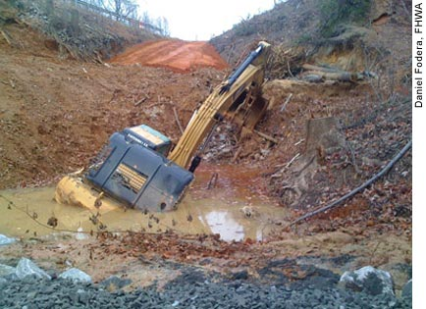
Inapproachable location
INVESTMENT PROJECTS
time-limited
limited resources
unrepeatable
Includes uncertainty and risk
The complexity and durability
A large number of participants

Slide 3
Breached deadlines
Increased costs
Reduction of quality
.
.
.
.
.

Slide 4
RISK MENAGAMENT IN THE PROJECT REALIZATION
RISK IDENTIFICATION
RISK ANALYSIS
RISK RESPONSE
MONITORING
QUALITATIVE ANALYSIS
QUANTITATIVE ANALYSIS

Slide 5
RISK RESPONSE
Ignoring risk
Reducing risk
Switching risks
Contigency planning

Slide 6
Contigency planning
Expert elaborate
Expert elaborate and statistical data
Parametric modeling
Monte Carlo simulation
Reserve funds

Slide 7
1. introduction
MONTE CARLO SIMUALTION
Stochastic simulation method
It use relevant samples (random) variables

Slide 8
MONTE CARLO SIMULATION STEPS

Slide 9
Identification of criterion and relevant variable
Output of simulation
Current value economic losses, earnings, profit ...
Criterium variable
Relevant variable
Profit = f (labor costs, material costs, sales, value write-off ...)

Slide 10
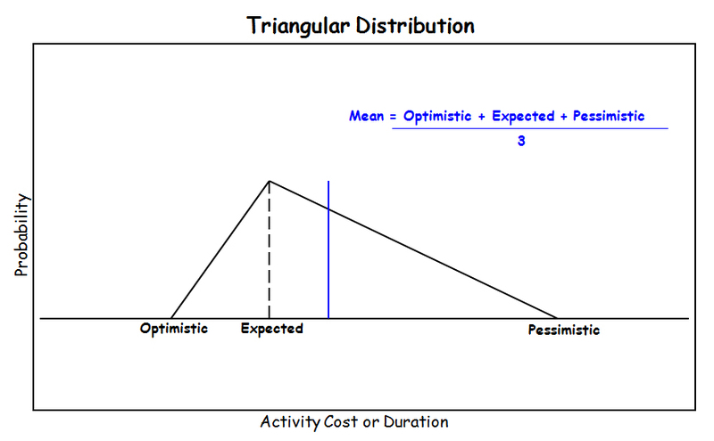
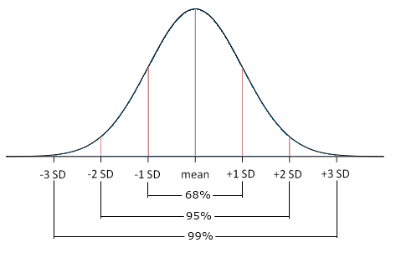
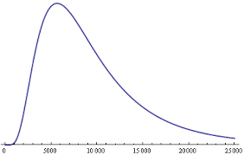
Value and probabilility distribution for relevant variable
Profit = f (labor costs, material costs, sales, value write-off ...)
Expert evaluation
using Anderson - Darling test (historical data)

Slide 11
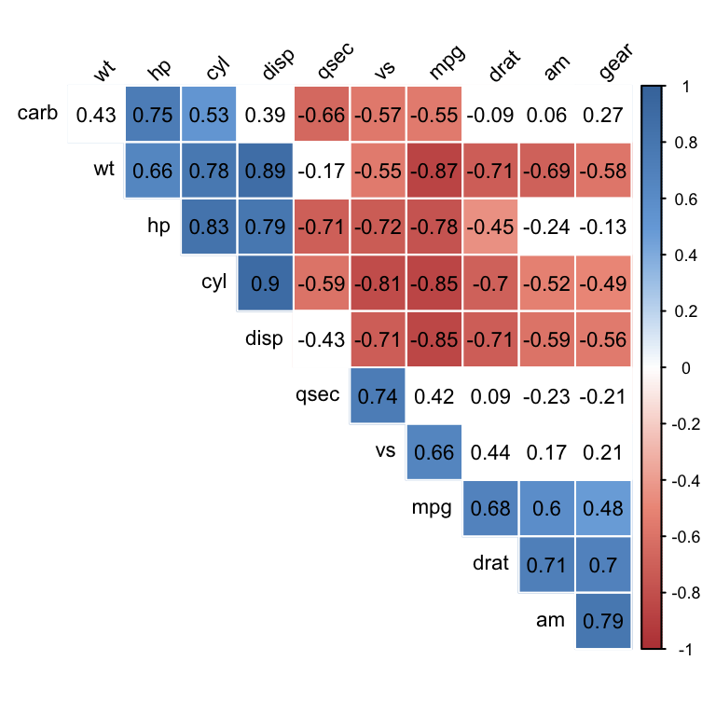
Determination of the correlation coefficient
Relationship or interrelatedness between the two variables
Hi Pearson Spearman correlation coefficient
Profit = f (labor costs, material costs, sales, value write-off ...)

Slide 12
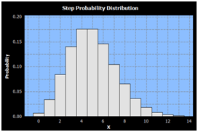
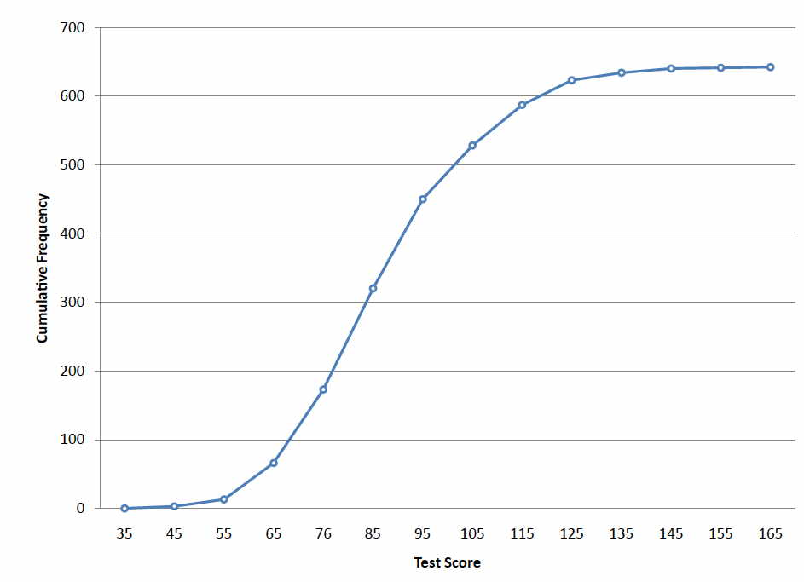
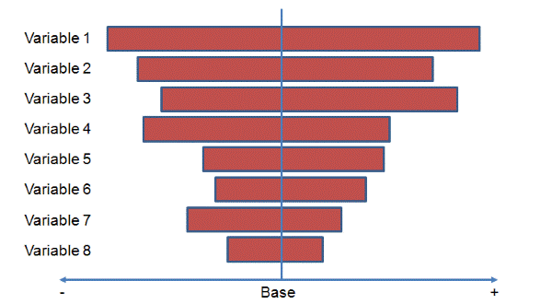
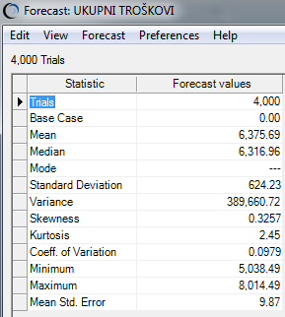
SIMULATING PROCESS AND RESULT ANALYSIS
Profit = f (labor costs, material costs, sales, value write-off ...)

Slide 13
ORACLE CRYSTAL BALL

Slide 14
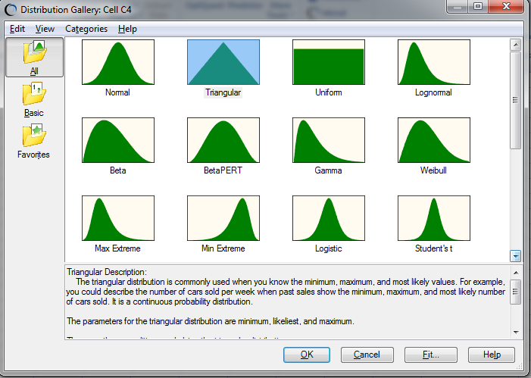
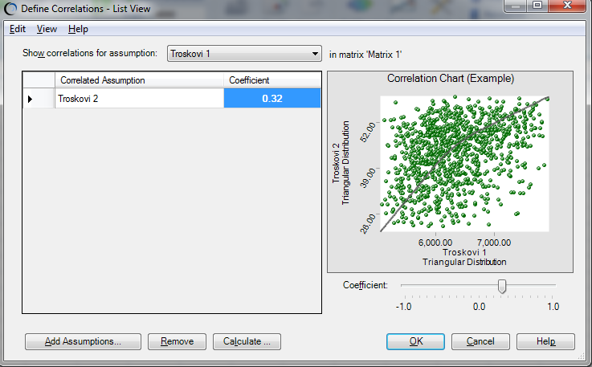
command - Deffine Assumpions
command– Deffine Correnations

Slide 15
command – Deffine Forecast

Slide 16
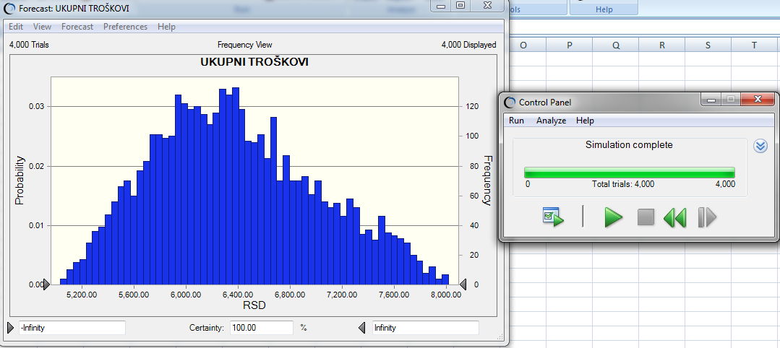
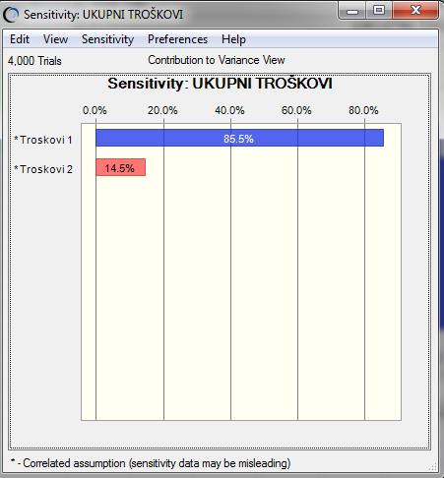
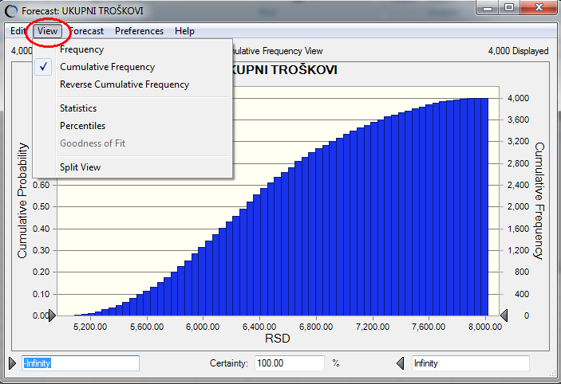
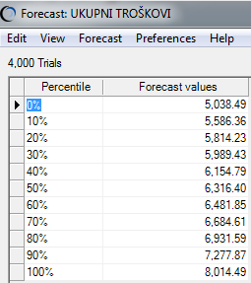
Results

Slide 17
Final design for the basin regulation of the River Dumača
Analysis of total cost of constaction using MONTE CARLO simulation
Determine funding that would serve as a backup

Slide 18
Criterion variable – the sum of preliminary, earth, masonry, concrete and finishing work
Relevantne variables – material costs (petroleum, fertiliyer , cement, gravel etc. and labor cost (all categories of laborers)
Fixed costs – cost of supplies and renting of plant

Slide 19
Relevant variables Data

Slide 20
preliminary, earth, masonry, concrete and finishing works

Slide 21
Mechanical bulk excavation of III category - 30.224.446 RSD
Relevant variables | % in price formation | Price in RSD | Coefficient
- Machine operator VI category | 1.89 | 573,055 | 1193
- Machine operator MVII category | 2.85 | 871,975 | 1614
- Excavator renting | 32.19 | 9,731.062 | Fixed cost
- Bulldozer renting | 45.26 | 13,679.886 | Fixed cost
- Petroleum | 15.68 | 4,739.193 | 35902
- other | 2.84 | 859,88 | Fixed cost

Slide 22
Function in the simulation for Mechanical bulk excavation III category
f_{x}=859885(other costs)+(35902*petroleum)+13679886(bulldozer cost)+9731062(excavator cost)+(1614*machine operator VII)+(1193*machine operator VI)

Slide 23
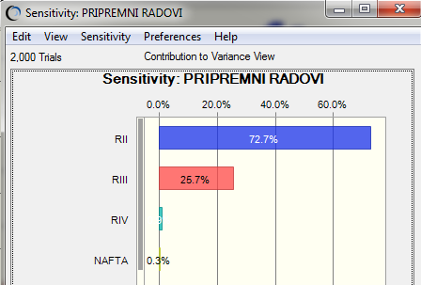
Costs for preliminary work

Slide 24
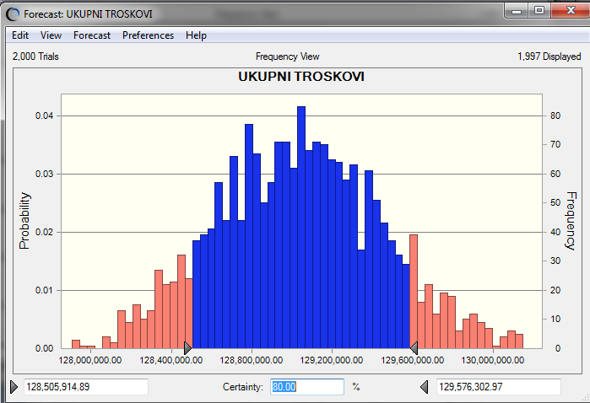
Total costs

Slide 25
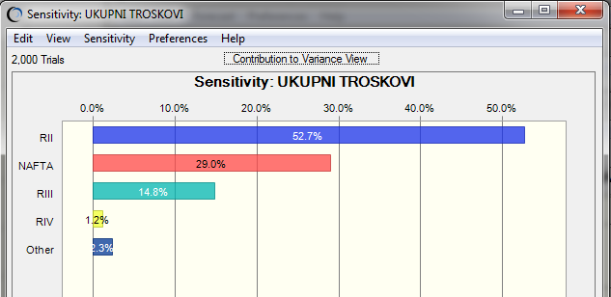
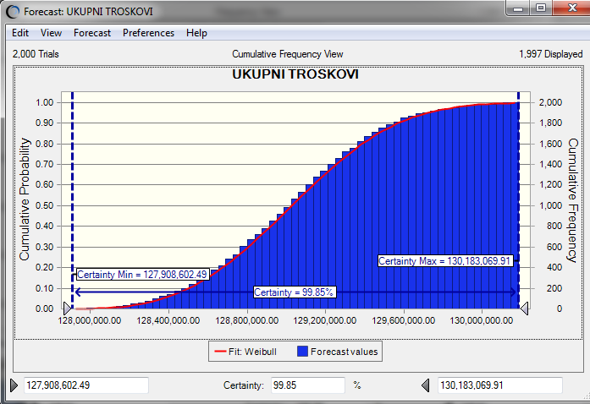
Total costs

Slide 26
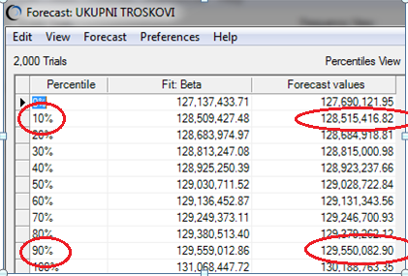
Contigency calculating
Total costs calculated with cost analysis
128.549.528 RSD
129.550.082 RSD
-128.549.528 RSD
=1.000.554 RSD

Slide 27
conclusion
One of the significant risks in project realization is the increase of total cost. To avoid the suspension of project realization due to the increase of cost, it is necessary to determine financial backup.
The calculation of financial backup based on total cost is conducted for the project of the basin regulation of the River Dumača. Monte Carlo, a stochastic simulation method, was used in this paper to calculate total cost and financial backup, with program Oracle Crystal Ball.
Total financial backup is obtained by difference between the simulated total cost with 90% probability occurrence and the calculated cost from cost analysis and it amounts to RSD 1,000,544.

Slide 28
thank you for attention

