Slide 1
SOCIO-ECONOMIC INFLUENCE ON THE SOIL EROSION INTENSITY IN THE PANEVLJANSKA RIVER WATERSHED
Stefana Babović¹, Miodrag Zlatić², Stanimir Kostadinov²
¹Geographical Institute “Jovan Cvijić” Serbian Academy of Sciences and Arts, s.babovic@gi.sanu.ac.rs
²Department of Ecological Engineering for Soil and Water Resources Protection, Faculty of Forestry, University of Belgrade
miodrag.zlatic@sfb.bg.ac.rs, stanimir.kostadinov@sfb.bg.sc.rs

Slide 2
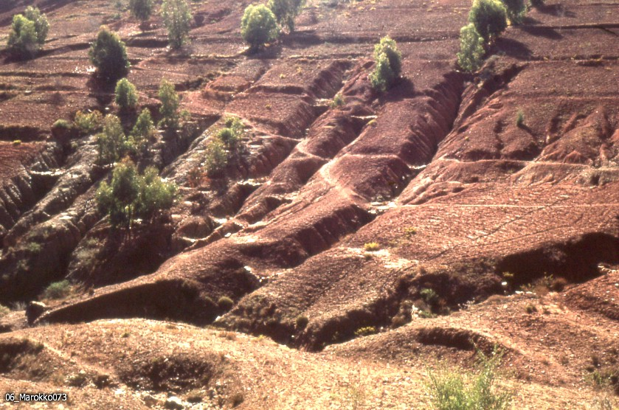
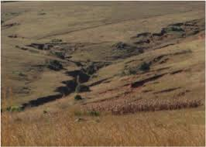
Introduction
Soil erosion is one of the major natural hazards in the world, causing soil degradation (Mircea et al. 2015).
Every year, 75 billion tons, of mainly arable land in the world, are being taken away due to erosion. Viewed spatially, this represents a loss of 20 million hectares in total (Ananda and Herath 2003).

Slide 3
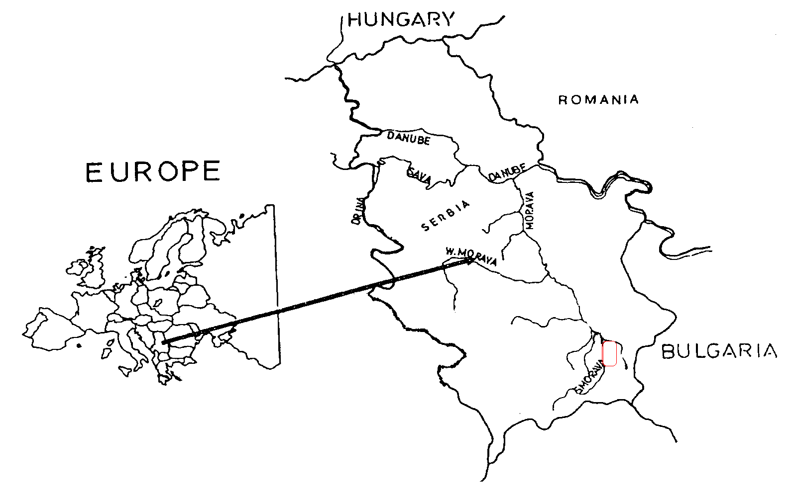
Introduction
On average, each kilometer of the Grdelica Gorge is threatened by five torrential flows and there are 143 of them (Gavrilovic, 1957; Kostadinov and Markovic, 1957).

Slide 4
The aim is…
men
illegal forest cutting on steep slopes
trimming of leafy branches for winter cattle forage
tillage down the slope
depopulation
erosion and torrent control works
soil erosion intensity

Slide 5
Study Area
the average annual temperature is 11.1 ºC
the lowest average monthly temperature is in January 0.1 ºC
the highest average monthly temperature is in August 21.6 ºC
the average annual precipitation is 567.7 mm
the month of minimum precipitation is January 35.4 mm
maximum precipitation is July 63.2 mm
Main characteristics of the Panevljanska River watershed
Perimeter(km) | 11.2
Watershed area(km²) | 3.82
Main stream length (km) | 5.04
Stream bed slope (%) | 9.82
Watershed length (km) | 4.74

Slide 6
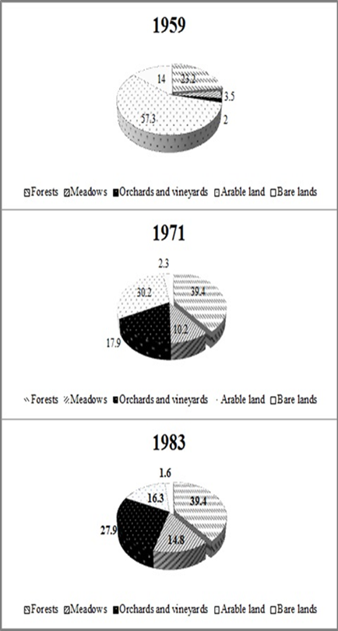
Land use
Institute for Agricultural Economics in Belgrade carried out a research in the Grdelica Gorge and Vranjska valley, in the time period 1956-1959. Agriculture was undeveloped at that time, poor technically equipped; in the hilly and mountainous areas people were engaged in farming, at the expense of forests (Zlatić 2010).
During the period 1959-1983 orchards and vineyards areas increased.
The similar situation is with meadows – these areas increased from 3.5% to 14.8% in 24 years’ time period.
Present state
1. broad-leaved forest (53.6%)
2. complex cultivation patterns (38%), 3. land principally occupied by agriculture with significant areas of natural vegetation (8.4%).

Slide 7
inhabitants
%
active inhabitants
agricultural inhabitants

Slide 8
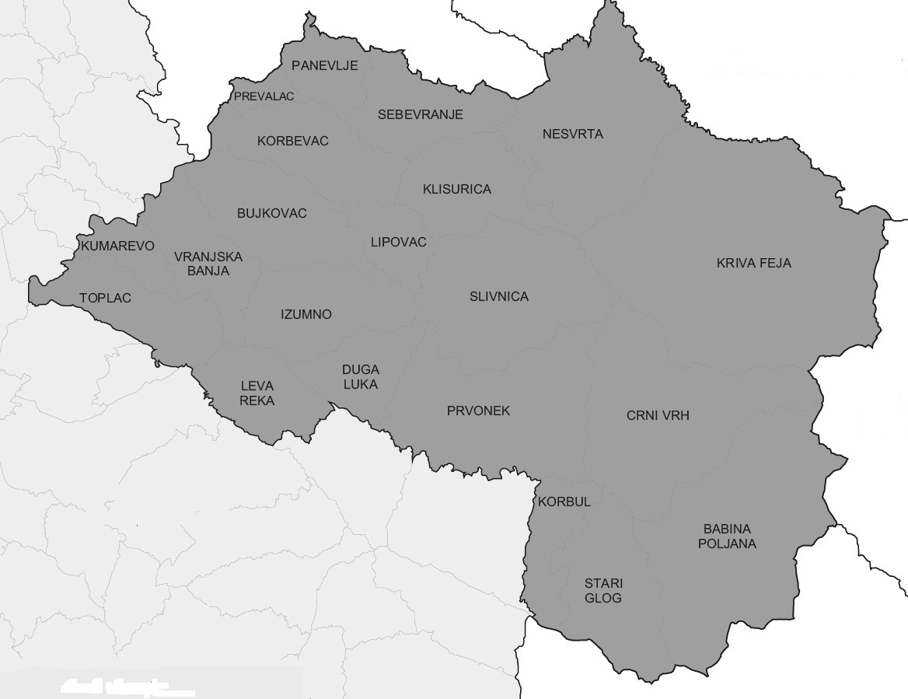
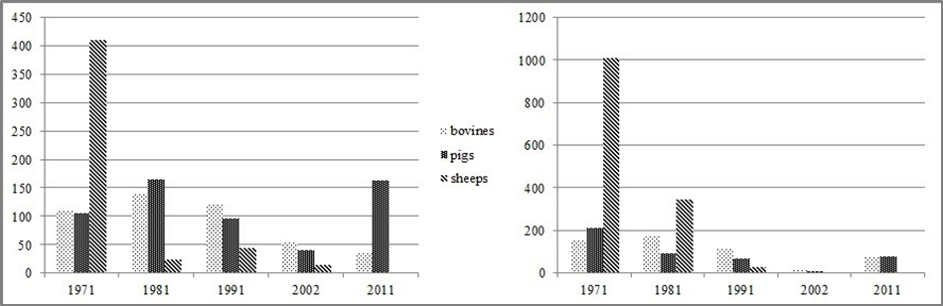
Municipality Vranjska Banja
43 of age
52 of age
average population age
The number of cattle and pigs decreased until 2002, and then increased in the last inter-census period, especially increased the number of pigs.

Slide 9
Methods
Average annual sediment transport (total sediment) is calculated by the Polyakov-Kostadinov method:
Population and agriculture data were taken from publications of the Statistical Office of the Republic of Serbia.
Statistical data analysis was performed by program Statgraphics XVII.

Slide 10
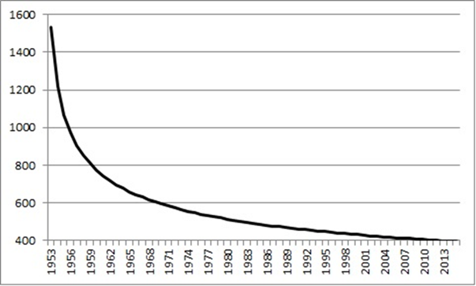
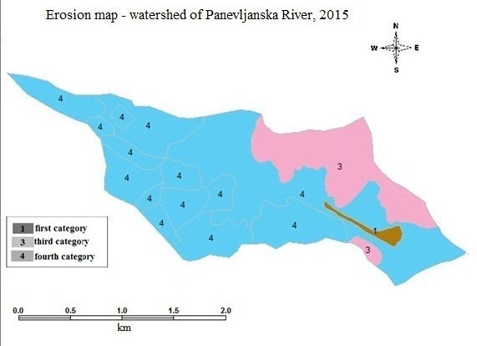
1531 m³/km²/year
One of the main causes for the current state of soil erosion is derived biological works in the watershed.
Prior to afforestation in 1959, mainly degraded forests occupied 23.2% of the total area. After afforestation, the forests occupied 39.4% of the total areas.
555
413
Causes of the emigration are: low income, then life conditions such as small houses made of bad material, missing sewerage system, bad traffic connection to local municipalities, changes in socio-economic issues regarding to rural – urban relation, etc. (Zlatić 1985; Dragićević et al. 2014).

Slide 11
arable land
number of
livestock
agricultural
inhabitants
Statistical analysis
average annual sediment transport
inhabitants
active inhabitants
G_{year} = 600.87 + 0.42*AgI + 0.12*NL – 2.88*AL
Where are:
G_{year} – average annual sediment transport
AgI – agricultural inhabitants
NL – Number of livestock
AL – arable land

Slide 12
Conclusion
The Panevljanska River watershed was characteristic for occurrence of all erosion phenomena, with the state of accelerated erosion in mid-fifties of the twenty century, endangering roads and railway, villages, human lives.
The population was constantly decreasing in recent decades, which led to the abandonment of agricultural land, so they are today largely unused.
These processes, together with a number of erosion and torrent control works contributed to the reduction of erosion.
Average annual sediment transport reduced from 1,531 m³*km⁻²*year⁻¹ (1953) to 413 m³*km⁻²*year⁻¹ (2015) and intensity of erosion reduced from excessive to weak.

