Slide 1
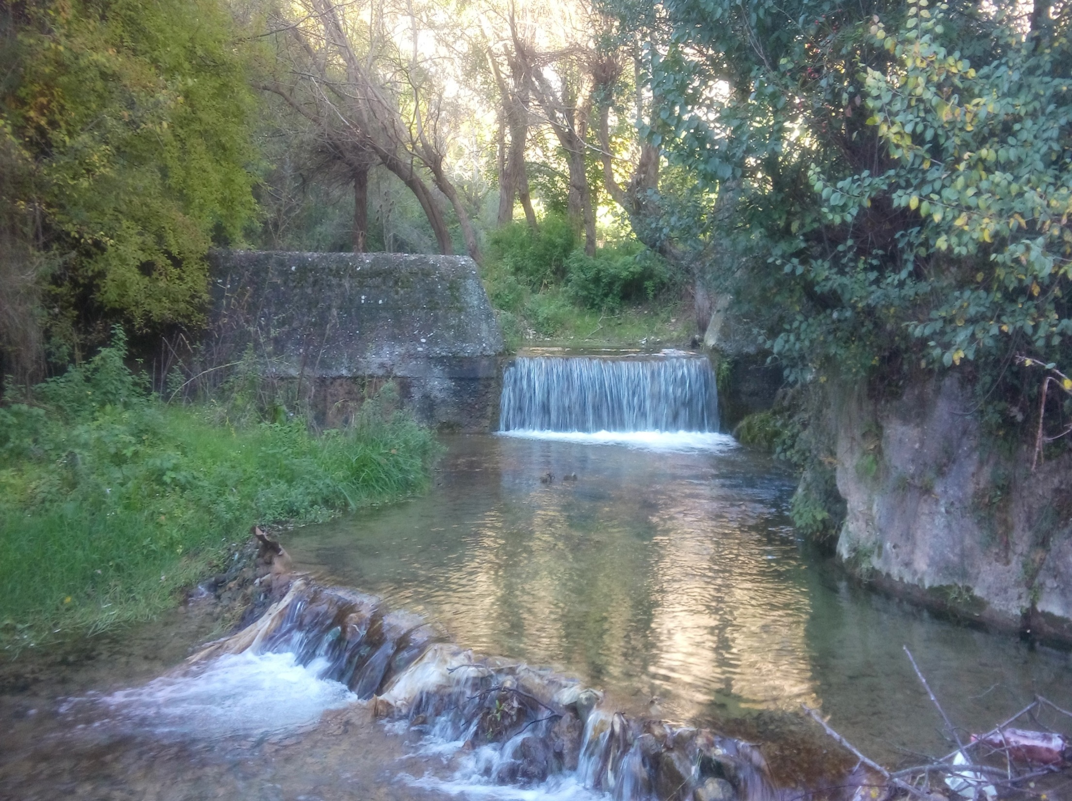
CHANGES IN THE HYDROLOGICAL STATUS OF THE BASIN DUE TO THE APPLICATION OF
EROSION CONTROL WORKS
MSc Jasmina Radonjic
PWC “Srbijavode”
WMC “Morava” Nis
Dr Ratko Ristic
Faculty of Forestry, University of Belgrade
MSc Sinisa Polovina
Faculty of Forestry, University of Belgrade

Slide 2
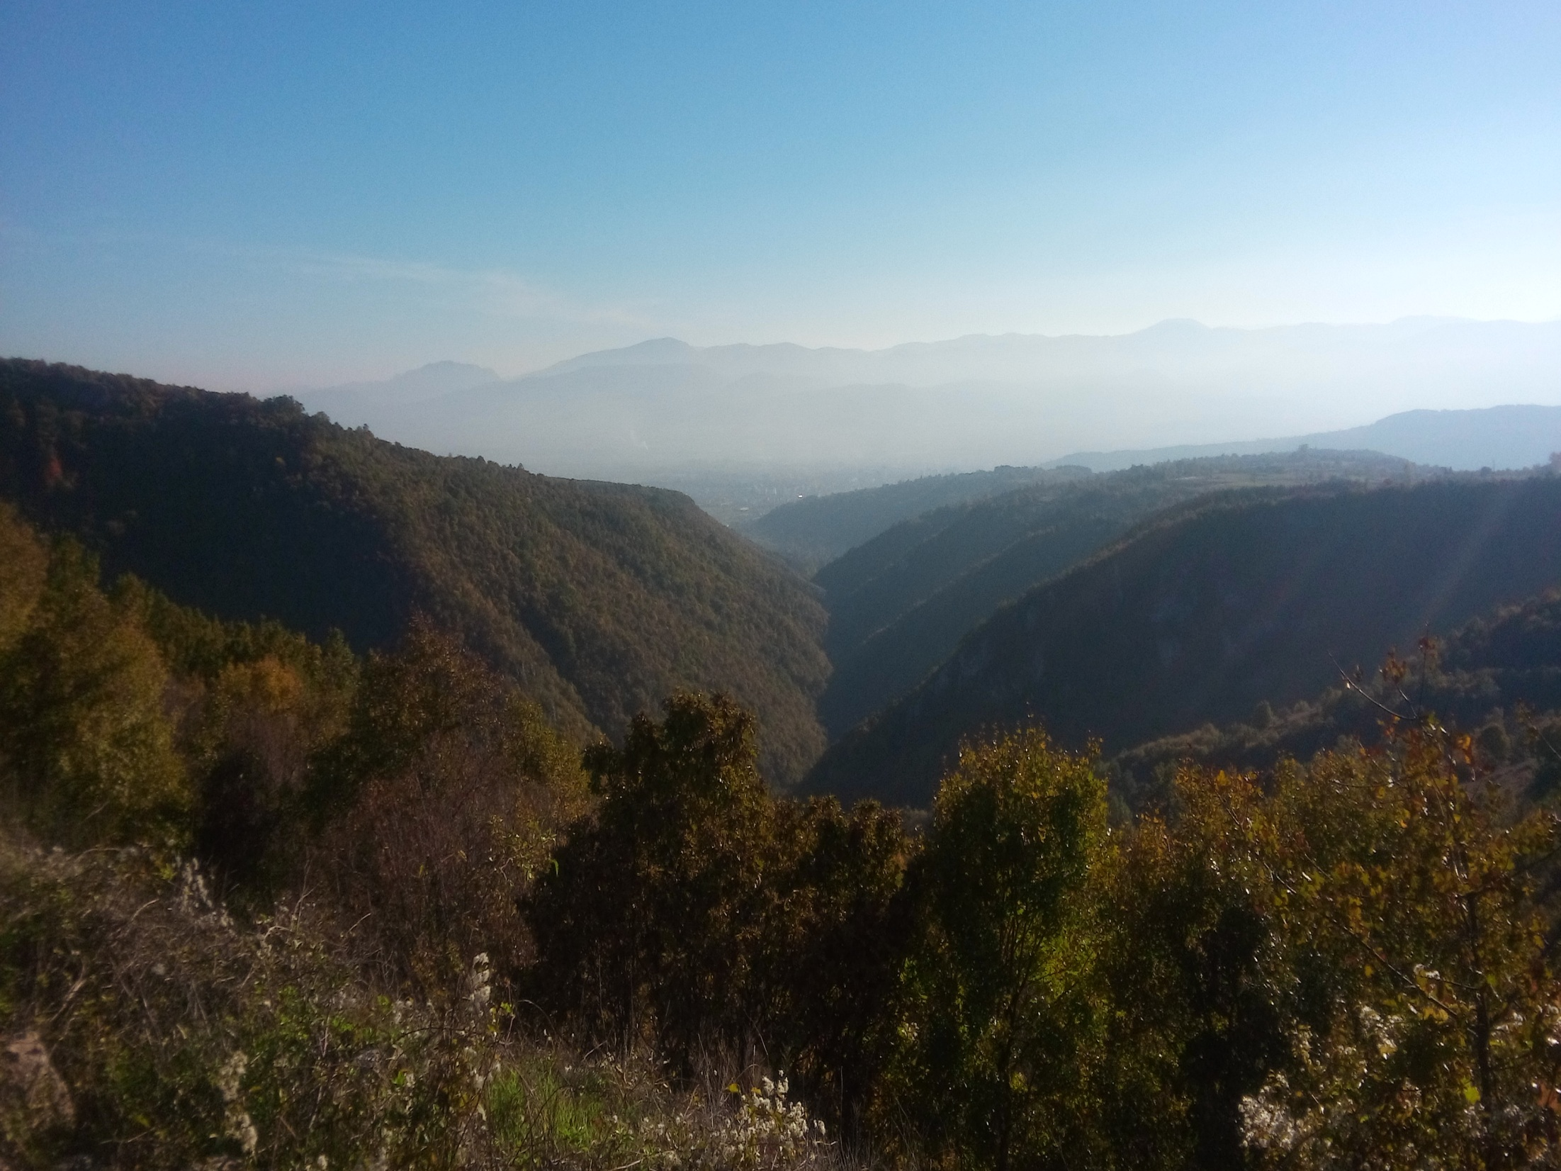
1907-1940: intensive beginning of the ECW in Serbia
1941-1954: a period of low intensity of ECW
mid-1970s: extensive activities of ECW
One of the first basins to be treated with works for the protection against erosion and torrent control is the Gradasnicka River basin
Figure 1: The basin of the Gradasnica River 2016

Slide 3
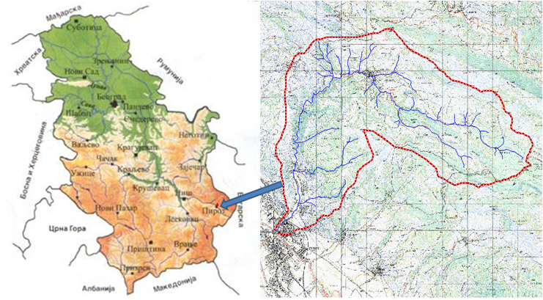
The basin is located in the southeast part of Serbia.
The Gradasnica River is the right tributary of the Nisava River, and it flows into it in the center of Pirot.
Figure 2: The position of the Gradasnicka River basin
The biggest floods in this basin occurred in 1948 (when the daily maximum precipitation was 62.3 mm), then in 1954, 1955, 1963 and 1965.

Slide 4
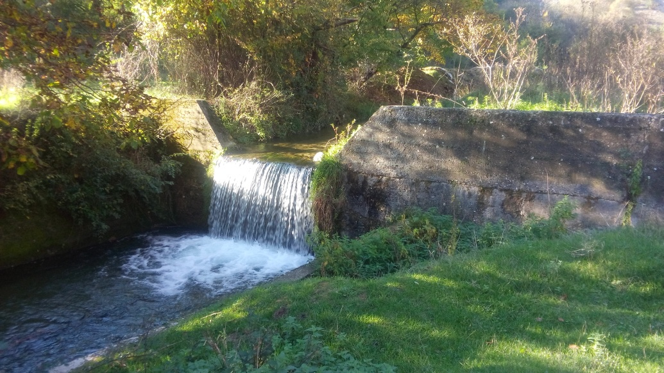
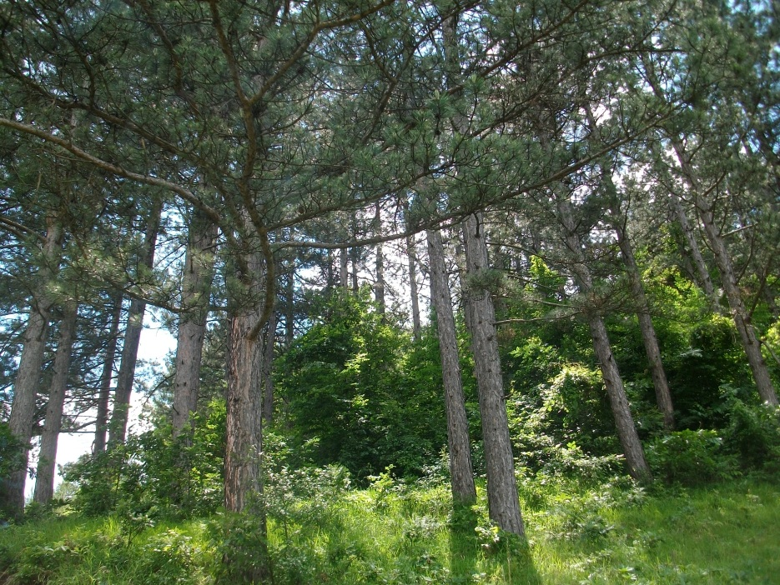
Basic parameters to display the changes of the hydrological status of the soil are:
the state of erosion
the value of erosion-coefficient
the annual production of erosion material
specific annual sediment discharge
runoff curve number as well as the value of the maximal discharge
Figure 3: Check dam in the riverbed of Gradasnicka River
All parameters of importance for understanding the state of the basin were analysed:
hydrological characteristics
pedological characteristics
geological characteristics
surface structure (space usage)
implemented erosion control works
Figure 4: Black pine forest in the basin of Gradasnicka River

Slide 5
GEOLOGICAL CHARACTERISTICS
Jurassic formations:
limestones
sandstones
marls
shales
Teritary is present in the village of Gradasnica:
yellow sandstones
red sandstones
conglomerate
quartz
quartyite
phyllite blue
PEDOLOGICAL CHARACTERISTICS
Gradasnica Gorge and parts of the basin were washed from the land to the limestone substrate, while the valley sides formed areas with deep pedological horizon.
On a limestone substrate, there is the formation of smonica, which is almost impermeable to water.
The presence of lime in the soil provides stability. The northeastern and southern parts of the basin are covered with sinkholes.
In areas that are established in the sandstone there are pedological layers of sand clay, whose permeability is low.
Parameter | Mark | Unit | Value for the Gradasnicka River basin
Magnitude | F | km² | 43.85
Perimeter | O | km | 42
Peak point | Kv | mnm | 1234
Confluence point | Ku | mnm | 370
Mean altitude | Hsr | mnm | 970
Length of the main stream | L | km | 18
Absolute slope of river bed | Iа | % | 4.8
Mean slope of river bed | Iu | % | 3.44
Mean slope of terrain | Isr | % | 33
Density of hydrographic network | G | km/km² | 1.1
Table 1: The main hydrographic characteristics of the Gradasnicka River basin

Slide 6
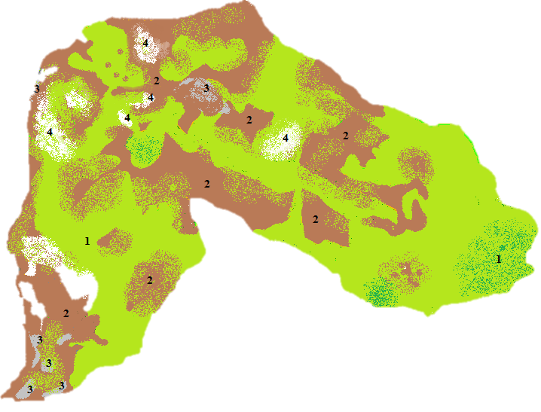
1- area under forest land with forests of diluted set and sporadically with forests of good set
2- land with intensive agricultural purposes, arable land and degraded pastures
3-settlements
4- areas under bare heights and limestone
WAYS OF LAND USE IN 1956:
forest (43%)
agriculture land (42%)
barren land (15%)
Forest of good set stretched over only to the source part of the basin.
The rest of the forest land was a low degraded forest or thicket.
Agricultural land was used on slopes greater than 60%.
The best preserved areas in the '50s in the basin of the Gradasnicka River were covered with pastures and meadows, dense and vital grass-legume cover, where there was no occurrence of intense leaching of soil.
Figure 5: Ways of land use in 1956

Slide 7
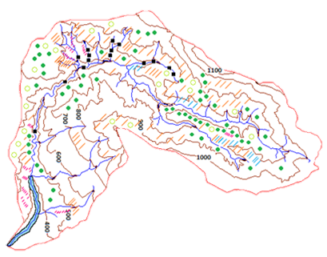
Technical works included:
small walls against leaching (3100.0 m³)
arched partitions (3 pcs.)
landfill-consolidation barriers (66 pcs.)
regulation of the riverbed in the length of 2.8 km
Biotechnical works included:
micro-retention belts (98.1 m²)
contour trenches with fruits (89.16 ha),
terracing (240.5 ha)
bench terraces (346.11 ha)
braidings (580 m²)
Biological works included:
felling of regeneration (180.11 ha)
reforestation in pits (109.05 ha)
reforestation in terraces (9.7 ha)
reforestation in bench terraces
or so-called ‘gradons’ (59.35 ha)
melioration of pastures (28.81 ha)
Figure 6: Position of biological, biotechnical and technical works

Slide 8
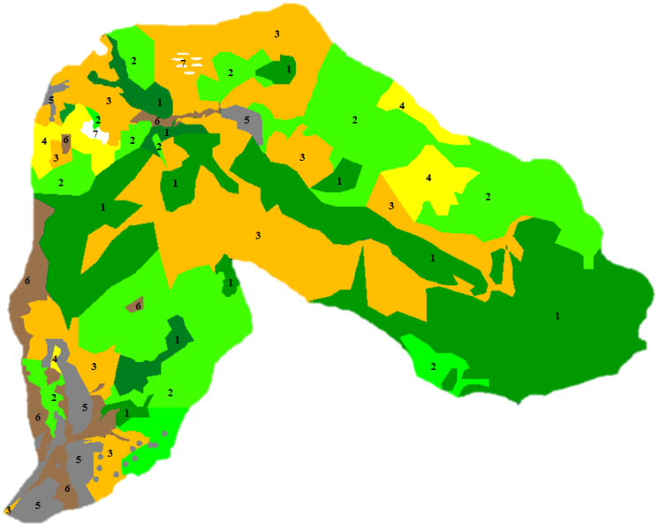
WAYS OF LAND USE IN 2014:
forest land 55.9%,
30.4% is covered by forests of good set
25.5% under forests with diluted set
meadows occupies 29.7%,
arable land 3.5%,
pastures 4.2%,
bare heights 3.8%,
urban and rural settlements 2.9%
Figure 7: Ways of land use in 2014
1- forest land with forests of good set
2- forest land with sporadically diluted set
3- preserved meadows and pastures
4- degraded pastures
5- settlements, urbanized land and industrial zones
6- land under intensive agricultural production and
fragmented individual landholdings under arable
land and orchards
7-bare heights

Slide 9
Table 2: Comparative review of the value of sediment yield and transport in 1956 and 2014
Parameter | Mark | Unit | 1956 | 2014
The total sediment yield | W_{a} | m³ | 84 977,56 | 24 611,39
Specific sediment yield | W_{asp} | m³/km²/year | 1 937,91 | 561,26
Annual sediment transport | W_{at} | m³ | 61 198,24 | 17 720,20
Specific sediment transport | W_{atsp} | m³/km²/year | 1 3395,63 | 404,11
Annual discharge of bed-load sediment | W_{abls} | m³/year | 25 091,28 | 3 189,64
Annual discharge of suspended sediment | W_{ass} | m³/year | 36 106,96 | 14 530,56
Erosion-coefficient | Z | - | 0.99 | 0.40
These values are representative indicators of the value of erosion-coefficient in the conditions before and after the execution of works on the protection of erosion and torrential floods management.

Slide 10
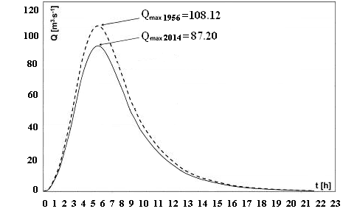
Reference value of the maximum flow, Q_{max(1956)} = 108.12 m³/s, in the basin of the Gradasnicka River (1956) was obtained as an average value, according to the following methods: 4 coefficients; Posenti; Kestlin; Iskovski; Meli; Kirstajner. Also, a mean value of runoff curve number CN_{sr(1956)} = 71.
The calculation of the maximum flow in the basin of the Gradasnicka River in 2014 was made on the basis of the combined method and amounts Q_{max (2014)} = 87.2 m³/s, while of the counted runoff curve is CN_{sr (2014)} = 62. The values of the maximum runoff and mean values of runoff curve number (in 2014) refer to the conditions in the basin after the execution of works for protection from erosion and torrential floods.
Figure 8: Hydrograph of the maximum runoff before (1956) and after (2014)
performing the works of erosion control measures

Slide 11
CONCLUSION
Soil erosion is a natural phenomenon present on the entire surface of the earth, the intensity of which has a direct impact on human activity.
The effects that occur after the completion of works on protection from erosion and regulation of torrents are numerous.
The initial state of erosion processes in 1956, was represented by the coefficient of erosion Z = 0.99 (strong erosion).
The value of erosion coefficients in 2014 was Z = 0.40 (poor erosion).
Works on protection from erosion and regulation of torrential floods affected the value of sediment yield and discharge, as well as the value of surface runoff.
Works on arranging the basin have led to the reduction of total annual production of erosion sediment W_{a (1956)} = 84977.56 m³ up to the value of W_{a (2014)} = 24611.39m³, reducing the value of the specific sediment discharge with W_{atsp. (1956)} = 13395.63 m³/km²/year to a value of W_{atsp. (2014)} = 404.11 m³/ km²/year.
The resulting value of the maximum flow Q_{max (2014)} = 87.2 m³/s was significantly lower than the value of the maximum discharge prior to application of erosion control works Q_{max (1956)} = 108.12 m³/s.
These changes in hydrological parameters directly indicate the effects that are caused directly by using erosion control works.

Slide 12
THANK YOU
FOR YOUR ATTENTION !!!

