Slide 1

Prospective of Non-Native Tree Species in Serbia
Ljiljana Keča, Nenad Keča, Dragan Borota, Milica Marčeta
University of Belgrade
Faculty of Forestry

Slide 2
List of NNTSs % of forest land coverage arranged in a frequency order
Source: THE NATIONAL FOREST INVENTORY OF THE REPUBLIC OF SERBIA

Slide 3
What is important/interesting to know about
NNTSs in Serbia
Of the 68 species of trees in the forests of Serbia, so far there are 15 non-native species (including 27 clones or cultivars).
Number of introduced species is certainly much higher if we take into account the park and other non-forest areas where these species grown for decorative or other reasons.
In the forests are non-native species the most common.
Some of introduced species can be treated at the same time and as invasive e.g, Robinia pseudoacacia, Ailanthus altissima, Amorpha fruticosa, etc.
Black locust participate in a volume of 3.1%. Euro-American poplar cultivars are present in a volume of 1.7%, and volume increment of 3.7%.
The total area covered with introduced species in Serbia is app. ~250 000 ha.

Slide 4
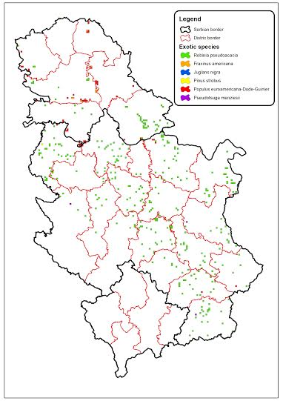
Distribution of NNTSs in Serbia
Regarding to the small relative share of introduced species in the forest fund in Serbia significantly, their presence is not an issue of strategic character. It is necessary to emphasize on the needs of the controlled potential spread of introduced species and others in our forests, due to strong invasive potential.

Slide 5
Material and method
Forestry and forest management are influenced by changes within internal and external operational environments (Kurtilla et al., 2000).
When examining the potential for a new business or product (in our case NNTSs potential), a SWOT analysis can help determine the likely risks and rewards.
In this research conducting a SWOT analysis means listing NNTSs strengths, weaknesses, opportunities and threats to evaluate current environment on the issue and how it may change for better or worse, and then develop a response strategy.
The primary objective of the research is to identify elements of SWOT and point the factors, positive and negative, that may affect strategic planning and decision-making in research regarding NNTSs in Serbia.

Slide 6
Material and method
We used preference data from opinion leaders in climate changes, silviculture and ecology and forest management, who have had intensive knowledge about NNTSs practices in Serbia.
Phases of research: identification of key stakeholders involved in the decision problem, classification of critical factors influencing the decision, and evaluation of the factors using SWOT–AHP framework NNTSs.
There were 28 respondents dealing with NNTSs in Serbia.
They are mainly men, with average 23 years experience in forestry.
The data obtained from respondents questionnaires were analyzed separately to derive factor priority and overall priority scores and weighted equally to estimate mean scores.
Identification and classification of critical decision factors was accomplished using questionnaire distributed to respondents, which were cathegorized i.e. marked by the mark 1 to 5. The “1” is the lowest grade/influence on the NNTSs issue in the field of ecology/silviculture (forest management)/climate changes. The “5” is the highest importance of the component.

Slide 7
Results
The overall priority scores obtained by adjusting priority scores with scale parameters illustrate the relative importance of each factor across all SWOT groups. Scaled values of SWOT in ecology aspect of NNTSs.
Faster adaptation to changing ecological conditions
Invasiveness and possible disappearance of native spp.
Replacement of native species-decreasing in vigor
Lack of experience in silviculture

Slide 8
Results
From within-group analysis of preferences, it is revealed that faster adaptation to changing ecological conditions was the most important strength of NNTSs ecological characteristic with a priority score of 0.075. With a priority score of 0.1 replacements for native species that are decreasing in their health condition was shown to be the major opportunity factor.
It is well known fact that NNTSs while growing out of its natural range are, at least at the beginning of the introduction, free of its natural enemies.
The most serious weakness, with a factor priority score of 0.05, was invasiveness and possible disappearance of native tree species.

Slide 9
A'WOT analysis on NNTSs in Serbia
The SWOT/AHP analysis shows that factors such as strengths and threats are dominant in all three aspects of NNTSs analyzed in Serbia.
This greater importance of external factor such as threats in all three cases can be explained by the fact that most of the researches in this field of science are relatively young.
Dominant strategy in all tree cases is “ST “strategy.

Slide 10
A'WOT for ecology, silviculture and climate change aspects of NTSs

Slide 11
Results
Regarding to current types of silvicultural systems used in plantations of exotic species we should notice that it is clear-cutting system on small area. In some cases, a conversion has been planned.
Observed damages or plantation devastation are usually connected with inadequate conditions for growth of exotic species or high inoculum potential of native pathogen.
The most frequently observed pathogens in Serbia on different NNTSs are: Poplar sp.-Melampsora spp., Cryptodiaporthe populea; Neonectria coccinea - Fagus sp.; Ophiostoma spp., Armillaria spp. – Quercus rubra; Juglans nigra - Brenneria nigrifluens; Pseudotsuga taxifoia - Rhabdoclyne pseudotsugae; Pinus strobus - Cronartium ribicola.
The most frequently observed insects are: R. pseudoacacia - Phyllonorycter robiniella, Parectopa robiniella, Obolodiplosis robiniae; Populus sp. - Pemphigus spirothecae, Sciapteron tabaniformis, Cosus cosus; Pseudotsuga taxifolia - Hylastes ater.

Slide 12
Conclusions
This study illustrates the application of SWOT–AHP approach to assess the importance of problems and prospects relating to non-native tree species in Serbia.
Drawing on the concept of opinion leader and representative principle, we selected 28 individuals who had experience and knowledgeable about NNTSs in Serbia from different institutions, mainly in forestry.
Results suggest that strengths and threats (‘ST’) strategies are dominant in all three prospects: ecology, silviculture and climate changes of NNTSs.
The greatest problems are: lack of experience in silviculture of NNTS, non-visibility of state to NNTSs, and reduce tree physiological status and increase susceptibility to pathogens.
Strengths are: faster adaptation to changing ecological conditions, well adapted to local climate and biodiversity richness.
As the results derived in this study are from a small sample, a caution should be taken in using these findings in a broader context.

Slide 13
Prospective of Non-Native Tree Species in Serbia
Ljiljana Keča, Nenad Keča, Dragan Borota, Milica Marčeta
Questions should be addressed to: ljiljana.keca@sfb.bg.ac.rs
Thank you for attention!

