Slide 1
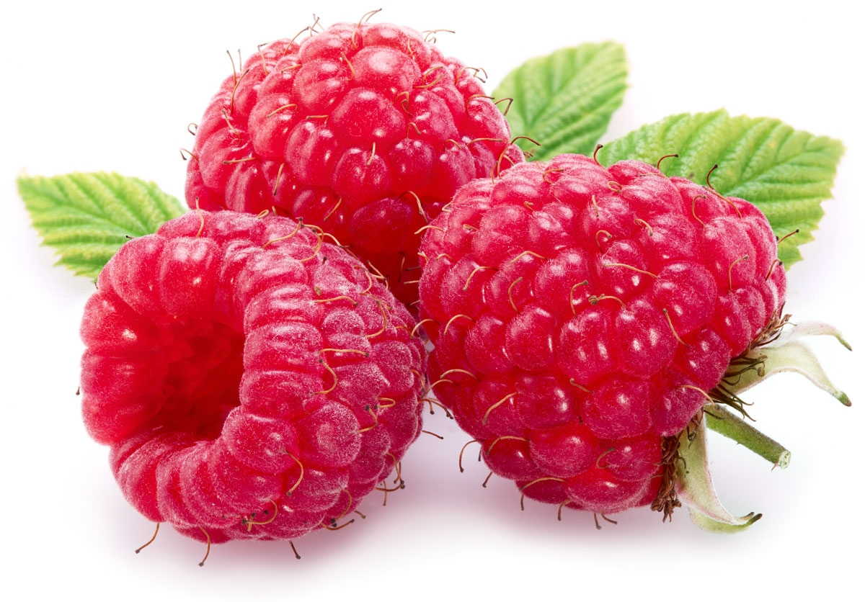
Raspberry production on sustainable principles in Western Serbia
Todosijević M¹., Čakmak D²., Belanović Simić S¹., Zlatić M¹., Kadović R¹., Lazarević K¹., Perović V. ²
¹University of Belgrade, Faculty of Forestry
²Institute of Soil, Belgrade

Slide 2

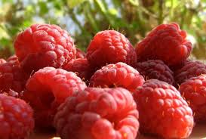
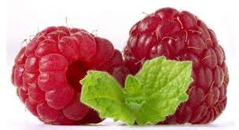
In the 4th century BC the Romans cultivated raspberries.
Only since 1900 began production of controlled raspberries
The main potential of the mountainous areas of western Serbia is in agriculture and forestry.

Slide 3
Serbia is one of the biggest producers and exporters of raspberries in the world (62% of the total value of exported fruits )
Serbia is the third country in the world in production of raspberries.
Thirteen thousand hectares are planted with this fruit.
Тhe annual average of 15,000 ha produces about 80,000 t raspberries whose average yield were 5.5 t/ha.

Slide 4

In 2009 even 63,200 t were exported which is brought into the country benefit of $ 200 million
In 2012, benefit from exports of raspberries were higher than 120 million euros
The success of the Serbian raspberry is in its production on small traditional family plantations with average size of 0.36 hectares

Slide 5
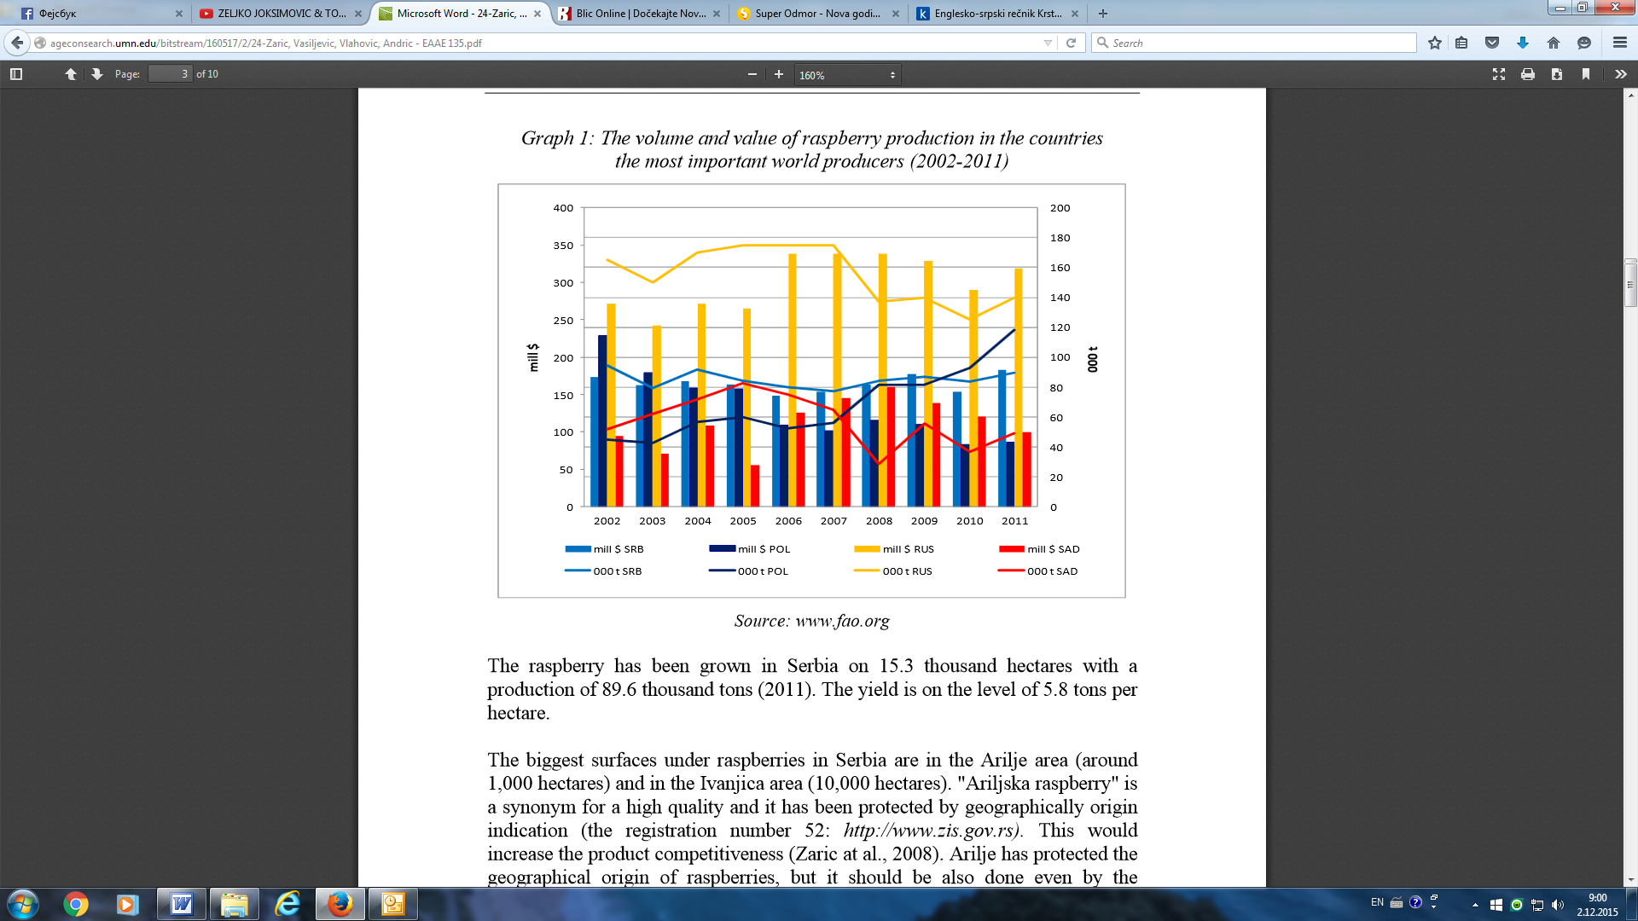

Slide 6
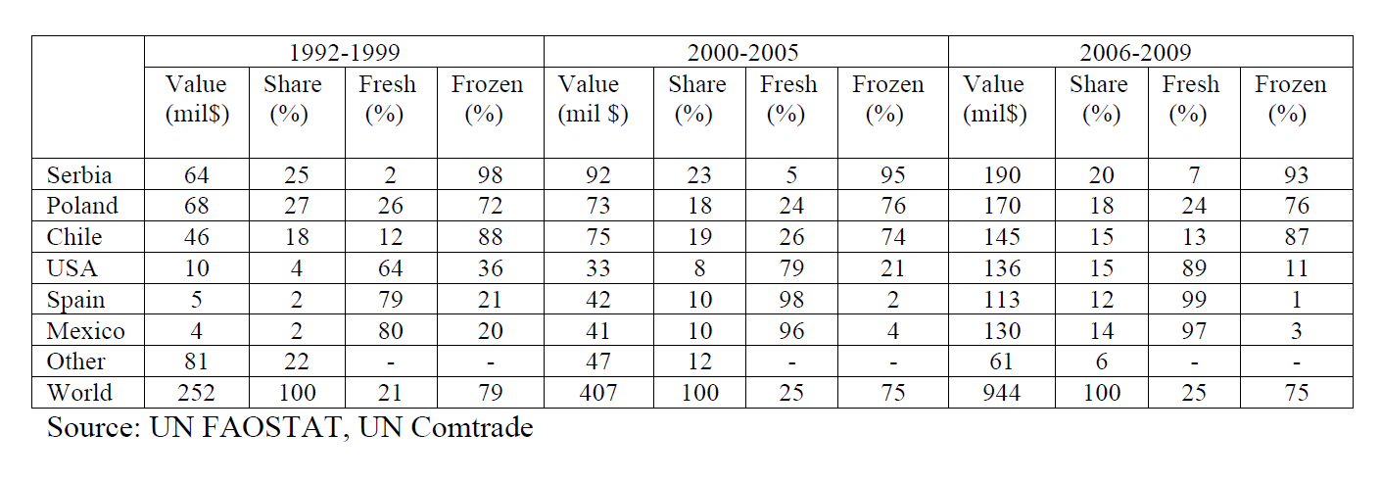
Raspberry production in Republic of Serbia
Raspberry production in the Municipality of Ljubovija for the period 2001-2010
.
Period | 2001 | 2002 | 2003 | 2004 | 2005 | 2006 | 2007 | 2008 | 2009 | 2010
Production (t/ha) | 3.542 | 4.138 | 3.937 | 1.751 | 3.452 | 3.578 | 3.537 | 4.575 | 4.516 | 3.889
Source: The Republic Bureau of Statistics, Municipalities in Serbia, 2002-2011

Slide 7
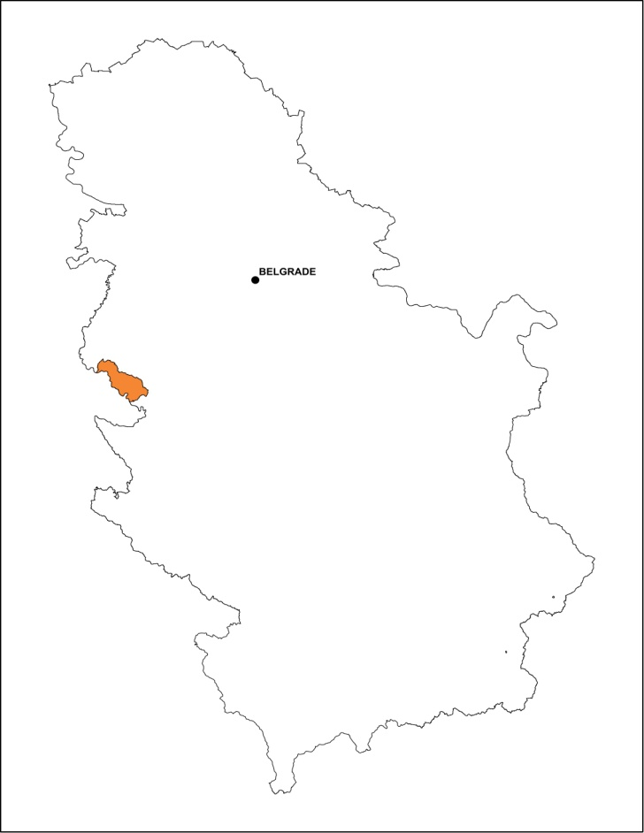
The municipality of Ljubovija (43°51'2.00''N, 20°4'9.39''E ) is located in the western part of Serbia and occupies an area of ​​356.2 km².
The total agricultural land area is 20,890 ha (forests on 12,220 ha)
The hilly and mountainous area with relatively few plain works, which are mainly located in the valley of the Drina River, Ljuboviđa and Trešnjica.
Municipality of Ljubovija
.

Slide 8
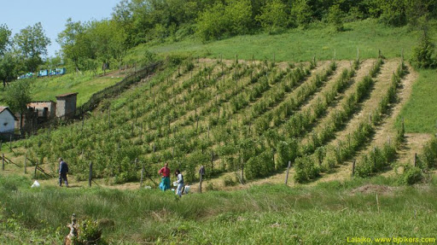
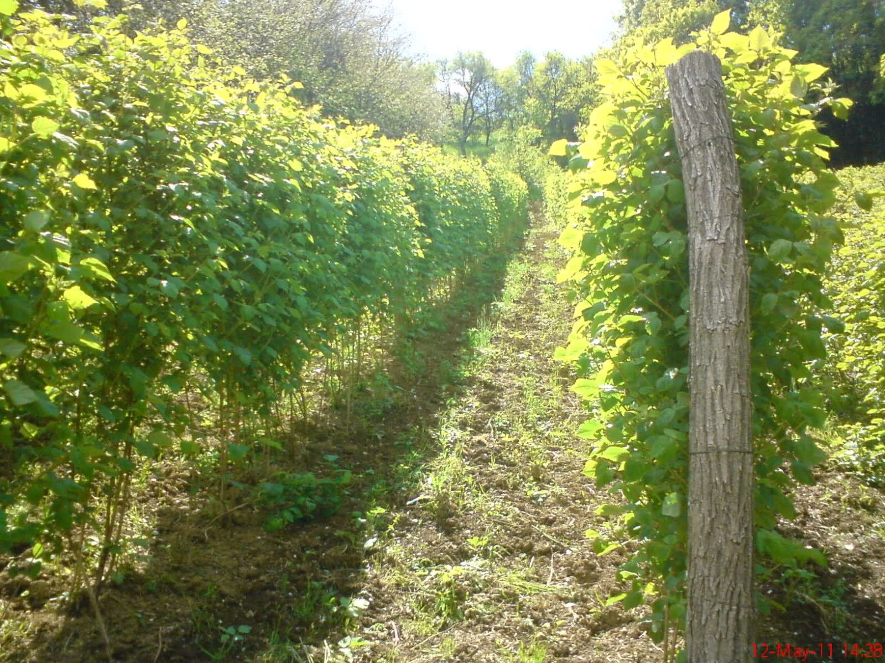
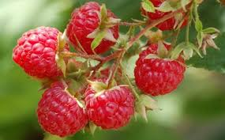
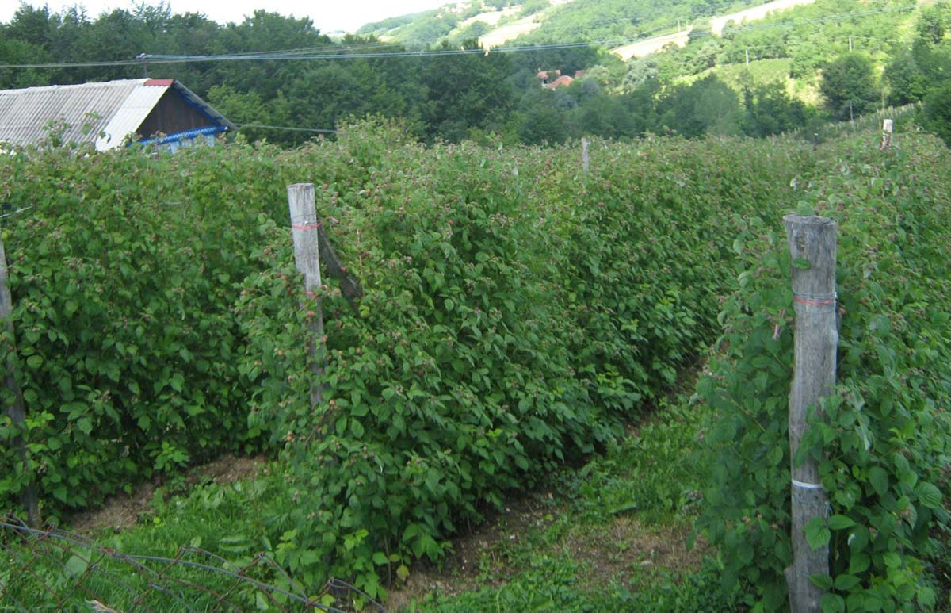
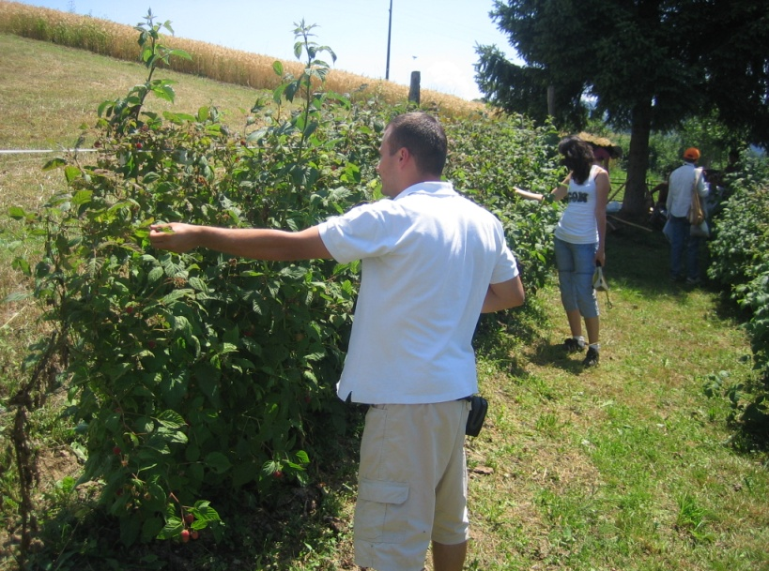
Exceptional natural advantages for the development of raspberry production

Slide 9

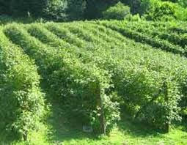
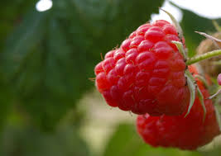
The main goal :
-record a location with soil characteristics which is better for a raspberry production without the use of fertilizers
- economic feasibility of investments in the same.

Slide 10
Materials and methods
The soil samples for the analysis of properties were taken at depths of 0-10;
10-20 and 20-40 cm
The laboratory studies of the soil were conducted using the major chemical
properties of soil were investigated by the standard methods recognized by
the Yugoslav Society of Soil Sciences (1997,1966).
The calculation determines the cost, selling price and the economic effects of raspberry plantations based on the principles of conservation of soil resources in western Serbia, the municipality of Ljubovija :
-The calculation of unit prices to raise raspberry
-The calculation of unit price of regular production
Internal Rate of Return (IRR)
Pay Back Period (PBP)
Cost/Benefit Analysis (C/BA)
Net Present Value (NPV)

Slide 11
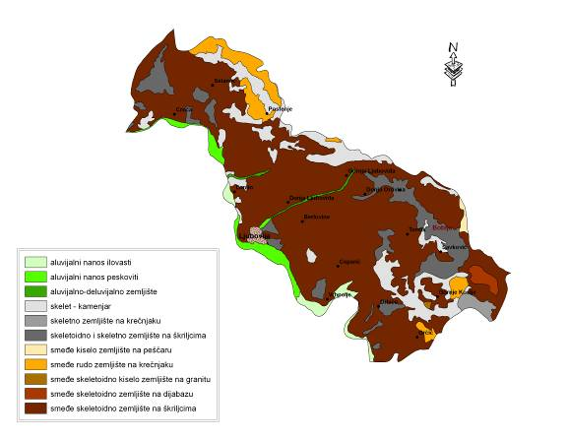
Source: Institute os Soil Science, Belgrade, 2013
In the profile the dominant types of land under agricultural areas
are characterized by WRB (2006):
- Haplic Cambisol (Eutric Leptic),
- Haplic Fluvisol (Calcaric, Siltic).

Slide 12
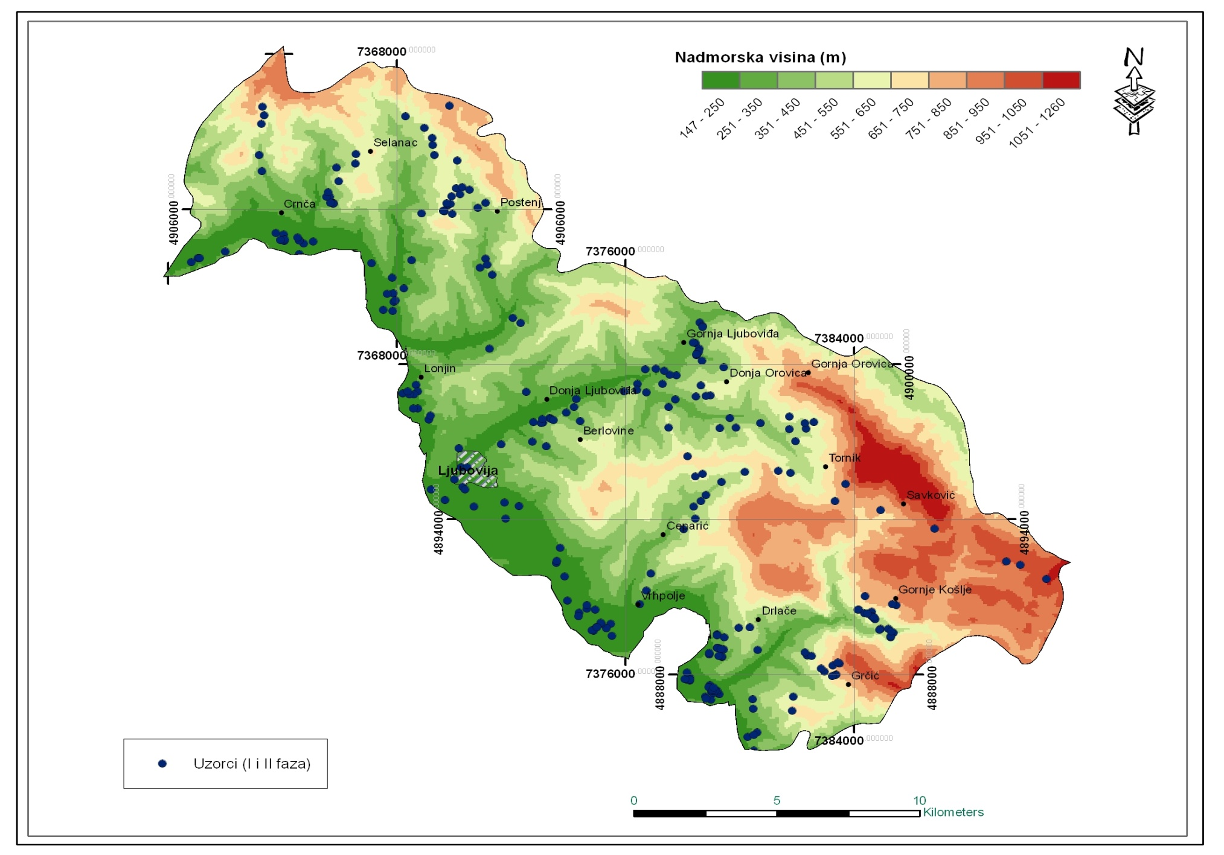
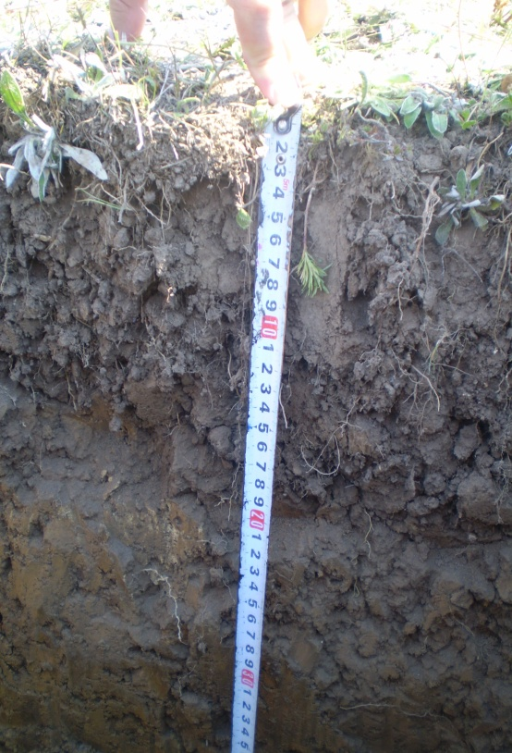
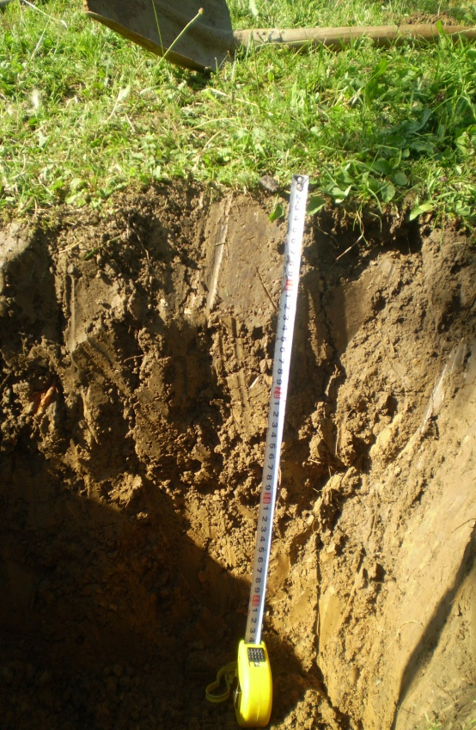
The soil samples in the municipality of Ljubovija were taken in September, October and November 2010 and 2011 with the 19 cadastral municipality.
Sampling was carried out on agricultural land at 620 locations with the GPS coordinates. At each location was taken one composite sample to a depth of 0 - 25 cm (Institute of Soil Science, 2013).

Slide 13
Desirable characteristics of soil for growing raspberries are:
- soil depth - 40-70 cm
- content of the soil - a moderately cold, moderately severe and permeable soils with rapid runoff of surface water
- pH acidity - between 5 and 6
- phosphorus - 8-10 mg per 100 g air-dry soil
- potassium - 18-20 mg per 100 g air-dry soil
- humus - over 3%, optimally 5%
Soil characteristics on the municipilaty of Ljubovija
Soil depth | pH | P₂O₅ | K₂O | Humus
40-60 cm | 6,31 | 8.18mg/100gr | 21.1mg/100g | above 3%
Source: Institute of Soil Science, 2013

Slide 14
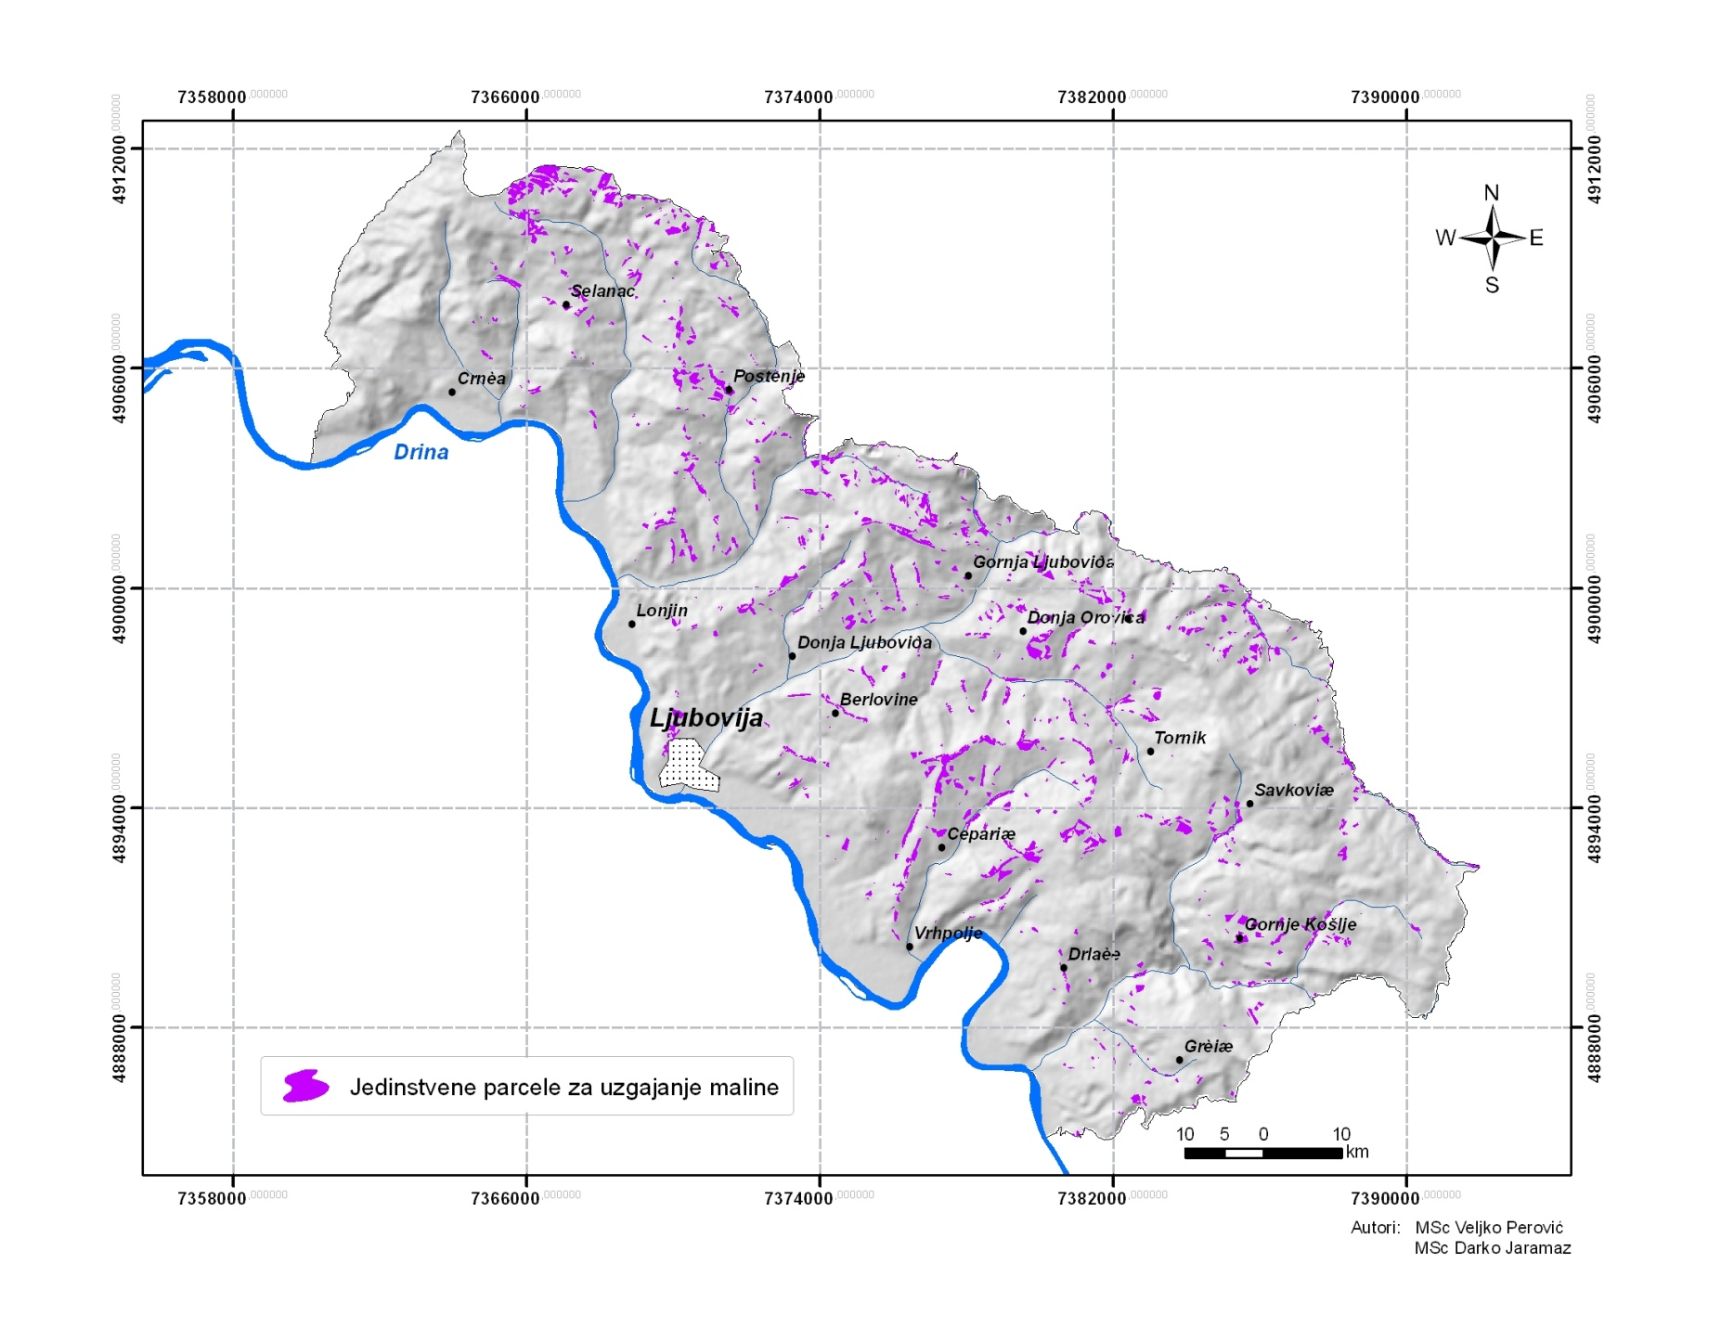
Surfaces unique plot for growing raspberries according to the parameters mentioned amount to 833.04 ha which is 2.33% of the total area of ​​the municipality

Slide 15
Economic analysis of the plantation of raspberries based on dynamic (discount) methods of assessing the effectiveness of investments (the real interest rates for Serbia is 12%).
The prices were taken from the STIPS (The system of the market agriculture information of Serbia) for the period 2015 where 1 euro was 120 RSD.

Slide 16
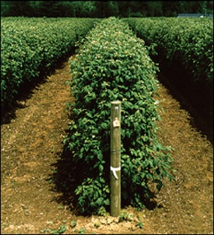
Raspberry
Dynamic methods
IRR | 39.61%
C/B | 1.634
PBP | 4
NPV | 33336.46

Slide 17
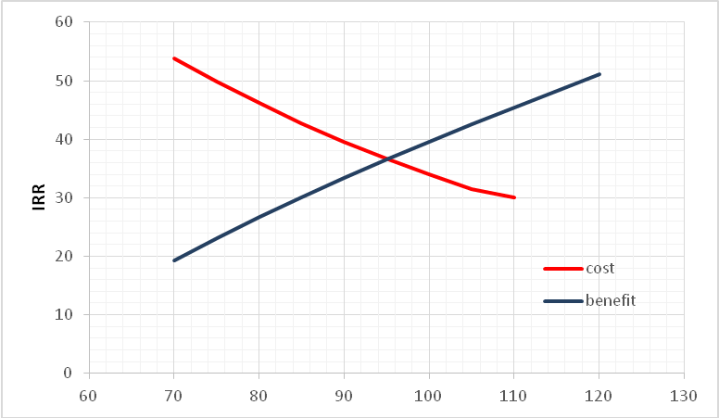
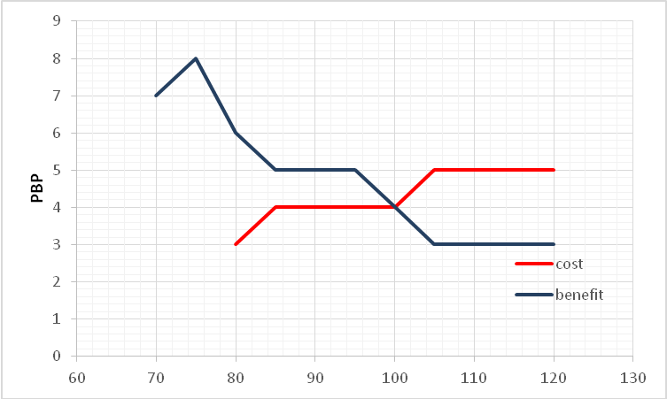
Sensitivity analysis - tested sensitivity to a possible change in investment cost and benefit.
Changing benefit for 38.79% and changing the cost of 63.36% come to the interest rate of 12%.
Changing benefit by almost 50% and costs by 63% - the PBP is changed from 4 years to 15 years.

Slide 18
The individual private property - Mutapović
The economic efficiency of raspberry productions
Raspberry 19.45% (11°) 917m²= 0.0917 hа
Dynamic methods | After land planning | Before land planning
 | meadow | raspberry
IRR | 51.98%
C/B | 1.992
PBP | 3
NPV | 3515.29
Assessment of the economic effects of the surface of raspberries (instead of a grass mixtures)
Raspberry (instead of a grass mixtures) 20% (11.3°) 4113.56 m²=0.41ha
Dynamic methods | After land planning | Before land planning
 | meadow | raspberry
IRR | 102.02%
C/B | 2.626
PBP | 2
NPV | 19610.4
Assessment of the economic effects of the surface of raspberries (instead of a crop rotation)
Raspberry (instead of crop rotation) 24% (13.5°) 5787.78 m²=0.58ha
Dynamic methods | After land planning | Before land planning
 | meadow | raspberry
IRR | 111.16%
C/B | 2.3
PBP | 2.739
NPV | 28290.4

Slide 19
Sensitivity analysis showed a trend of benefit and cost in positive and negative direction (from 20% -130%) and a simple regression established the level of statistical significance (correlation coefficient, coefficient of determination, t-statistic, F-statistics)
Change in cost | Value | Change in benefits | Value
R (correlation coefficient) | 0.970383 | R (correlation coefficient) | 0.887486
R²(coeff. of determination) | 0.941642 | R²(coeff. of determination | 0.787631
F- statistic | 225.9003 | F- statistic | 51.92307
t - statistic | -15.03 | t - statistic | -7.20577
y = 10.241e^{-0.0162x} |  | y = 0.0199x+4E-05
In the areas under crops of raspberries has been found that if the rate of cost increases by 1%, the ratio of C/B is reduced to 0.016

Slide 20
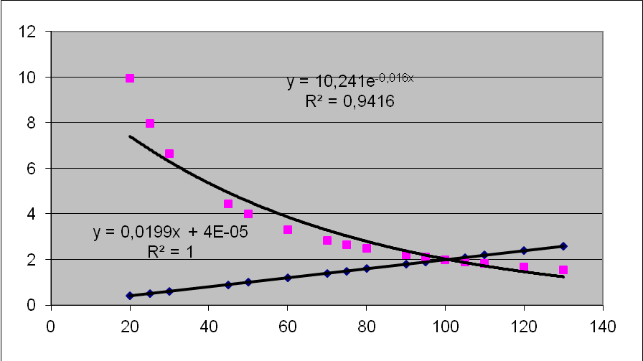
y = ae^{-0,0162x}
The model (function) can be used for efficient calculation of investment funds in raspberry plantations on degraded mountain areas.

Slide 21
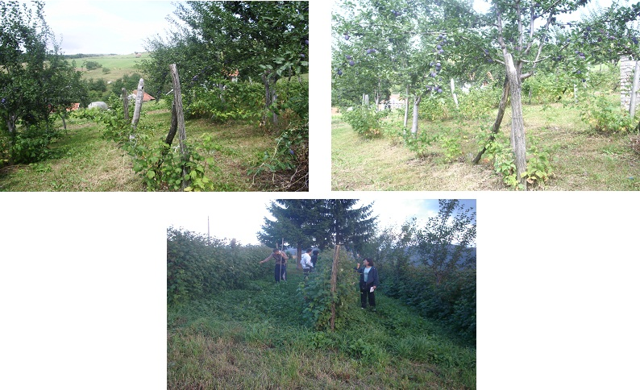
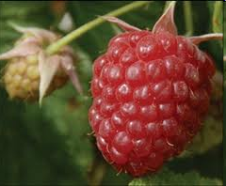
In the basin of Trešnjica river on plots under crops of raspberries, loss of land were reduced up to 24 times compared to the situation before to the application of the same (Todosijević M. et al, 2014).

Slide 22
Conclusion
Serbia has favorably agro ecological conditions for production of
raspberry and good perspectives for their export.
In the municipality of Ljubovija in the mountainous area the
pedological conditions are very good for the raspberry production
and economic analysis showed the economic feasibility of investing in
plantations of raspberries.
Regression analysis of C/B, to assess the efficacy of financial
investment in the raspberry fruit crops represents a model for the
analysis of C/B depending on the percentage change in the cost of
raspberry plantations.

Slide 23
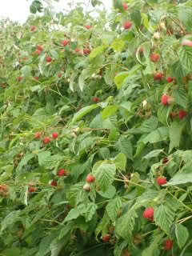
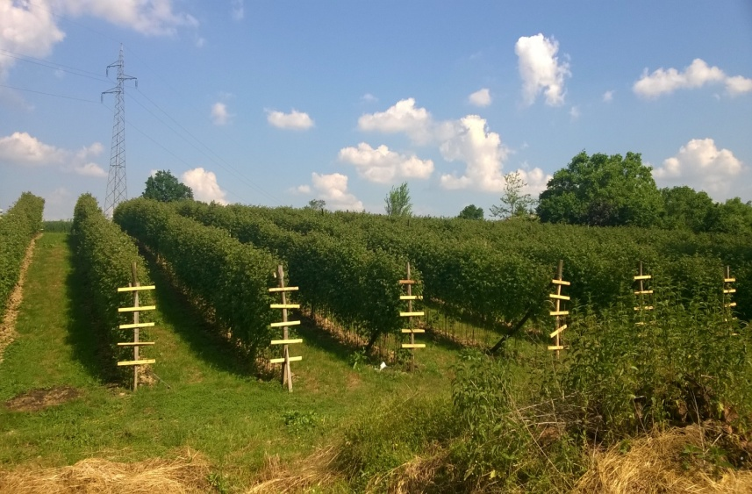
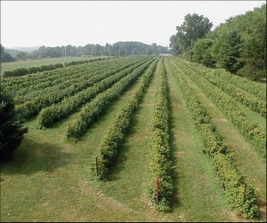
The raspberry is profitable fruit species for producers in western Serbia.
It also affects the prosperity of this region.
Due to its protective role in the degradation processes are the tenets that will need to invest in the future.
Raspberry production is an exceptional chance for the development of agriculture and Serbian еconomy in general.

