Slide 1
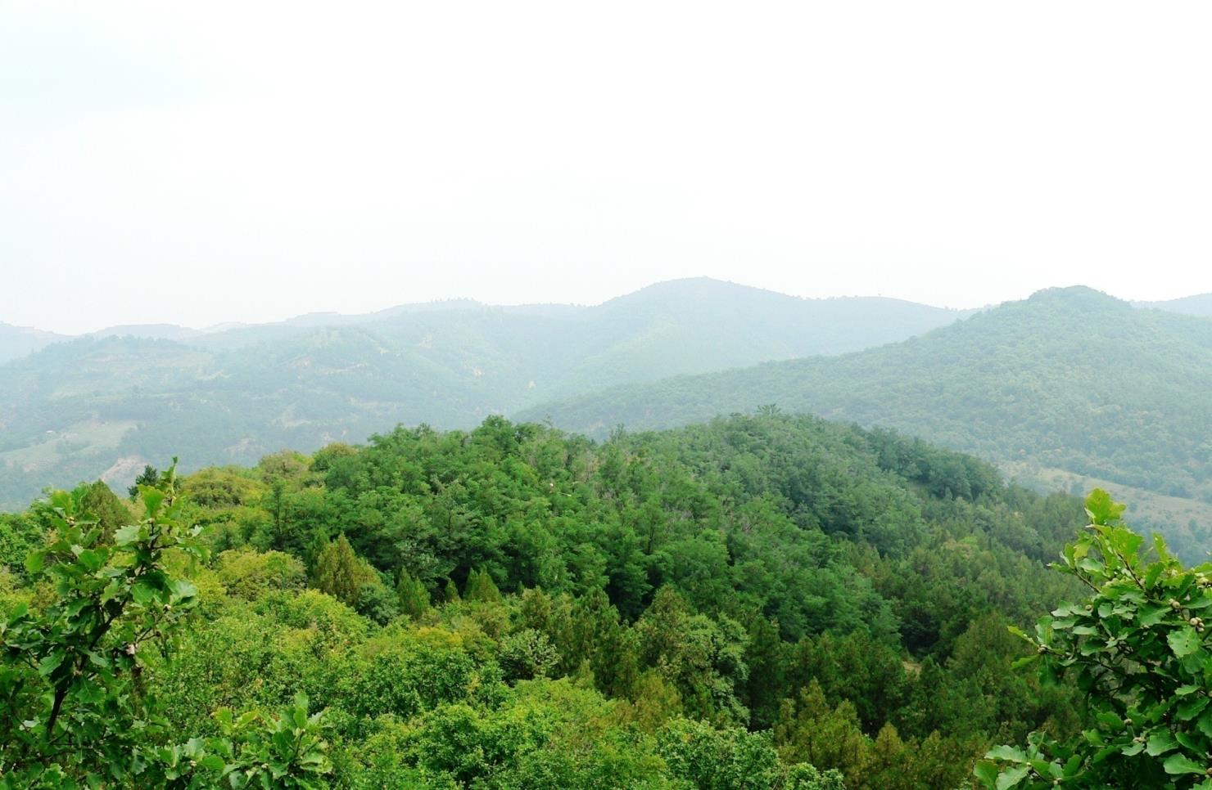
WASWAC2016Belgrade
Carbon accumulation in two typical forest ecosystems in the Loess Plateau
DU, Sheng; etc
Institute of Soil and Water Conservation, Chinese Academy of Sciences and Ministry of Water Resources
Yangling, China

Slide 2
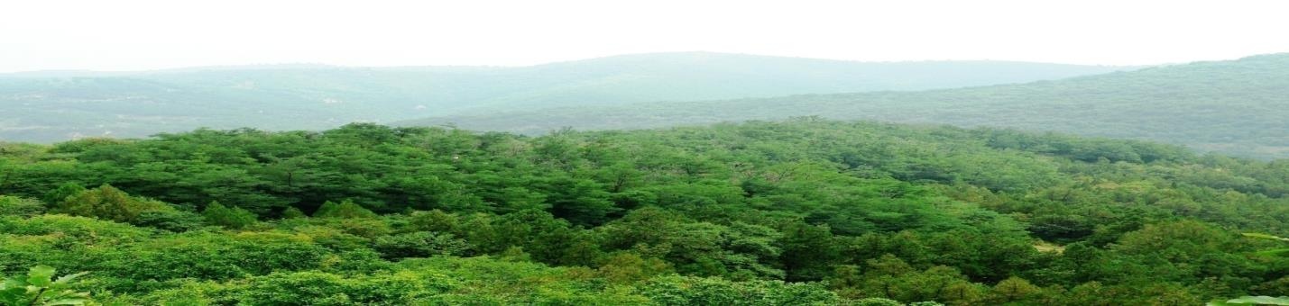
Outlines
Background
Approaches
Some results

Slide 3
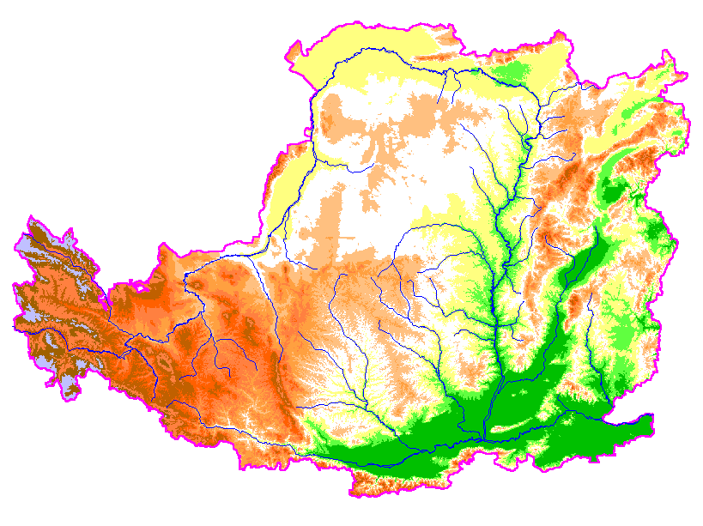
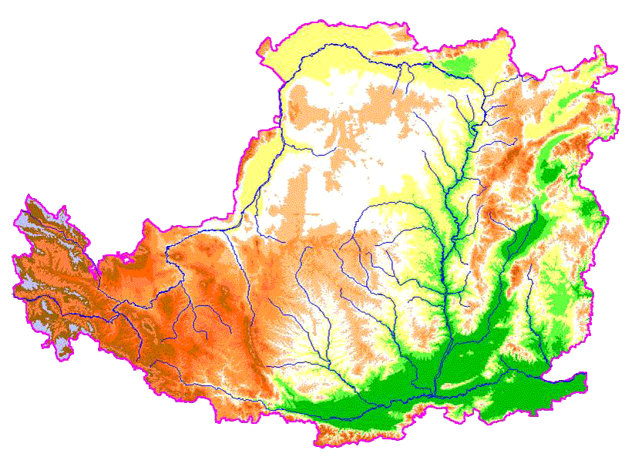
Location of the Loess Plateau: middle reaches of Yellow River Basin
Loess region: 0.64 million km²
Typical loess: 0.42 M km²
Severe erosion: 0.28 M km²
Population: 29 million

Slide 4
General information for the natural environments
Soil easily eroded, severe wind and water erosion.
Deforestation and land use changes (increases in population and crop cultivation) caused shrinkage of natural vegetation distribution (decades before).
Rehabilitation approaches have been conducted, vegetation cover have been increasing (since 1970s).
Evaluation of various vegetation types based on multiple ecological services are insufficient.
Vegetation cover, soil conservation, OK!
Other services ?

Slide 5
Objectives in this work
To investigate biomass/carbon storage and production, taking two forest ecosystems as examples.
To particularly investigate the carbon storage in soil, considering the special development of loess soil.

Slide 6
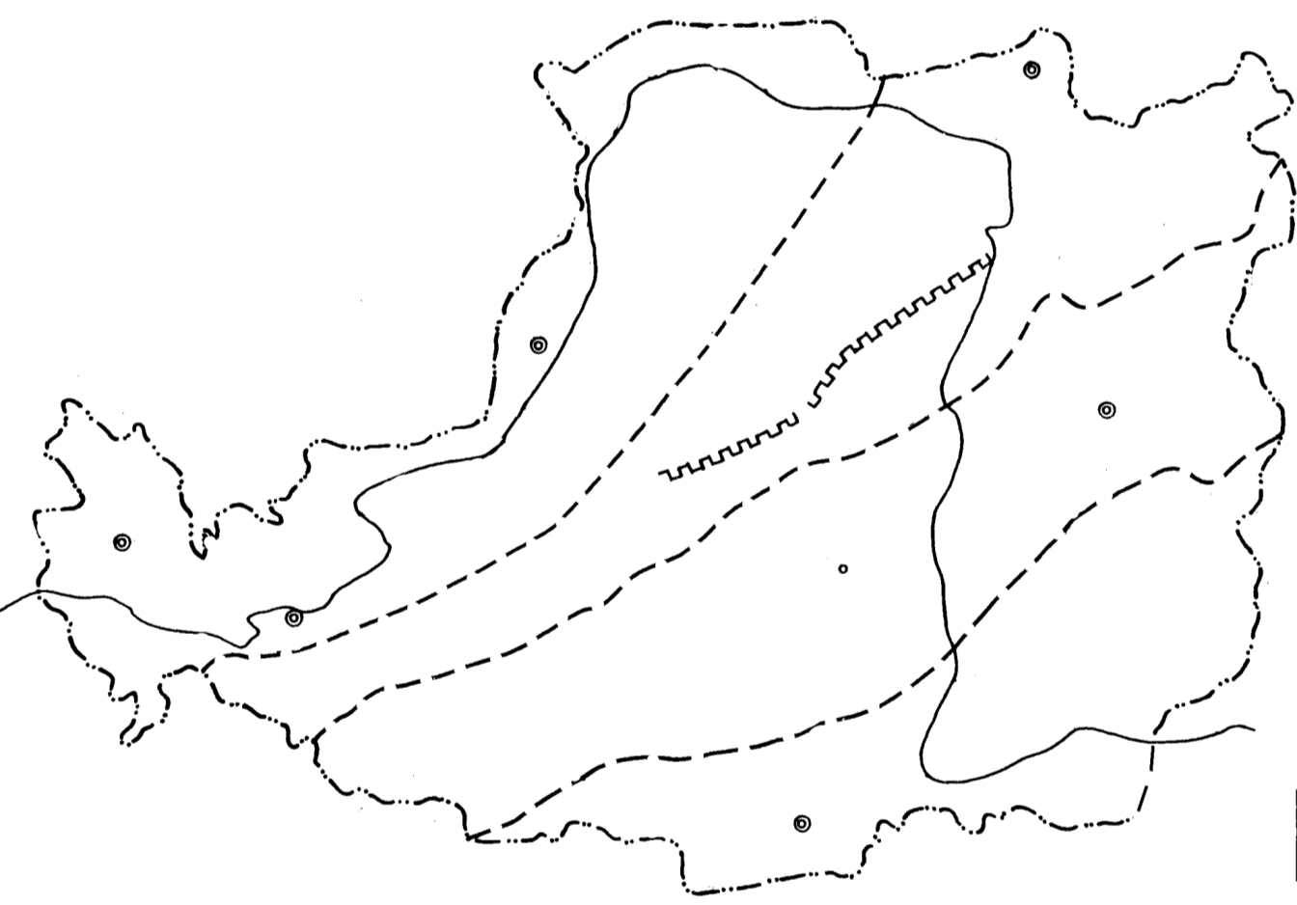
Natural (potential) vegetation in the region
Desert
Grassland
Forest+Grassland
Forest
Rain fall
Xi’an

Slide 7
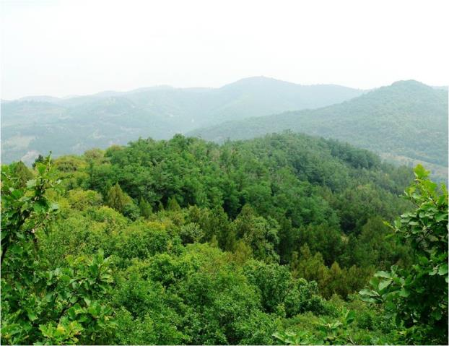
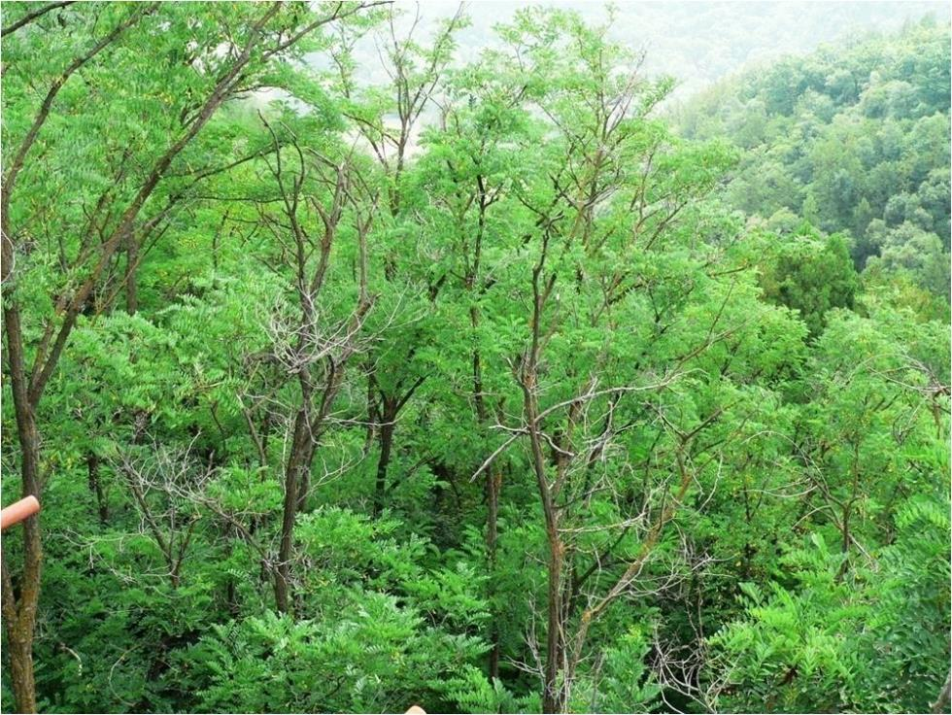
Natural secondary forest
(60-70 years)
Plantation
(38 years)

Slide 8
Plot surveys
Permeant plots (since 2002):
20m×20m, growth surveys, litterfall production
Intensive survey of replicated plots (2013):
Basic surveys for arbor trees (40m×20m), destructive survey of subplots for shrubs (2m×2m), herbs and litter (1m×1m).
Soil coring (Ø8cm, 0-40cm) with replicates for fine root sampling.
Soil survey: 2m profile, bulk density; Coring with replicates (Ø4cm) for carbon analysis.

Slide 9
Carbon stock estimate
Arbor layer: Biomass was calculated using allometric equations for components (stem, branches, leaves, roots).
Shrub, herb, and litter layers: Biomass were calculated for harvested components (above- and below-ground).
Organic carbon in each plant component, organic and inorganic carbon in each soil layer were determined.
Carbon stock of each plant component and soil layer was calculated.

Slide 10
Biomass C and N
Trees
Shrubs
Herbs
Carbon and Nitrogen density（t ha⁻¹）
Litter
Fine roots
Total C: Oak 78.8 t ha⁻¹; Locust 67.6 t ha⁻¹
Total N: Oak 1.47 t ha⁻¹; Locust 2.79 t ha⁻¹
More understory and fine roots in oak forest.
C N
Oak
Locust

Slide 11
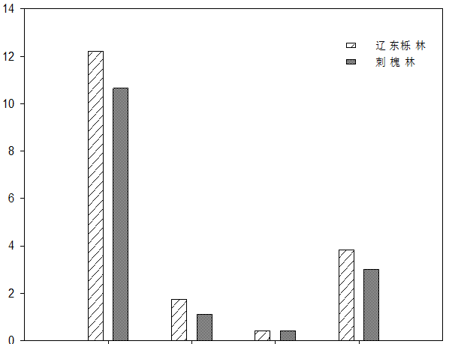
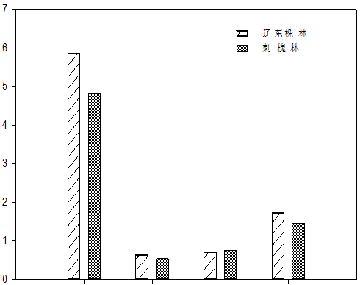
Net primary production
Oak
Oak
Black locust
Black locust
NPP (t ha⁻¹ yr⁻¹)
Annual C sequestration (t ha⁻¹ yr⁻¹)
Trees shrubs Herbs Litter
Trees shrubs Herbs Litter
Except the herb layer, oak forest showed larger NPP and carbon sequestration than the black locust plantation.

Slide 12
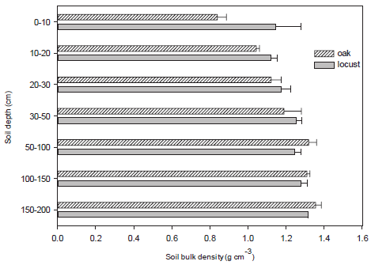
Soil buck density
Oak forest had a lower soil bulk density than the black locust plantation, particularly in the surface layers.

Slide 13
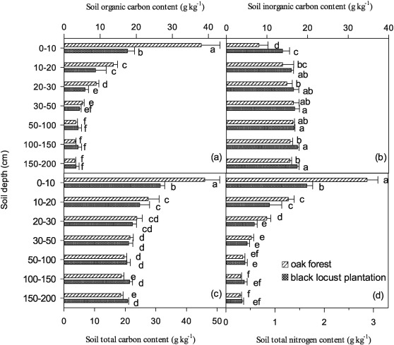
C and N in soil
Organic C and N contents are higher in surface layers and remain steady under 1 m.
Distribution of N contents followed the pattern of SOC.

Slide 14
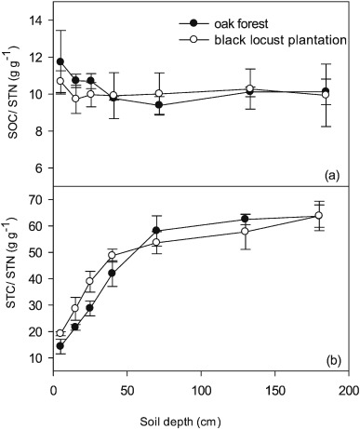
Ratios of C vs. N
C/N ratios calculated as SOC/STN in both forests did not vary much with depth and approached a general constant of 10 g g⁻ ¹
In shallow soil layers, the ratios were higher in oak forest than black locust plantation
STC/STN showed a trend of increasing to constant level along the vertical profile, due to the contribution of SIC

Slide 15
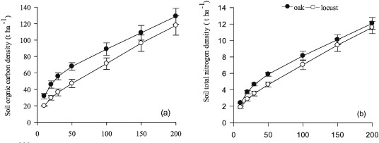
Stocks of SOC and N
128.9 t ha⁻¹
89 t ha⁻¹
117.8 t ha⁻¹
71.4 t ha⁻¹
SOC over area were greater in the oak forest than in the black locust plantation.
N density is consistent with SOC in the two types of forest.

Slide 16
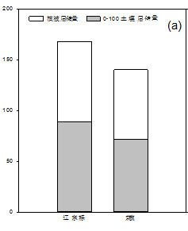
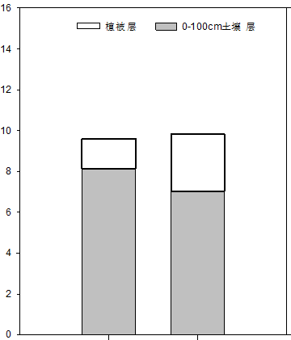
Ecosystem C and N
Biomass
Biomass
Nitrogen density（t ha⁻¹）
Carbon density（t ha⁻¹）
Soil (100cm)
Soil (100cm)
Oak Black locust Oak Black locust
Soil contributes substantial organic carbon accumulation.
Oak forest has greater C stock than black locust plantation.

Slide 17
Comparison with other studies
Xu et al (2003), using database of the national soil survey, 0–20 cm depth SOC density in the Loess Plateau region averaged 24.9 t ha− 1.
This study: 45.90 (oak) and 29.66 t ha⁻ ¹ (black locust)
Li et al (2013), a woodland in this region, 0–100 cm depth SOC density of 26.3 (12.4–83.4) t ha⁻ ¹.
Zhang et al (2014), 61 t ha⁻ ¹ at an arid native shrubland.
This study: 89 (oak) and 71.4 t ha⁻ ¹ (black locust)
The forest ecosystems in this area have substantial C accumulation potential and previous investigation was underestimated. .

Slide 18
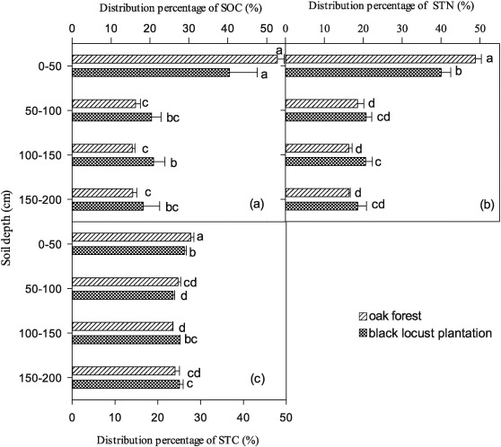
2-m vertical distribution percentage
The upper 50 cm contributed 52.7% and 40.1% for SOC in the oak forest and the black locust plantation, respectively.
Relative to the conventional survey of 100-cm depth, the SOC in 100–200 cm account for 0.45 and 0.65 times in oak forest and black locust plantation, respectively

Slide 19
2-m vertical distribution percentage
Including SIC, the STC in 100–200 cm account for 0.9 to 1.0 times of the 0-100 cm depth.

Slide 20
Implication
In addition to the primary effect of soil conservation, forest restoration in the semiarid loess region contributes greatly to C accumulation, thus to the mitigation of global climate change.
Natural oak forest has advantage over black locust plantation in C and N accumulation.
The deep soil layer (1–2 m) still stores great amounts of C and N in this region.
Inorganic C content is substantial in the loess soil and relatively stable along profiles.

Slide 21
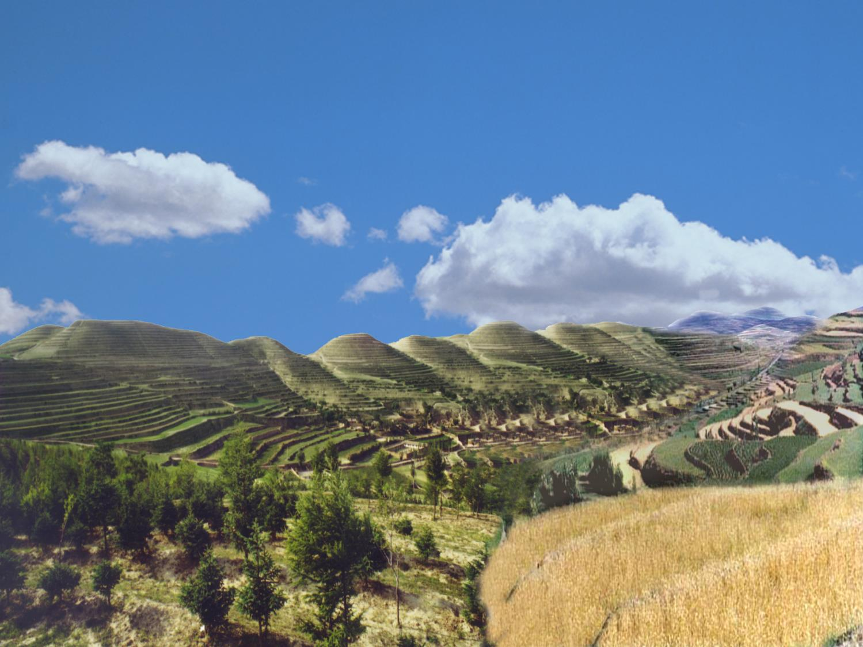
Thank you !

