Slide 2
Proposal Evaluation
David W Chadwick

Slide 3
Three Evaluation Criteria for FP7
Scientific and technical quality
  Soundness of concept and quality of objectives
  Quality and effectiveness of methodology and associated workplan
Implementation
  Management - Quality of participants and the consortium as a whole
  Adequacy and Use of the resources
Impact
  Contribution (European or international) to impacts listed in call
  Appropriateness of measures for dissemination / use

Slide 4
Scoring
Each criteria is scored out of 5
0- The proposal fails to address the criterion under examination or cannot be judged due to missing or incomplete information
1- Poor. The criterion is addressed in an inadequate manner, or there are serious inherent weaknesses.
2- Fair. While the proposal broadly addresses the criterion, there are significant weaknesses.
3- Good. The proposal addresses the criterion well, although improvements would be necessary.
4- Very Good. The proposal addresses the criterion very well, although certain improvements are still possible.
5- Excellent. The proposal successfully addresses all relevant aspects of the criterion in question. Any shortcomings are minor.
Threshold of between 10 to 12 for projects deemed to be fundable

Slide 5
Results of FP7 Call 1
Failure:
  Ineligible
  Below Threshold
Fundable but insufficient funds
Success:
  Retained for negotiation
  317 = 14% of total
Retained
317
Below
Thresholds
1012
Eligible
For
Funding
884

Slide 6
Evaluation Process - Commission Overview
Submission
Individual
reading
Consensus
Panel
with optional
Hearings
Commission
Follow-up
Evaluators
Evaluators
Evaluators
Final ranking
list
Full/short
Proposal
Criteria
Criteria
Criteria
Proposal
forms
Rejection list
Questions
Proposals in
suggested
priority order
Eligibility
Illustration from DG RTD

Slide 7
Evaluation Process – Evaluator’s Viewpoint
Does the proposal have a bright idea (or two)
Do the partners complement each other
Does the proposal match the Call

Slide 8
Evaluation principles
Transparent
  Criteria are laid down in legislation
  Standardised procedures
  The process is observed
  The list of evaluators is made public
    (once selection is made, but not who read which proposal!)
Fair
  It is the proposal that is judged on its merits – not the proposing organisations
  Every proposal is handled the same way whether good or bad
Independent
  Commission officials may not intervene in the judgement of the proposal

Slide 9
Individual Reading
Similar to reviewing a conference or journal paper
Done remotely in reviewer‘s own time
  At home or travelling. Internet access essential for submission of reviewer‘s evaluation report
Strict timetable for completion of reports
Assumed reviewers can evaluate 2 proposals per day
No access to opinion of other evaluators until reviewer‘s own report is completed online
Reviewer‘s scores have to be justified by commenting on the three specific criteria

Slide 10
Individual Evaluation Report - Scientific
Scientific and technical excellence
  Soundness of objectives and quality of objectives
  Progress beyond the state-of-the-art
  Quality and effectiveness of the S/T methodology and associated work plan

Slide 11
What Will Your Project Achieve Scientifically?
A breakthrough – a completely new way of doing things
Do you have leading researchers?
Is the novelty and its benefits clear?
What are the chances of success?
Move a technology closer to widespread adoption
Do you have appropriate user involvement?
Are you integrating existing and novel technologies?
Do you have routes to exploitation?
Address a need of a specific industrial sector
Are the industrial “standard bearers” involved?
Do you have a detailed knowledge of the industry?
Provide support for the implementation/acceptance of aspects of EU policies or programmes
Do you have knowledge of the policies?
Are key committees involved?
Do you have a track record in policy advice?
Bring communities of practitioners together
Are you constructing a network?
Are the leaders there?
Is the network sustainable?

Slide 12
Individual Evaluation Report - Implementation
Quality and efficiency of the implementation and the management
  Appropriateness of the management structure and procedures
  Quality and relevant experience of the individual participants
  Quality of the consortium as a whole (including complementarity, balance)
  Appropriateness of the allocation and justification of the resources to be committed (budget, staff, equipment)

Slide 13
Appropriate Management Structure 1
EC
Project Manager
May be OK for a €3m STREP
Not OK for a large €20m IP
General Assembly
Tech
Board
WP2
WPm
WP3
WPm
WPn
WPm

Slide 14
Appropriate Management Structure 2
EC
Project Manager
Quality Manager
Dissemination Manager
General Assembly
Inappropriate for €3m STREP
IP Manager
Standardisation Manager
May be ideal for a €20m IP
Technical Board
Training Manager
Technical Manager
Collaboration Manager
WP2
WPm
WP3
WPm
WPn
WPm

Slide 15
Things to Consider
Who’s in the General Assembly? Why? 1 rep. per project partner? Or less?
Is there a need for an external body? If so have they agreed to this?
What about links to other running projects?
Have you spelt out the responsibilities of all the entities in the management structure?
Is there a need for a cross WP management actions?

Slide 16
Management Procedures and Processes
Quality Management
Decision Making Procedures
  administrative, technical, at WP and project level
Communications Management
Project Control
Risk Management
Interaction with the EC

Slide 17
Balancing The Consortium
Show the partner balance clearly
    Overlap is not a bad thing, it provides fall-back
Demonstrate skills/ experiences in partner profiles
 | Partner 1 | Partner 2 | Partner 3 | ……. | Partner n
Skill 1 | X
Expertise 1 |  | X | X
Skill 2 |  |  | X |  | X
Experience 1 | X |  |  |  | X

Slide 18
Partner Profiles
Show why you can do what you say you’ll do
  History in the field / activity
  Publication records
  Existing products, R&D, open source
Say who can do it
  Provide brief CVs of key people, showing relevant experience
  But don’t go overboard
    Is the CEO or Vice Chancellor really going to do this?

Slide 19
Justifying Person Effort
Is there enough to get the project done?
Is there an over-abundance of time?
Is there an imbalance between WPs?
  Can all WPs be done for the stated effort?
  Is there an over-supply somewhere?
Is there an imbalance between partners?
  Why and is this justified?
Is there an inappropriate academia/ industrial balance?
  And are they working on the right WPs?

Slide 20
Justifying Travel
Is often a good thing
  Plan for it
  Explain what you expect to get from it
Think hard about it
  What is justifiable?
  What consortium meetings can be electronic?
Dissemination and Standardisation
  Travel is inevitable
  Budget for it

Slide 21
Justifying Other Resources
Equipment
  Does the project need specialist machines?
  Is there a need for mobile demo kit?
  What is the re-use value post project
    Lease or buy?
Sub contractors
  Why are they not in the consortium?
  Do they know that they are to be used?

Slide 22
Individual Evaluation Report - Impact
Potential impact through the development, dissemination and use of project results
  Contribution, at the European and/or international level, to the expected impacts listed in the work programme under relevant topic/activity
  Appropriateness of measures for the dissemination and/or exploitation of project results, and management of intellectual property.

Slide 23
Who Feels the Impact?
  Academics
  - can extend their research into new fields and build upon the project’s technical approaches
  - introduced to new line of science & technology
  - can enhance products to use technologies developed in the project.
  - pass on the benefits of project to their end-users
  - contribute to improved design and functionality of the system via their feedback
  - Incorporate project’s input to new standards
  - as the funding agency, tax payers money well spent
  Research students
  Enterprises
  Suppliers
  End users
  Standards groups
  The EC

Slide 24
Impact Should Be Measurable
Otherwise how do know if it has been achieved?
Examples include
  Website visits, software downloads
  Articles published
  Participation in conferences and exhibitions
  Workshop organisation
  Patents
  Demonstrations
  Licensing agreements
  Spin out companies
  New standards
Impact should bring benefits to partners and wider community

Slide 25
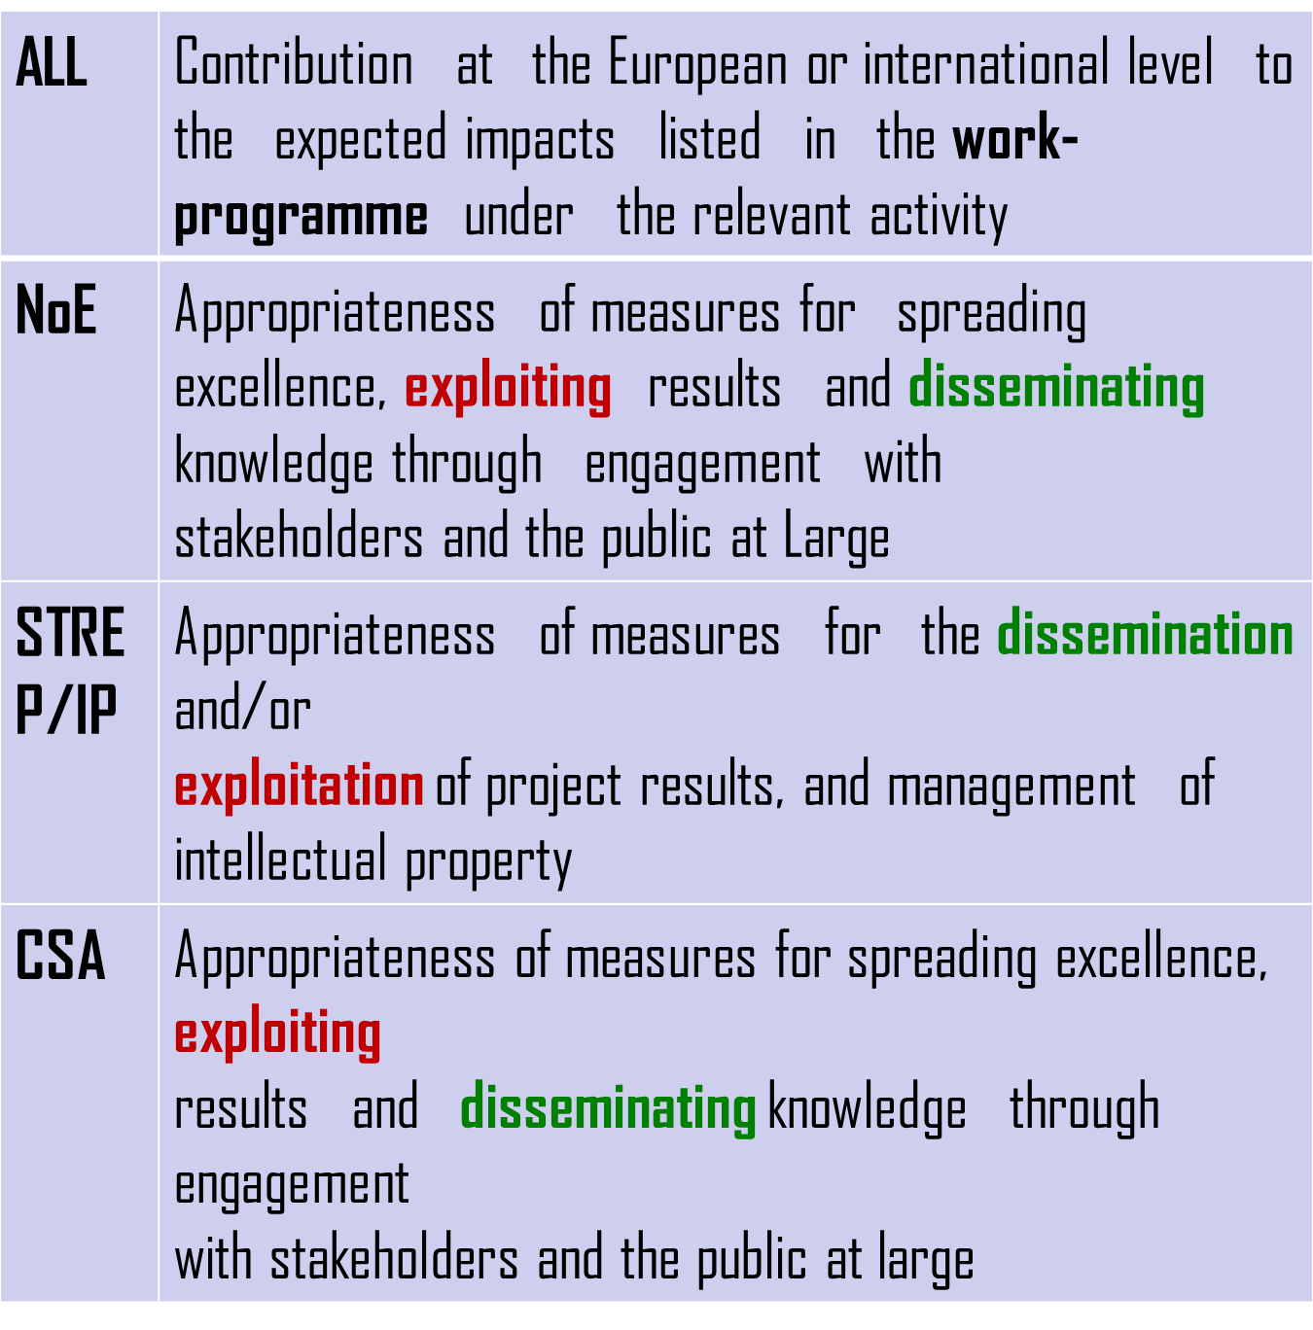
EC’s Definition of Impact

Slide 26
Dissemination
The sharing of project output and results with the wider community in order to build awareness and demand
Show project’s commitment to knowledge sharing
Identify relevant stakeholders and channels to be used to inform them
Example channels: websites, brochures, conferences, newspapers, TV, trade shows etc.

Slide 27
Exploitation
Activities that achieve a commercial return or sustainability benefit for the consortium partners from the project results
Brings tangible benefits to partners
Direct – done by partners, Indirect – done by third parties
Potential routes: licensing, open source projects, new partnerships, new project proposals

Slide 28
Standards
EU has tradition of supporting standards development
Impacts on wider community, increases competition
Benefits to partners who have a head start on others
Partners should be involved in standard’s creation

Slide 29
Other Issues
Say how you will manage the Intellectual Property Rights of both the background and foreground technologies, both during and after the project
Be familiar with concertation meetings of existing related projects
Will you contribute to influencing future work programmes?

Slide 30
To Summarise
Is the scientific idea really novel? In what way? What is really exciting about it?
Do the partners appear to have all the skills necessary to achieve their stated objectives? Why should you succeed where others have not?
Are the costs reasonable?
Are the results likely to be usable and will they contribute to Europe’s scientific competitiveness?
Why is it worth the tax payer taking part of the risk?

Slide 31
In the words of one seasoned reviewer
Experts are quick to form an opinion
  Excellent proposals stand out
  Most proposals are good projects, but not excellent ideas
Time is spent verifying or reforming the opinion and justifying the mark
  To defend the opinion to other evaluators
The evaluator will not necessarily read the sections in order
  Particularly if opening sections are long winded

Slide 32
Consensus meeting
Takes place in Brussels with between 3-5 evaulators, possibly an additional rapporteur, a project officer and possibly an observer
Aim is to get a consensus on an agreed score and the justification for it
If a consensus cannot be achieved, additional evaluators will be asked to read the proposal
Discrepancies between hard and soft markers are noted

Slide 33
Ranking of Proposals
Ranked according to scores
Where scores are equal, the score of one criteria (usually S&T excellence) will determine its order
All evaluators (except those who may have a conflict of interest) are given the opportunity to comment on the ranking order.
This list goes forward and negotiations are usually started in the order given (though EC may wish to ensure that all topics in a call are covered)

Slide 34
Things to Watch Out For
Generic waffle!
  Too many words repeating what is stated in the work programmme
  Motherhood and apple pie statements
Too much highlighting of buzz words
Lack of clarity on what is to be achieved
Weakly described scenario for ensuring outcomes will be achieved
But – if you dont shout about your strengths then you cannot be credited with them

Slide 35
Remember - Horizon 2020
Starts in January 2014 and takes over from FP7
So new evaluation mechanisms will be employed
But the material presented here should still be useful

Slide 36
Acknowledgements
Thanks to presentations by
  Costis Kompis, Vodera Ltd
  Tim Courtney
  The UK FP7 National Contact Point
  Monica Schofield, TuTech Innovation GmbH
  The EC
For information and material that has been used in this presentation

Slide 37
Any Questions??????
gabriella.calderari@uniroma1.it
d.w.chadwick@kent.ac.uk

