Slide 1

training & research
for academic newcomers
A project of the King Baudouin Foundation
Notes:
Please use this slide at the beginning of your presentation.
Background color: red-120; green-150; blue-150; transparancy-80%

Slide 2

Education and Training Programme
Gabriella Calderari
David W Chadwick
Notes:
Second slide.

Slide 3
Overview
Tempus Programme
Tempus and Erasmus Mundus
How to submit a Tempus proposal
Forms
Themes
Partnership
Proposal structure
Activities
Budget
Submission

Slide 4

http://eacea.ec.europa.eu/tempus/
Trans-European Mobility scheme for University Studies.
TEMPUS is the European Union’s programme which supports the modernization of higher education in the EU's surrounding area.
The overall objective of Tempus is to contribute to the creation of an area of cooperation in the field of higher education between the European Union and the Tempus Partner Countries.
Notes:
If you want you can use this template for you presentation, see potx-file.

Slide 5
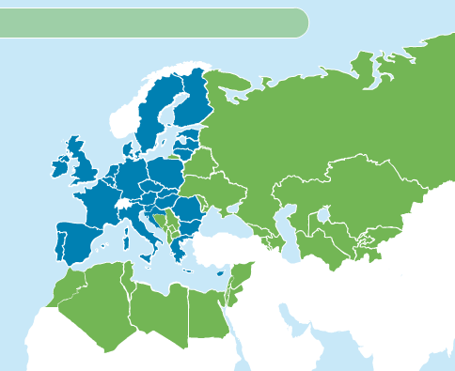
Eligible Countries
Partner Countries:
Eastern Europe,
Central Asia,
the Western Balkans
Mediterranean region.

Slide 6

Lifelong
Learning
Programme
Tempus,
Alfa, Edulink, Bilateral
Programmes
International
higher education
programmes:
Erasmus Mundus
Youth in Action Programme

Slide 7
Specific Objectives of TEMPUS
To promote the reform and modernisation of higher education in the Partner Countries;
To enhance the quality and relevance of higher education to the world of work and society in the Partner Countries;
To increase the capacity of higher education institutions in the Partner Countries and the EU, in particular their capacity to cooperate internationally and to continually modernize;
To assist them in opening up to the world of work and the society at large in order
  to overcome inter-country fragmentation in the area of higher education and inter-institutional fragmentation in the countries themselves;
  enhance inter-disciplinary thinking and working within and between faculties and universitiesarity and trans-disciplinarity between university faculties;
  enhance the employability of university graduates;
  make the European Higher Education Area more visible and attractive to the world;
To foster the reciprocal development of human resources;
To enhance mutual understanding between the peoples and cultures of the EU and the Partner Countries.

Slide 8
TEMPUS
Tempus IV finances two types of projects through calls for proposals
  Joint Projects
  Structural Measures (through call for proposals)
  (+ direct support to Ministries)
  Other: Accompanying Measures (tenders/framework contracts)

Slide 9
TEMPUS ACTIONS
Joint Project
Structural Measures
Projects with a ‘bottom-up’ approach aiming at modernization and reform on an institutional level. Joint Projects aim at transferring knowledge between universities from the EU and from the partner countries and between partner country entities.
seek to contribute to the development and reform of HE systems in partner
countries, as well as enhance quality and relevance and increase convergence with EU developments interventions designed to support structural reform of HE systems and the strategic framework development
at National level.
Notes:
If you want you can use this template for you presentation, see potx-file.

Slide 10
TEMPUS Joint Projects
1- Curricular reform:
adapt, modernise and restructure existing curricula with a focus on content, structure, teaching methods and the use of new teaching materials.
establish study programmes with a double or multiple degree or a joint degree;
establish links with the labour market.
2- Governance reform:
modernise the capacity, management and governance of higher education institutions
promote a quality assurance culture
3- Higher education and society:
strengthen the role of higher education institutions in society at large
address the "knowledge triangle" of education, research and innovation (project must not focus on research)
encourage links between higher education institutions and the labour market

Slide 11
TEMPUS Structural Measures
Projects implemented at national level for the development and reform of the national higher education structures and systems in the partner countries:
1- Governance reform (licensing, accreditation, qualification frameworks, quality assurance, autonomy…)
2- Higher education and society (links between different sectors of education, with the world of work, capacity building for public administration…)

Slide 12
TEMPUS ERASMUS+
Erasmus+ will be new EU programme to support initiatives in the areas of education, training, youth and sport. It will bring together all current EU and international schemes in these areas, including the current Lifelong Learning Programme (Erasmus, Leonardo da Vinci, Comenius, Grundtvig), international programmes (Erasmus Mundus, Tempus, Alfa, EduLink and bilateral programmes) and the Youth in Action Programme.
The overall budget foreseen for Erasmus+ will be approximately
€14.5 billion

Slide 13
The education and training element of the programme will concentrate on
learning mobility for individuals, by providing support for international study, training, teaching and volunteering opportunities;
cooperation for innovation and the exchange of good practices, by supporting cross-institutional and cross-sectoral exchange and partnerships between education and training institutions and the world of work;
support for policy reform, by promoting the implementation of EU transparency and recognition tools, and continuing the policy dialogue with European stakeholders in education and training.

Slide 14
Design a new proposal!
Identify your partnership
Verify Regional and National priorities
Grant size and duration
Design the project structure
Fill the forms
Compile the budget

Slide 15
Partnership
Projects with multiple
partners from the same Country
Single country projects
For national projects, proposals must be submitted by groupings of institutions involving:
- at least three higher education institutions from a partner Country
- at least three higher education institutions from the EU, each from a different EU Member State.
Notes:
If you want you can use this template for you presentation, see potx-file.

Slide 16
Partnership
Multi- country project
Projects with multiple
partners from different Countries
Submitted by groupings of institutions involving:
- at least two higher education institutions, from each of the participating partner countries (minimum two partner countries) involved in the proposal (with the exception of Kosovo and Montenegro where the requirement is one higher education institution from each),
- at least three higher education institutions, each from a different EU Member State.
Notes:
If you want you can use this template for you presentation, see potx-file.

Slide 17
How to find the right partners
Attending Infodays
Existing contacts
Checking requests for Partners in TEMPUS-TALK
Contacting National TEMPUS Office
http://eacea.ec.europa.eu/tempus/tools/contacts_national_tempus_offices_en.php
Notes:
If you want you can use this template for you presentation, see potx-file.

Slide 18
Priorities
National Priorities (Annex 7-8): The national priorities were established in close consultation between the EU Delegations and Ministries responsible for higher education in the Partner Countries. National priorities are set for both types of eligible activities, Joint Projects and Structural Measures.
Regional Priorities (Annex 9-10): The regional priorities are based on the EU's policy for cooperation with the Partner Countries‘ regions as identified in its strategic documents concerning the neighbouring countries. Regional priorities are established for both types of eligible activities, Joint Projects and Structural Measures.
Cross-cutting priorities: Priority will be given to projects focusing on subject areas insufficiently covered by past or existing projects and which include Partner Country higher education institutions not having benefitted under Tempus IV.

Slide 19
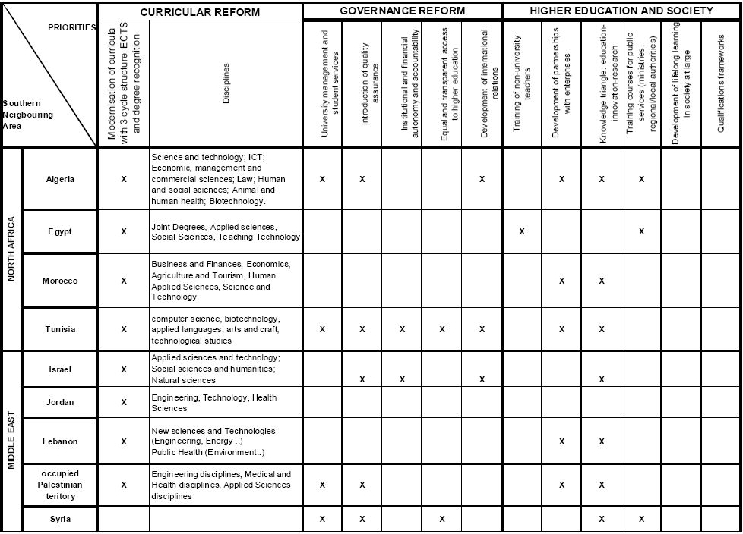
National Priorities
Project must fit Country or regional priorities
Annexes 7-10 of Fourth Call Application Guidelines

Slide 20
Grant size and duration
Joint Projects and Structural Measures
Minimum
€500,000
Maximum
€1,500,000
Minimum grant size for countries with annual budgets below € 1 million: €300,000 (Albania, Montenegro, Central Asia)
The applicant must co-finance at least 10% of the eligible direct costs
Project duration: from 24 to 36 months
Notes:
If you want you can use this template for you presentation, see potx-file.

Slide 21
APPLICATION PACKAGE:
The Application Package consists of the following items:
Part 1 Application form (the eForm): Adobe form that is downloaded to your local computer, completed and then submitted electronically
Part 2 Declaration of Honour by Legal Representative of Applicant Organisation
Part 3 Detailed Workplan and Budget tables
Part 4 Logical Framework Matrix (LFM)
Part 5 Mandates
Part 6 Legal Entity Form
Part 7 Financial Identification Form: (applicant organisation only)
Applicant organisations that do not have the status of a "Public Body"
Part 8 Profit and loss accounts (applicant organisation only)
Profit and Loss Accounts, balance sheet for the last three financial years in which the accounts have been closed (if applicable).

Slide 22
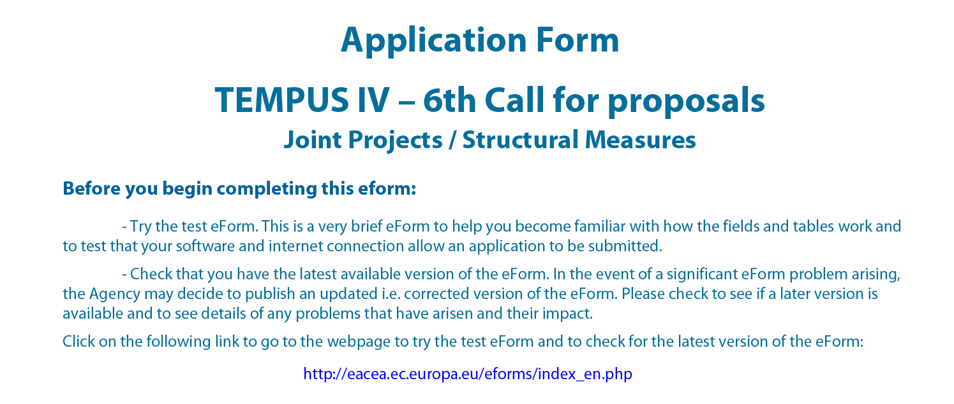
FORMS
http://eacea.ec.europa.eu/eforms/index_en.php#1
Notes:
If you want you can use this template for you presentation, see potx-file.

Slide 23
Detailed Workplan: Workpackages
The application must be structured by Workpackages: Workpackage types listed above has to be included:
Management (MNGT): Activities ensuring the sound management of the project,
Development (DEV): The substance of the work planned including production, testing etc,
Quality Plan (QPLN): Quality control and monitoring, internal and external evaluation,
Dissemination (DISS): Provision information and awareness raising about the project and its achievements,
Exploitation of results (EXP): Sustainability of the project results used by end-beneficiaries during and beyond the
project lifetime.
Notes:
If you want you can use this template for you presentation, see potx-file.

Slide 24
Deliverables / outcome
Teaching material
Learning resources
Training
Reports
Events
Methodology
Other products
Notes:
If you want you can use this template for you presentation, see potx-file.

Slide 25
Eligible activities
Teaching/training assignments for Partner Country staff/trainers
Teaching/training assignments for European Union staff/trainers carried out on the premises of the beneficiaries in the Partner Countries;
Retraining and update courses for Partner Country staff carried out on the premises of the beneficiaries in the European Union or the Partner Countries;
Practical placements in companies, industries and institutions for Partner Country teaching/administrative staff and trainees carried out in the European Union or Partner Countries participating in the project;
Notes:
If you want you can use this template for you presentation, see potx-file.

Slide 26
Eligible activities
Meetings for management, coordination, planning, monitoring and quality control activities, carried out in the European Union or Partner Countries;
Workshops and visits for dissemination purposes to other parties in the Partner Countries participating in the project (other educational institutions, regional education authorities, business community, institutions);
Language training for a well-defined target group of teaching/administrative staff from the Partner Country in the Partner Country itself wherever possible;
Inter-project coaching
Notes:
If you want you can use this template for you presentation, see potx-file.

Slide 27
Budget and grant
Direct costs
Maximum 40% of the total eligible direct costs
Staff costs
Travel costs and costs of stay
Costs for printing and publishing
Equipment costs
Other costs
Maximum 30% of the eligible direct costs
Maximum 7% of the eligible direct costs
Indirect costs
Notes:
If you want you can use this template for you presentation, see potx-file.

Slide 28
Eligible Costs
necessary for the implementation of the action/project,
necessary and reasonable for the completion of the action/project
included in the estimated budget attached to the agreement
incurred during the lifetime of the action/project as defined in the agreement
consistent with the principles of sound financial management, in particular in terms of value for money and cost effectiveness
incurred by the beneficiary and its partners
recorded in the beneficiary’s accounts in accordance with the applicable accounting principles
declared in accordance with the requirements of the applicable tax and social legislation
identifiable and verifiable and be backed up by original supporting documents
Notes:
If you want you can use this template for you presentation, see potx-file.

Slide 29

Staff Costs
Cost of staff assigned to the action/project, including actual salaries plus social security charges and other statutory costs included in their remuneration, provided that they do not exceed the maximum rates listed in Annexes 1 and 2.
Notes:
If you want you can use this template for you presentation, see potx-file.

Slide 30

Printing and publishing costs
All costs relating to printing (paper, electronic, web) publishing and photocopying of teaching material and any other documentation necessary to reach the objective of the project should be recorded under this
heading.
Notes:
If you want you can use this template for you presentation, see potx-file.

Slide 31
Indirect costs
Indirect costs can be allocated up to a flat rate of 7% of the eligible direct costs.
Indirect costs may, for example, cover stationery, general photocopying, office supplies, postal and telecommunication costs directly related to the project.

Slide 32
Travel Cost and Cost of Stay
Travel and subsistence allowances for staff and students taking part in the action/project (for meetings, European conferences, training, study periods etc.), if in line with the usual practices of the beneficiary.
Subsistence allowances may not exceed the
maximum rates in the tables in Annex 3;
Notes:
If you want you can use this template for you presentation, see potx-file.

Slide 33
Other Costs
Other expenses necessary for the implementation of the project which do not clearly fit into other budget headings.
dissemination of information (advertising in the media, promotional materials
such as pens, bags, posters, renting of premises for dissemination events with
prior written approval only)
specific external evaluation of the an activity or action (including expert fees
for this specific purpose)
audits, inter-project coaching (up to a maximum of €2500)
bank charges including bank guarantee charges where requested by the European Commission
external language courses
external IT courses
external translation services
Notes:
If you want you can use this template for you presentation, see potx-file.

Slide 34
Ineligible Costs
return on capital, debt and debt service charges
provisions for losses or potential future liabilities
interest owed
exchange losses
VAT, unless the beneficiary can show that he is unable to recover it
costs declared by the beneficiary and covered by another action or work programme receiving a Community grant
excessive or reckless expenditure
expenses for travel to or from countries other than those participating in the project/programme, unless explicit prior authorisation is granted by the Commission.
expenses incurred outside the eligibility period.
Contributions in kind shall not constitute eligible costs.
Notes:
If you want you can use this template for you presentation, see potx-file.

Slide 35
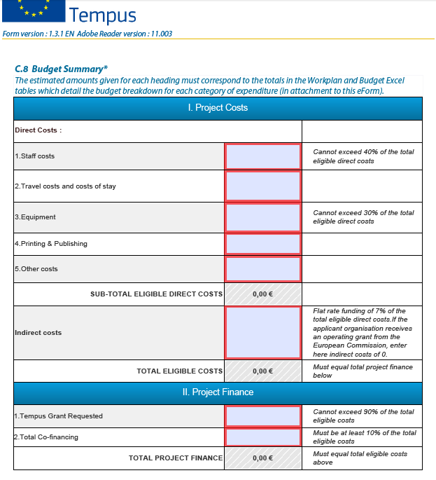

Slide 36
Key factors of successful projects
Sustainability demonstrate how the work achieved will continue after the project life-time | Quality control demonstrate how you will ensure the objectives you plan are reached and effective
Dissemination plan courses and conferences to ensure your work is known widely in the country(ies) in question and others where it would apply | Monitoring use an external consultant or inter-TEMPUS coaching
Notes:
If you want you can use this template for you presentation, see potx-file.

Slide 37
Submission
The duly completed electronic applications forms for Joint
Projects and Structural Measures must be sent
A complete paper copy of the submitted eForm together with additional documents (see Application Guidelines) must be sent by post to the Agency by the deadline (date of postmark) to the following address:
Education, Audiovisual and Culture Executive Agency
Tempus & Bilateral Cooperation with Industrialised Countries
Call for Proposals EACEA/32/10
Office: BOUR 2/17
Avenue du Bourget 1
1140 Bruxelles/BrusselBELGIQUE/BELGIË
Notes:
If you want you can use this template for you presentation, see potx-file.

Slide 38
Thank you!
gabriella.calderari@uniroma1.it
d.w.chadwick@kent.ac.uk

