Slide 1

training & research
for academic newcomers
A project of the King Baudouin Foundation

Slide 2

Project Reporting
Gabriella Calderari
David W Chadwick

Slide 3
OVERVIEW
Technical reporting
Financial reporting
Reporting Forms
Supporting Documents
Financial Audit

Slide 4
REPORTING
PROJECT REPORTS
Technical
Financial

Slide 5
Technical reports
Deliverables
Periodic technical report
Final tecnical report
    An overview of the progress of work towards the objectives of the project including achievements of any milestones and deliverables as defined in Annex I
    any supplementary reports required by any Annex to the contract, especially Annex I (technical annex)
    Publishable Summary

Slide 6
Financial reports
Costs reports
Management reports
Audit certificate
    an explanation of the use of the resources
    a Financial Statement (Form C) from each beneficiary together with a summary financial report
    and if requested an audit certificate per contractor

Slide 7
All reports must
  be submitted within the contractual delays (60 days after the end of the reporting period)
  be organized by work packages and tasks
  identify the contributions from the various participants
  respect the reporting guidelines
  respect the page limit where applicable
  be concise and clear

Slide 8
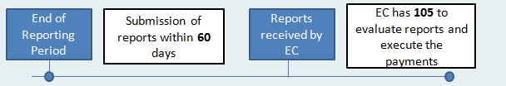
Reports Timeline
  Reporting periods: temporary periods corresponding to a project technical and financial check (defined in Art. 4 of the Grant Agreement)
After reception Commission may:
  Approve
  Suspend the time-limit requesting revision/completion
  Reject them giving justification, possible termination
  Suspend the payment
  No tacit approval of reports: Automatic payment of interest

Slide 9
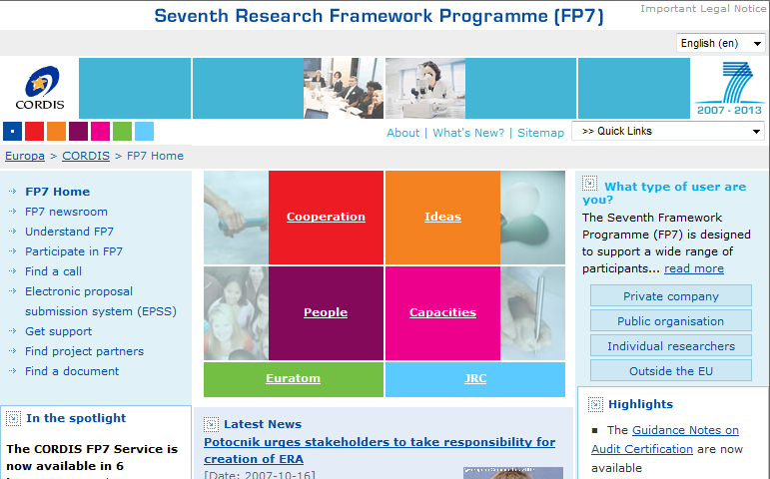
Reporting templates
  All the templates are accessible on CORDIS website under the session “Find a Document”

Slide 10
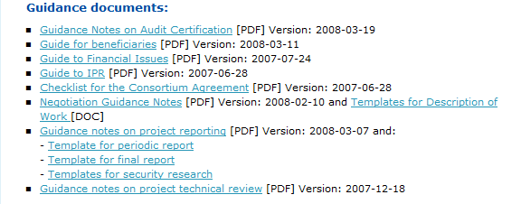

Link: http://cordis.europa.eu/fp7/find-doc_en.html

Slide 11
FORCE
FORCE = FORm C Editor.
Management Platform implemented across FP7 as the way to prepare and submit Form C (although not yet used for all FP7 projects: some use NEF).
FORCE is used for:
  Preparing Form Cs, which will be pre-filled with updated and correct contract/grant information of each beneficiary participating in the project/grant
  Electronic submission of Form Cs to the Commission (signed paper version to be sent afterwards)
  Correction of Forms C if EC does not approve them
  Printing Form Cs for signature of relevant authorizing officer

Slide 12
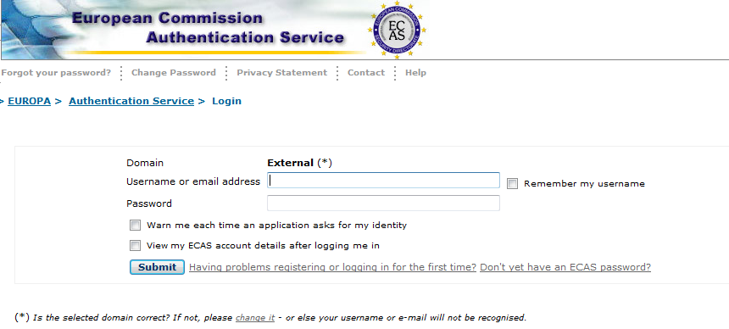
How to register..
https://webgate.ec.europa.eu/cas/login

Slide 13
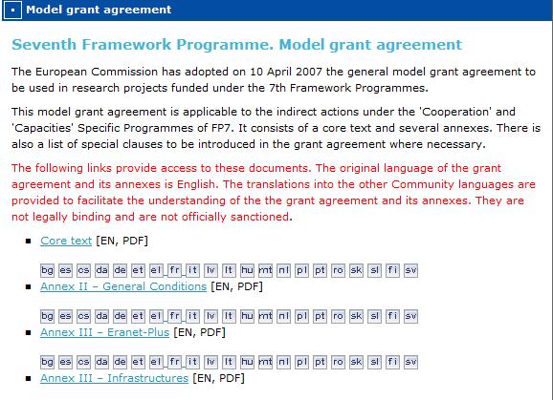
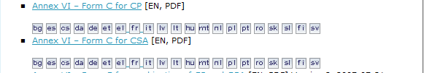
Financial Statements – Form C (PDF)
http://cordis.europa.eu/fp7/find-doc_en.html
Notes:
.

Slide 14
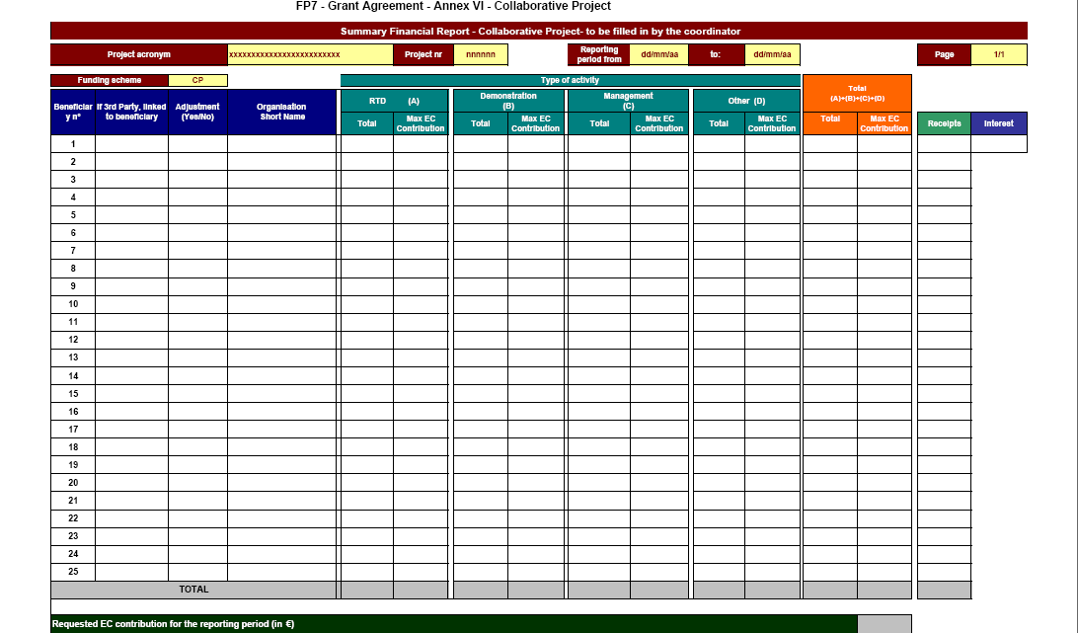
Form C – Collaborative project (a)

Slide 15
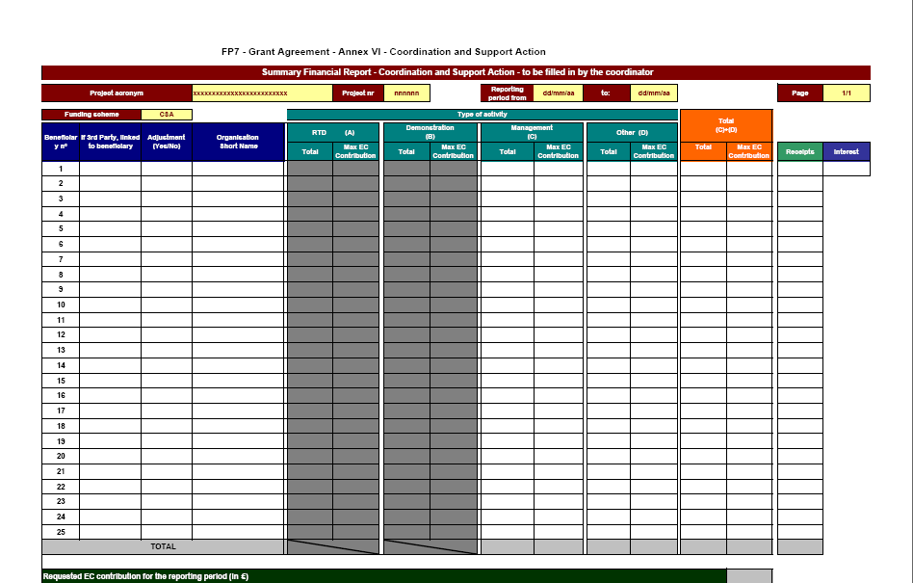
Form C – Coordination Support Action (a)

Slide 16
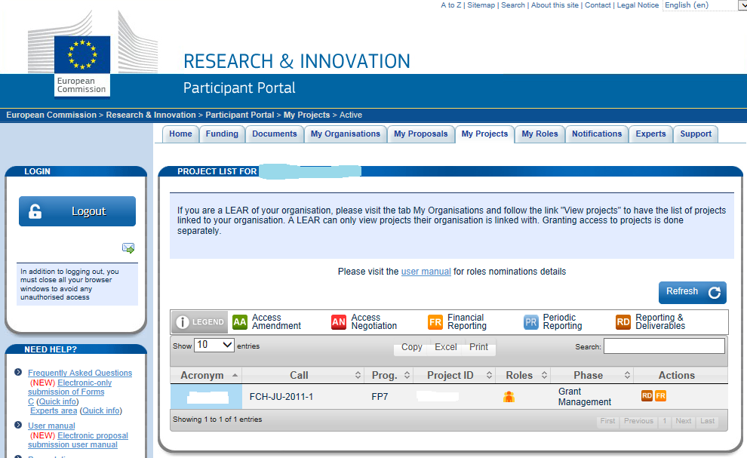
Participant Portal (NEF)
Notes:
NEF – negotiation forms

Slide 17
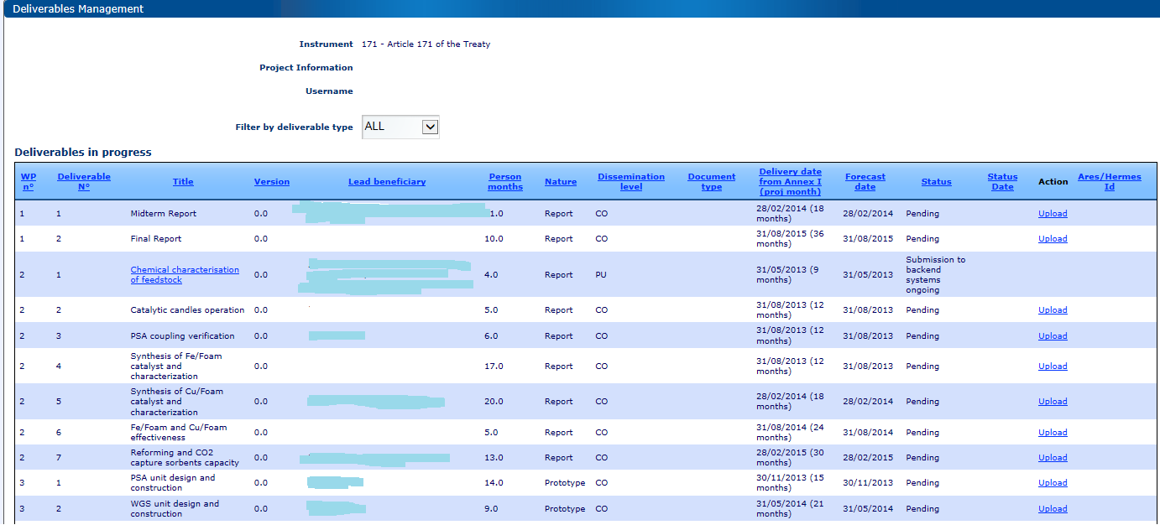
Deliverables and Milestones
  By filling in this table, the coordinator inform the Commission about the status of each deliverable and milestones

Slide 18
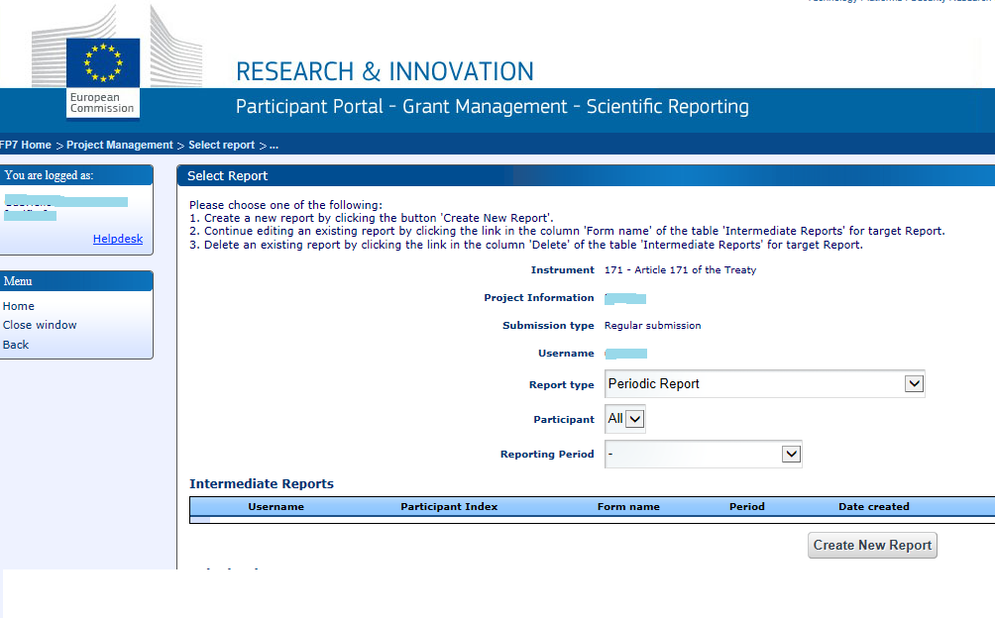

Slide 19
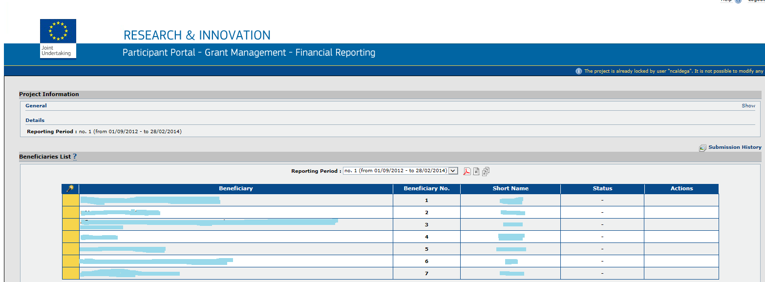
Financial Statements
Each beneficiary at the end of each reporting period has to fill in its own financial statement
FORM C templates are provided on the NEF website in the Section Financial Reporting

Slide 20
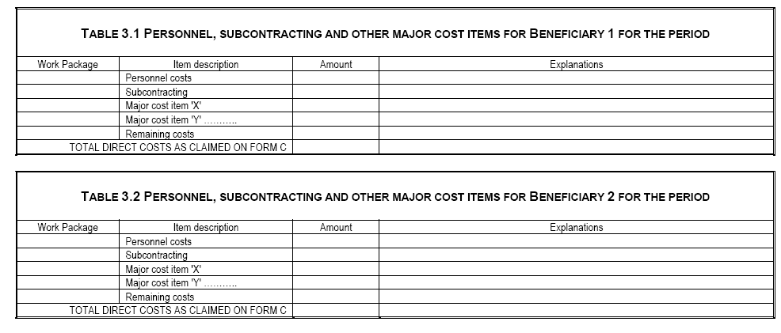
Explanation of the use of the resources

Slide 21
SUPPORTING DOCUMENTS
PERSONNEL COSTS:
List of personnel indicating:
  period(s) they worked for the project,
  position classification / category.
Copies of employment/work contracts (temporary and permanent), including CVs (dated and signed)
Copies of certified time sheets including summary records for all personnel charged to the project.
Copies of payrolls for all personnel charged to the project.
Copy of bank transfers/payment receipts

Slide 22
Time Sheet
Time sheets must contain:
  Title and project account number;
  full name of beneficiary as indicated in the GA;
  full name and a signature of the employee directly contributing to project;
  time period concerned (for instance on daily, weekly, monthly basis) according to the beneficiary's normal practice;
  amount of hours or days claimed on the project.
  full name and a signature of a supervisor (person in charge of the project).
  Indication of all other projects/activities the employee is involved in

Slide 23
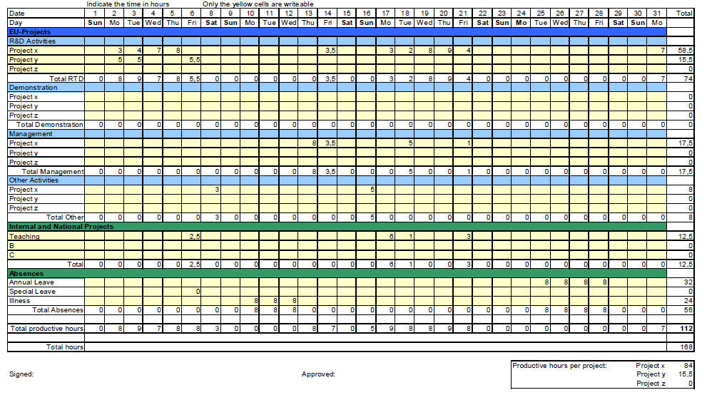
Time Sheet

Slide 24
SUPPORTING DOCUMENTS
Durable equipment
Copy of the contractor's guidelines for procurement of durable equipment (if available).
Original invoices for purchase of equipment.
Copies of the equipment (related to the project) inventory register.
Copies of the equipment's usage diary/register (for equipment used by different projects)

Slide 25
SUPPORTING DOCUMENTS
Consumables
Copy of the contractor's guidelines for procurement of consumables (if available)
Original invoices for consumables
Proof of payment
Notes:
.

Slide 26
SUPPORTING DOCUMENTS
Travel and subsistence
Copy of the meeting agenda or of any other document relevant to demonstrate the relation between the mission and the objectives of the journey
Copy of the contractor's guidelines for reimbursement of travel expenses.
Copy of authorized travel request forms
Original invoices for travel and accommodation expenses
Copy of EC agreement for travels outside Western Europe (if applicable)
Copies of mission reports (if available)

Slide 27
SUPPORTING DOCUMENTS
Other costs
Copy of the contractor's relevant guidelines
Original invoices for the relevant expenditure
Copy of EC agreement for the relevant expenditure
Subcontracts
Copy of the contractor's guidelines for procurement of services (if available).
Original invoices for external assistance and evidence of delivery
Copies of subcontracts

Slide 28
CERTIFICATE ON FINANCIAL STATEMENTS (CFS)
For each period for which an audit certificate is required (typically ≥ €375,000), each contractor shall provide an audit certificate prepared and certified by an external auditor:
certifying that the costs incurred during that period meet the conditions required by this contract.
The certificate should expressly state the amounts that were subject to verification.
The cost of this certification is an eligible cost under the activity relating to Management of the consortium, under the budget heading “subcontracts”.

Slide 29
AUDITING
External auditor must be:
independent from the contractor;
qualified to carry out statutory audits of accounting documents in accordance with the 8th Council directive 84/253/EEC of 10 April 1984 or similar national regulations.
Each contractor is free to choose any external auditor, including its usual external auditor

Slide 30
Default interests (art.II.21.5)
Possible sanctions:
Reduction of the Grant (art. II.18.5)
Termination of the Grant Agreement (art. II.38
Recovery of the Grant (art. II.21)
Suspension of payments (art. II.5.3)
Suspension of contract (art. II.8)
Liquidation of damages (art. II.24)

Slide 31
Thank you!
gabriella.calderari@uniroma1.it
d.w.chadwick@kent.ac.uk

