Slide 1

training & research
for academic newcomers
A project of the King Baudouin Foundation
Notes:
Please use this slide at the beginning of your presentation.
Background color: red-120; green-150; blue-150; transparancy-80%

Slide 2

Preparing an RTD Project Proposal
Gabriella Calderari
David W Chadwick
Notes:
Second slide.

Slide 3
OVERVIEW
Register a proposal
Part A
Part B
Participation Modalities
Project activities
Build a budget

Slide 4

Where everything starts:
Project IDEA
Never adapt your idea to the Call, but find the right Call for your idea!
Notes:
If you want you can use this template for you presentation, see potx-file.

Slide 5

Where to find the right Call
http://cordis.europa.eu/fp7/cooperation/home_en.html
Notes:
If you want you can use this template for you presentation, see potx-file.

Slide 6
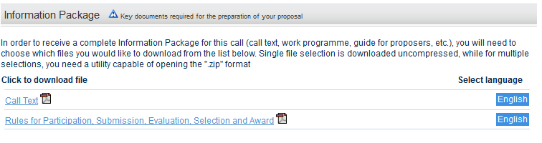
INFO PACK
Call text
Rule for Participation, submission, Evaluation, Selection and Award

Slide 7
FIRST STEPS
Read the Work program accurately
Read the Guidelines
Contact you NCP
Participate in the Infodays
Identify the expertise necessary to implement your idea
Consider the deadline

Slide 8
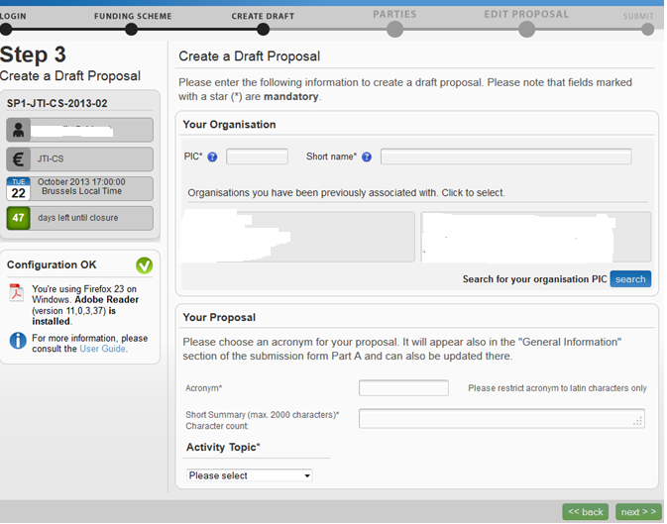
REGISTER THE PROPOSAL
If you are the coordinator , you have to access the participal portal and register the new proposal, inserting the PIC number of all your partners.

Slide 9
PIC NUMBER
Participant Identification Code
All organisations participating in FP7 will be assigned a Participant Identification Code (or PIC). The organisations that already have signed an FP7 grant agreement have already been assigned a PIC. Organisations without a signed FP7 grant agreement may obtain a PIC by registering in the Unique Registration Facility (URF) which is hosted in the Participant Portal(http://ec.europa.eu/research/participants/portal/page/home). The PIC can then be used for proposal submission.
How to find out your organisation's PIC:
First, try to find out within your organization who is the LEAR of your organisation; he will be able to tell you what the PIC is. If you still cannot find the PIC of your organization, then please query online our PIC database by using the
PIC search functionality (http://ec.europa.eu/research/participants/portal/appmanager/participants/portal?_nfpb=true&_pageLabel=searchorganisations#wlp_searchorganisations).
How to register your organisation in URF:
You will have to first create an ECAS account (European Commission Authentication System) in order to access the Participant Portal and its underlying services such as the Unique Registration Facility (URF). The PIC is provided at the end of the registration process and can be used for proposal submission after 48 hours. During registration, URF does not check for duplicate registrations; this will be done if your proposal is retained for negotiation. If there is a duplicate registration your PIC will change and you will learn about it during negotiation.

Slide 10
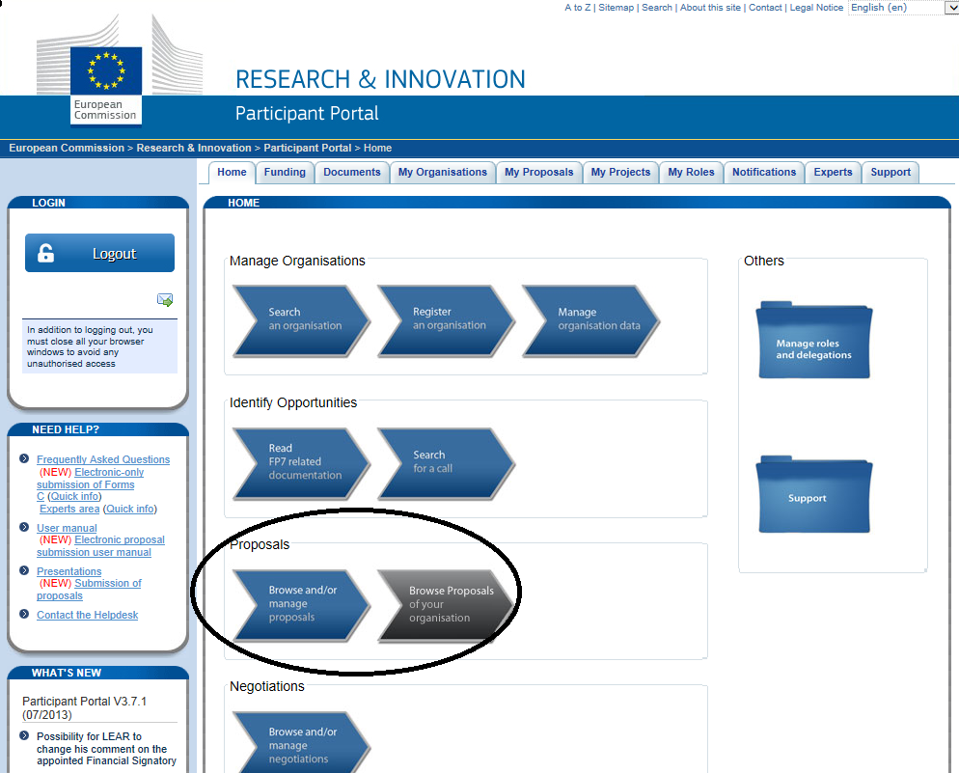
NEF System
Participant Portal
Notes:
If you want you can use this template for you presentation, see potx-file.

Slide 11
PROPOSAL
Part A
Part B
GENERAL INFORMATION, PARTICIPANTS, BUDGET
SCIENTIFIC AND/OR TECHNICAL QUALITY, RELEVANT TO THE TOPICS ADDRESSED BY THE CALL | CONCEPT OF YOUR PROJECT AND S&T OBJECTIVES
IMPLEMENTATION | ORGANISATIONAL STRUCTURE AND DECISION-MAKING MECHANISMS OF THE PROJECT
IMPACT | EXPECTED IMPACTS ON RESEARCH AND MARKET AND EUROPEAN APPROACH
ETHICAL ISSUES | ETHICAL ISSUES THAT MAY ARISE IN THE PROPOSAL
1:
.
Notes:
If you want you can use this template for you presentation, see potx-file.

Slide 12
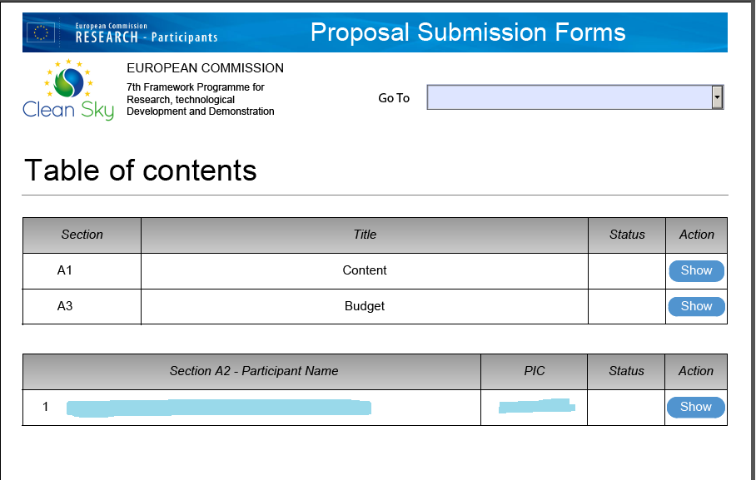
FORMS A
Examples of Forms

Slide 13
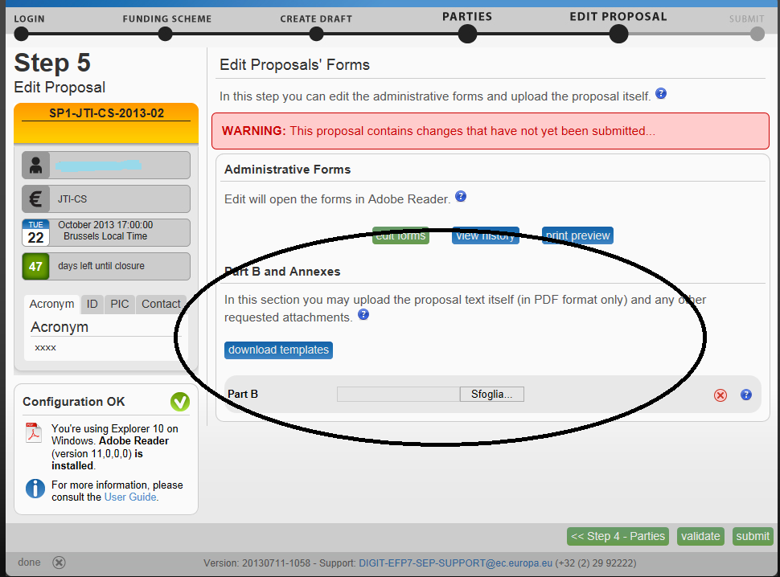
PART B

Slide 14
PART B
1.SCIENTIFIC AND TECHNICAL QUALITY
1.1Progress beyond the State of the Art
1.2Scientific and Technology methodology and work plan:
    Work package list (table 1);
    Deliverables list (table 2);
    Milestones List (table 3);
    Description of each work package (table 4);
    Summary effort table (table 5)
2.IMPLEMENTATION
2.1 Management structure and procedures
2.2 Participant(s)
2.3 Resources to be committed
3. IMPACT
3.1 Expected impacts
3.2 Dissemination and/or exploitation of project results, and management of intellectual property
4.ETHICAL ISSUES
5.CONSIDERATION OF GENDER ASPECTS

Slide 15
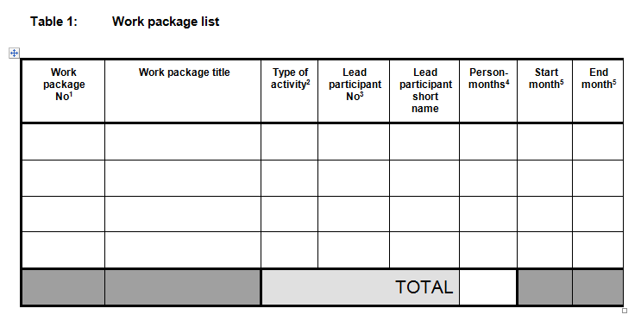
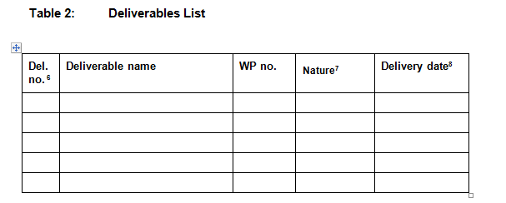
Work Package List
Deliverables List

Slide 16
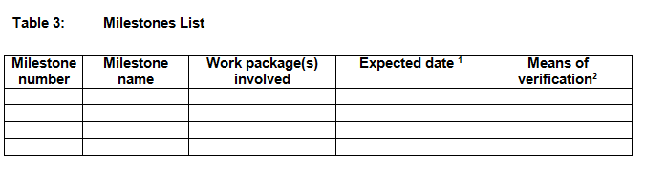
MILESTONES
Milestones are control points where decisions are needed with regard to the next stage of the project. For example, a milestone may occur when a major result has been achieved, if its successful attainment is required for the next phase of work.
Notes:
E.g. Complete Design verified by sponsor approval

Slide 17
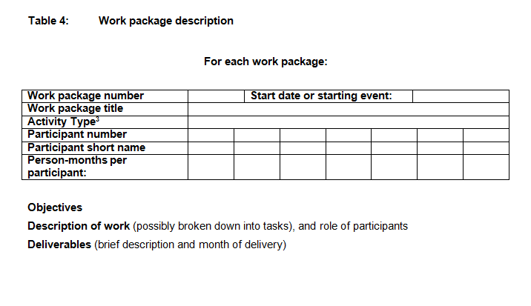
Table 4: Work package description

Slide 18
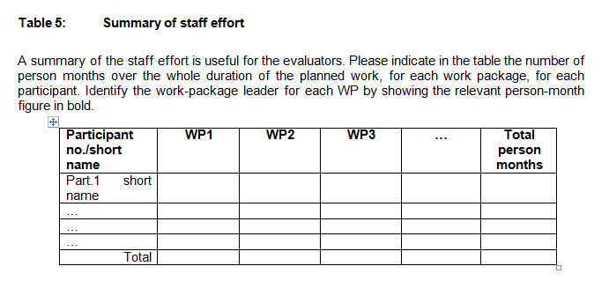
PERSON MONTHS
Person-month is a measure of work effort. Other similar measures are person-day and person-year.

Slide 19
PROJECT ACTIVITIES
Activities aimed at achieving new scientific knowledge, without pursuing commercial and industrial aims
Activities aimed at achieving new scientific knowledge, whose tangible outputs could be used to improve quality of products already on the market
Scientific coordination
RTD activities
Notes:
If you want you can use this template for you presentation, see potx-file.

Slide 20
PROJECT ACTIVITIES
Demonstration activities
Demonstration activities aim at proving the viability of new technologies that offer a potential economic advantage, but which cannot be commercialized directly (e.g. testing of products such as prototypes).
Dissemination
Networking activities
Coordination
IPR protection
Exploitation of foreground
Training
Management
Other activities
Notes:
If you want you can use this template for you presentation, see potx-file.

Slide 21
ELEGIBLE PARTICIPANTS
• Any undertaking, university or research centre or other legal entity, whether established in a:
- Member State (MS), or
- Associated country (Ac) , or
candidate country, or
• International organisations and participants from third countries can participate only if in addition to the minima
Notes:
If you want you can use this template for you presentation, see potx-file.

Slide 22
CONDITIONS FOR PARTICIPATION
• Minimum number, as a general rule at least 3 independent participants
from 3 different Member States (MS) or Associated countries (Ac)
– Joint Research Centre (JRC) - is deemed to be established in another
MS or Ac
• Additional conditions can be established by the work programme or
specific programme (number or type of participant, place of establishment)
• Specific conditions apply for:
– For specific cooperation actions dedicated to International
Cooperation Partner Countries (ICPC) – minimum is 4 participants, 2
of which from MS or Ac and another 2 from ICPC countries unless
otherwise foreseen in work programme
Notes:
The JRC provides independent scientific and technical advice to the European Commission to support a wide range of EU policies. The JRC has seven scientific institutes, located at six different sites in Belgium (Brussels and Geel), Germany (Karlsruhe), Italy (Ispra), the Netherlands (Petten) and Spain (Seville), with a wide range of laboratories and unique research facilities. Its headquarters are located in Brussels.

Slide 23
PARTICIPATION MODALITIES
Every legal entity directly contributing to project activities and with a contractual link with the Community
Direct Beneficiary
Only in exeptional cases and if their participation is clearly identified in the Annex I
Third parties
Third parties carrying part of the work
Third parties making available resources
Subcontracted activities must be a “minor task”
Cannot take place between beneficiaries
Cannot be used to fund a legal entity that would not have been eligible for funding under the FP
Coordinator’ tasks cannot be subcontracted
Subcontractors
Notes:
If you want you can use this template for you presentation, see potx-file.

Slide 24
ROLE OF THE COORDINATOR
Contractually, the Coordinator:
• Administers the EC Contribution
• Keeps the records and financial accounts
• Informs the EC of the distribution of Funds
• Reviews the reports to ensure consistency with the tasks foreseen
• Monitors the compliance of beneficiaries with their contractual obligations
• Must be financially viable
Notes:
If you want you can use this template for you presentation, see potx-file.

Slide 25
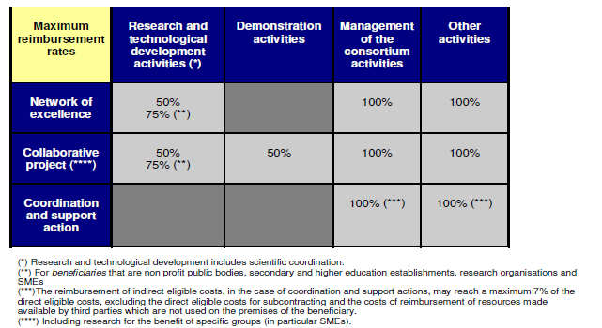
PROJECT BUDGET
Upper funding limits
Notes:
If you want you can use this template for you presentation, see potx-file.

Slide 26
ELIGIBLE COSTS
can be directly attributed to the project
either actual overhead or simplified method
Direct
Indirect
• actual
• incurred during the lifetime of projects
• in accordance with the usual accounting and
management principles of the beneficiary
• recorded in the accounts of beneficiary
• used for the sole purpose of achieving the
objectives of the project
Notes:
If you want you can use this template for you presentation, see potx-file.

Slide 27
COSTS CATEGORIES
  Personnel
  Equipment
  Travels
  Consumables
  Subcontracts
  Other direct costs
Notes:
If you want you can use this template for you presentation, see potx-file.

Slide 28
PERSONNEL
  "Permanent employees", who have permanent working contracts with the contractor.
  "Temporary employees", who have temporary working contracts with the contractor.
“External Consultants” only in certain cases
Notes:
If you want you can use this template for you presentation, see potx-file.

Slide 29
Personnel costs
Subcontract
Personnel costs regardless if self-employed or employed by a third party, if the following cumulative criteria are fulfilled:
Beneficiary has a contract to work on tasks under the EC project;
He/She must work under instructions & at the premises of the Beneficiary
The result of the work belongs to the Beneficiary (Article II.26 of EC GA)
Costs of employing the consultant are not significantly different from a staffer.
Remuneration is based on working hours rather than on the delivering of specific outputs/products and should be recorded in the accounts of Beneficiary.
Travel and subsistence costs of consultant to be paid directly by beneficiary to be eligible
Subcontract if hiring consultants to perform part of the work & the conditions of Art. II.7 of EC GA are fulfilled:
Sub-contracting agreement based on business conditions w/ profit included
Sub-contractors do not have any IPR or ownership rights on the deliverables
Do not usually work on the premises of the beneficiary and is not under the direct instruction /hierarchical supervision by Beneficiary
Remuneration based on the delivering of specific outputs/products rather than on working hours
Sub-contracting between beneficiaries of the GA is not allowed.

Slide 30
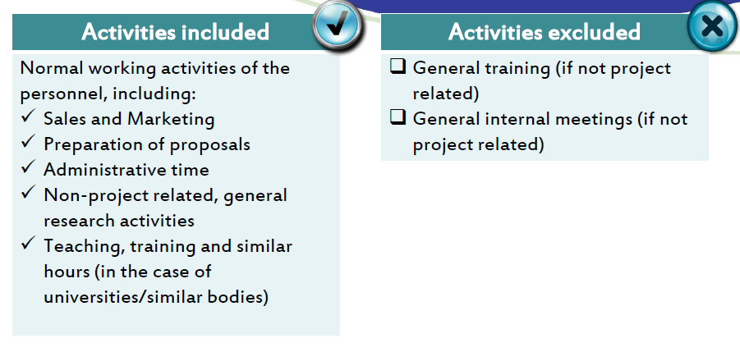
HOURLY RATE: PRODUCTIVE HOURS

Slide 31
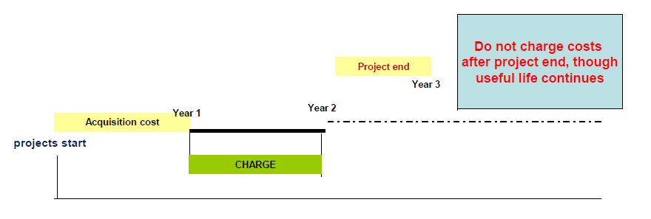
EQUIPMENT DEPRECIATION
Depreciation costs for equipment used for the project and bought before the start of the project are eligible, if the equipment has not yet been fully depreciated according to the usual accounting practices of principles of the beneficiary

Slide 32
COSTS OF DURABLE EQUIPMENT
To be considered as eligible, the equipment cost must be charged on the project according to the beneficiary's usual depreciation system for durable equipment.
A = usage period (in days or months)
B = write-off period (in days or months)
C = historical cost
D = percentage used
(A/B) x C x D
Prototypes Can be fully charged on the project budget

Slide 33
DEPRECIATION
Can depreciation costs for equipment used for the project but bought before the start of the project, be eligible?
If the equipment has not yet been fully depreciated according to the usual management and accounting practices of the beneficiary, the remaining depreciation (considering the amount of use for the project in percentage of use and time of use ) can be eligible under the project.
E.g. equipment bought in 01/ 2005, depreciation period of 48 months as per beneficiary accounting practices. If a GA is signed in Jan. 2007, & equipment is used for this EC, the beneficiary can declare the depreciation incurred under the GA for the remaining 24 months in proportion of the allocation of the equipment to the project.

Slide 34
CONSUMABLES
Consumables usually relate to the purchase, fabrication, repair or use of any materials, goods or equipment and software
Elegible if:
not considered overheads according to the beneficiary’s internal accounting regulations
bought after the start date of the project
not placed in the inventory of durable equipment of the contractor;
not treated as capital expenditure in accordance with the accounting conventions and policies of the contractor.
have a short life expectancy, certainly not greater than the duration of the the work under the contract
Notes:
If you want you can use this template for you presentation, see potx-file.

Slide 35
CASE STUDIES
Computer
  Eligible, but you have to pay attention to the usage percentage
Costs of transports, site preparation, installation, etc.
  Eligible
Maintenance
  Usual maintenance costs are considered overheads, unless the specific necessity for the project implementation is demonstrated
Office furniture
  Overheads
Notes:
If you want you can use this template for you presentation, see potx-file.

Slide 36
TRAVELS AND SUBSISTENCE
Only people under official contract in the beneficiary institutions, experts or subcontractors may have their travel reimbursed.
Their actual travel and related subsistence costs can be charged on the project, provided that:
they comply with the beneficiary’s usual practices, and
they are adequately recorded
Notes:
If you want you can use this template for you presentation, see potx-file.

Slide 37
Some Examples
Travel costs related to staff members belonging to another member of the consortium
  Better not: each beneficiary should upfront its own expenses
Travel costs related to a staff member whose contract has come to an end
  NO: unless he is given an assignment without being paid
Travel costs related to students
  Not eligible
Travel costs related to subcontractors
  Such costs should be included in the total amount to be subcontracted
Travel costs for key-note speakers in network-wide events
  Eligible
Notes:
If you want you can use this template for you presentation, see potx-file.

Slide 38
OTHER COSTS
This category covers any other expenses necessary for the implementation of the project which do not clearly fit into other budget headings (for instance, the costs for key-note speakers participating in conferences)
Notes:
If you want you can use this template for you presentation, see potx-file.

Slide 39
INELIGIBLE COSTS
The following non-eligible costs may not be charged to the project:
any identifiable indirect taxes, including VAT or duties;
interest owed;
provisions for possible future losses or charges;
exchange losses;
costs declared, incurred or reimbursed in respect of another Community project;
costs related to return on capital;
debt and debt service charges;
excessive or reckless expenditure;
any cost which does not meet the eligibility principles
Notes:
If you want you can use this template for you presentation, see potx-file.

Slide 40
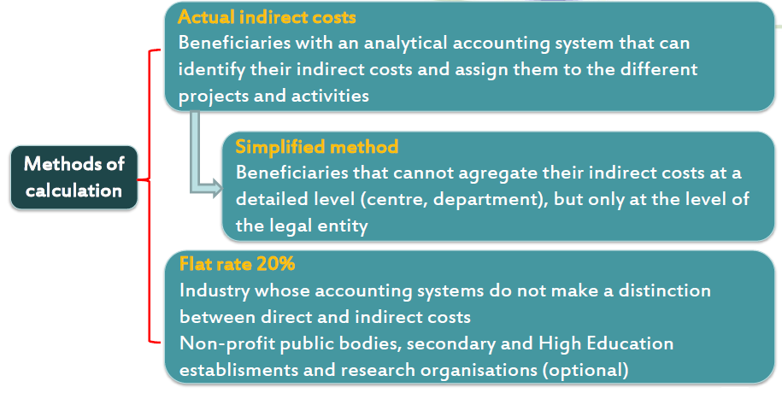
INDIRECT COSTS
Indirect costs are all those eligible costs which cannot be identified by the beneficiary as being directly attributed to the project, but which can be identified and justified by its accounting system as being incurred in direct relationship with the eligible direct costs attributed to the project .

Slide 41
REIMBURSEMENT OF INDIRECT COSTS
– flat rate of 20% of direct costs minus subcontracting and 3rd parties not used on the premises of the beneficiary
– For Non-profit Public Bodies, Secondary and Higher Education establishments, Research Organisations and SMEs unable to identify real indirect costs, may apply for a flat rate of 60% for funding schemes with RTD.
– For CSA limit of 7% of direct costs minus subcontracting and 3rd parties not used on the premises of the beneficiary.
Notes:
If you want you can use this template for you presentation, see potx-file.

Slide 42
EXAMPLE OF REIMBURSEMENT OF INDIRECT COSTS
Example
Collaborative project submitted by a university,
using the 60% flat rate for indirect costs
Project Direct Costs
Indirect Costs (60%)
100,000 RTD Costs (60,000)
50,000 Demonstration (30,000)
10,000 Management (6,000)
Notes:
If you want you can use this template for you presentation, see potx-file.

Slide 43
EXAMPLE OF REIMBURSEMENT OF INDIRECT COSTS
60% flat rate
Total Project Costs (Direct + Indirect costs)
RTD 160,000
Demonstration 80,000
Management 16,000
=>
Reimbursement i.e. EC contribution
RTD 160,000 * 75% = 120,000
Demonstration 80,000 * 50% = 40,000
Management 16,000 * 100% = 16,000
Total EC Contribution =176,000
Notes:
If you want you can use this template for you presentation, see potx-file.

Slide 44
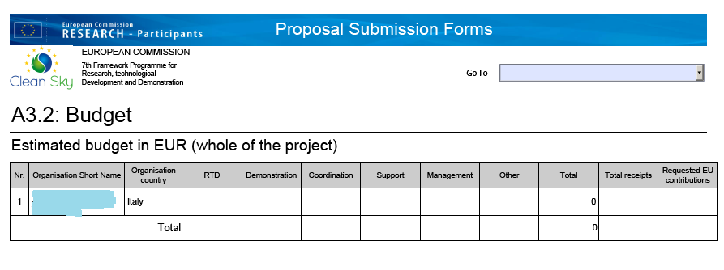
BUDGET FORM

Slide 45
PAYMENTS
Within 45 days the signature of Grant Agreement.
Usually a consistent % of the Grant.
Pre-financing
– Retention (5%)
Interim and final payments
Based on financial
statements (EC contribution= amounts
justified & accepted * funding rate)
Notes:
If you want you can use this template for you presentation, see potx-file.

Slide 46
FINAL COMMENTS
Fit project idea into Work Programme Emphasize project’s goal, necessity and advantages in a European context
Involve partners with European programme experience
Get involved in writing of your Work Package or Task(s) Clarify your role and ensure that your expertise is fully utilized
Communicate well to show your commitment

Slide 47
Thank you!
gabriella.calderari@uniroma1.it
d.w.chadwick@kent.ac.uk

