Slide 1

training & research
for academic newcomers
A project of the King Baudouin Foundation

Slide 2

Introduction to Project Management
Gabriella Calderari
David W Chadwick
Notes:
Second slide.

Slide 3
Problem Solving
Start
Problems Solved
Detect Problem
Execute Project
Decide Solution
Plan Project
Notes:
Organisations are continually detecting problems and launching projects to solve them. It is usually a never ending cycle. Projects are usually initiated by organisations because they have detected that a problem exists, and it needs to be solved. The problem might be categorised as not being able to do something, e.g. transfer orders and invoices electronically, or it might be categorised as wanting to do something better i.e. for less money or quicker or more efficiently e.g. transfer orders and invoices over the Internet instead of via a private network. Quite often projects are proposed as a means of effecting change in an organisation. A project proposal will usually then be written, in which a solution to the problem is suggested. If the project proposal is accepted by the organisation's management, it will get the go-ahead, and the project will be initiated, planned, implemented and hopefully completed satisfactorily. Often during the course of a project new problems are detected. Sometimes these can be solved within the remit of the original proposal, and sometimes they cannot be. In the latter case, one or more new project proposals will need to be written, and the whole cycle will start again.

Slide 4
What is a Project?
Any Task
Which Has
A Beginning
And an End
Notes:
A project is any task that has a beginning and an end. It can be a simple thing like going to the shop to buy some bread, or a complex thing like building an Olympic Stadium. Getting married is a project, but staying married is not. The latter should not have a planned ending!

Slide 5
Which of the following are Projects?
Applying for an EC Project
Implementing an EC Project
Getting a job
Keeping a job
Seeking promotion
Everyday living
Buying a house

Slide 6
Project Objectives
Quality
Time
Cost
Notes:
A project usually has defined objectives for cost, time for completion, and quality of the final deliverable (the project Triangle).
Cost is the cost of resources, both materials and person effort. These three objectives are strongly inter-related. Increased quality usually requires longer time and/or greater cost. Reducing the time and keeping the quality usually costs more.

Slide 7
Objectives are Strongly Inter-related
Increase the quality -> increase cost and/or time
Decrease the time -> decrease in cost and/or quality
Increase the time -> increase the cost

Slide 8
What is Project Management?
The role of a Project Manager is to ensure that the project can be completed on time, to cost and to the required quality
But this is not an easy role (which is why good project managers are highly sought after and well paid)

Slide 9
Project Management Skills
Project management involves a wide variety of skills and techniques, including:
  technical skills to be able to understand the technical solutions being proposed
  interpersonal skills, to be able to motivate all the members of the project team
  planning and estimating skills so as to formulate good project plans
  communication skills, to be able to write clear reports and give presentations to project stakeholders
  numerate and financial skills so as to control project resources
  creativity to solve problems and develop solutions

Slide 10
Two Basic Laws of Project Management
All project management decisions must be made by considering their effect on the objectives for the project
Only the remaining work in the project can be managed - you cannot manage what has already happened

Slide 11
Phases of a Project
Project
Initiation
Project Planning
Task Scheduling
Information Gathering
Project Proposal
Project
Re-planning
Project Execution
Information Evaluation
Project Termination
Feedback
Initiation
Planning
Execution
Control
Feedback

Slide 12
Project Proposal Phase
Document proposals for new projects, possibly arising from existing projects, new business opportunities, changing market conditions etc.
Specify goals of project, not solutions (leave that till later phase)
Notes:
Too many IT projects specify solutions as project goals. Leave solution specification till later on during the project. Clarify the goals of the project before the project starts. For example “We need a Unix stock control system” is not really a goal. It has mixed up goals “stock control system” with solutions “Unix”. Ask why? to determine the real goals of the project. It might be “We want to improve cash flow, increase stock turnaround and lower inventories”. A stock control system is one way of achieving this. “We want it to link into our other systems” might be the reason that Unix was specified. Solutions can become goals, but be clear at the start why this is so. For example, a Unix system (a solution) can be a goal if it is determined that the IT systems staff are only proficient in Unix operating systems, and all the other organisational IT systems also run on Unix.

Slide 13
Project Initiation Phase
Collect project ideas and proposals
Evaluate project proposals and select best project(s) for planning
Select project manager and initiate the planning of the project

Slide 14
Project Planning Phase
Establish the project plan
  Including risk management plan and quality plan
Make Resource Input contracts
Initiate the project document files
Notes:
During planning some initial solutions may be determined to satisfy the project goals, although some early tasks in the project may be to determine the best solution to meet the desired goals.

Slide 15
Task Scheduling Phase
Initiate the sub-project groups
Establish and distribute task descriptions
Order the execution of tasks

Slide 16
Execution Phase
Execute activities
Document work results and resources consumed
Control the quality of work

Slide 17
Information Gathering Phase
Record project control information (time, cost, quality) continuously
Prepare project control statements periodically

Slide 18
Evaluation Phase
Relate project control information to project plan data
Isolate and define present and/or anticipated deviations from the project plan
Determine the causes and effects of the deviations
Decide upon appropriate actions

Slide 19
Project Re-Planning Phase
Develop proposals for project plan alterations
Refer to the Steering Group if alterations exceed the limits of the project
Carry out alterations to the project plan and Resource Input contracts

Slide 20
Project Termination Phase
Develop proposal for premature project termination if necessary
Decide on termination of project (possibly via Steering Group)
Execute the termination process
Produce final project report
Disband the project team

Slide 21
Project Feedback Phase
Collect and document experience information and proposals for change
Develop proposals for improvements
Decide on, carry out and communicate information about changes and improvements
Notes:
Essential part of “continuous improvement” and “learning organisation”

Slide 22
Prematurely Terminating a Failing Project is Hard
Read “Blowing the Whistle” by M. Keil and D. Robey
  CACM, April 2001, Vol 4, No 4, pp 87-93
The “Mum Effect” – Reluctance to Blow the Whistle
  “Career suicide to be honest”
  “Political suicide to go and speak up”
The “Deaf Effect” – Reluctance to Hear the Whistle
  “I don’t think they believed it would be that serious”
  “We really appreciate your efforts, but thanks no thanks”

Slide 23
Organization Contexts of Whistle Blowing
Cover Up Organisation | Deaf-Dumb-Blind Organisation
Healthy Organisation | Ostrich Organisation
Strong
Mum
Effects
Weak
Weak
Strong
Deaf Effects

Slide 24
Project Planning
Why Plan
  to ensure project can be completed on time, to budget and at the required quality
  to set the standard for time, cost and quality for project control to measure against
Planning tools: Gantt Charts, Dependency Tables, Work Breakdown Structures, Activity Networks
Start by listing all the activities and tasks in the project. A WBS may help
Then work out the dependencies between tasks

Slide 25
WORK BREAKDOWN STRUCTURE
Project
Work Package 1
Work Package 2
Activity A
Activity B
Activity C
Activity D
Task A
Task B
Task C
Task E
Task F
Task X
Task Y
Task M
Task N
Task O
Notes:
Depending upon the size of the project, different work packages may or may not be needed

Slide 26
Dependency Table
ACTIVITY/TASK | DEPENDENT UPON
A B C D E F | - - B A,B,C B E,B
Notes:
Note. Dependency tables say nothing about task durations or scheduling. They just indicate which tasks or activities must be completed before another one can start.

Slide 27
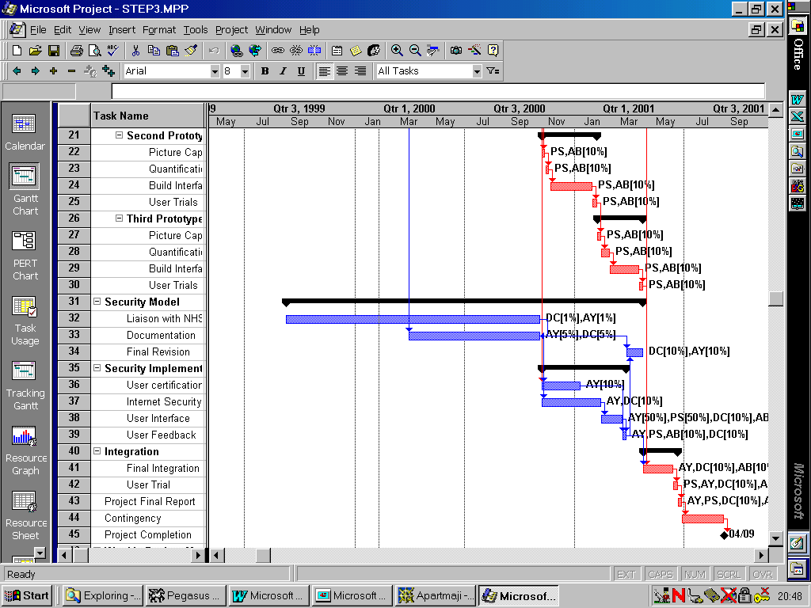
Gantt Charts
Notes:
These are the best known planning chart. Activities are listed in a column at the left-hand side of the page (y-axis), and time spans the page from left to right (x-axis). They are sometimes known as Bar Charts, since the duration of each activity is shown as a bar drawn on the page, the length of the bar representing the duration of the activity. The position of the bar shows when the activity is scheduled to take place.
Some software tools, e.g. Microsoft Project, have further embellished the Gantt Chart by adding dependencies to it, in the form of arrows linking the various activities together, as well as other optional information such as the resources assigned to each task.

Slide 28
Activity Networks
Two types: Activity on Node, and Activity on Arrow.
  Activity on Node is used by Microsoft Project
Features: Various types of links: Start-Start, Finish-Start, Finish-Finish, all with or without lag (time delay)
Shows Critical Path – each task on this path must finish on time otherwise the project will be late
Notes:
Activity Networks are also know by various other names such as:
PERT Programme Evaluation Review Technique
CPP Critical Path Planning
CPM Critical Path Method
There are two types: Activity on Node, and Activity on Arrow. The former is used by Microsoft Project.

Slide 29
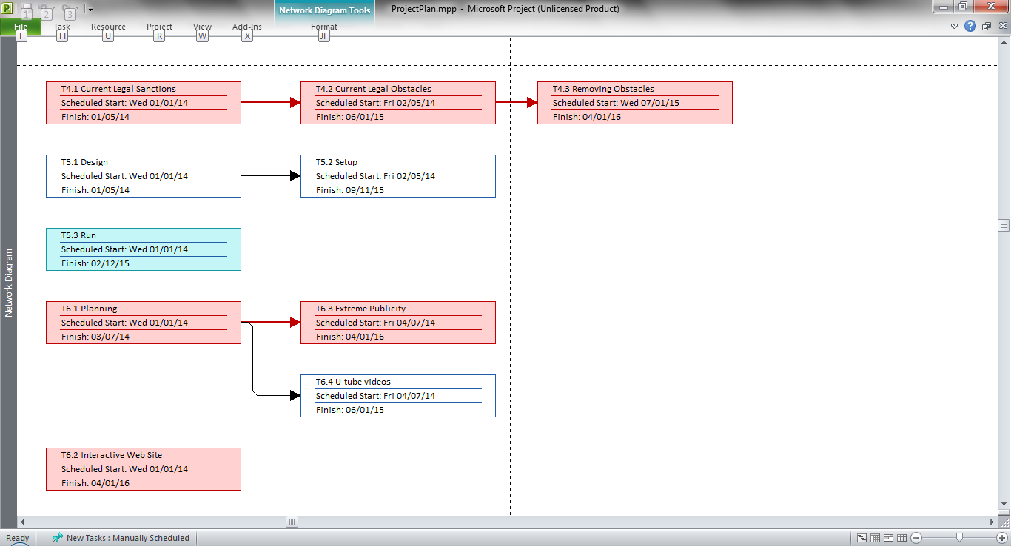
Network Diagram in MS Project
All tasks on critical
path are coloured red

Slide 30
Resourcing
Determine what resources a project needs over time
Resources :
  People
  Equipment
  Materials
  Facilities
Scheduling
Determining when the tasks are going to be performed
Notes:
Scheduling is determining when (i.e. the order that) the tasks are going to be performed. Resourcing is the process of relating the resources required for a project to the time they are needed, so that realistic schedules can be set up. The schedules can then be used as a basis for obtaining the resources when they are needed, and for allocating tasks to people. With most projects, people resources will usually be specified as roles e.g. programmer, analyst etc. and task allocation to specific individuals and teams will only occur at the start of a project activity.

Slide 31
Steps in Resourcing and Scheduling
Estimate activity durations from workload estimates
Combine with logical dependencies to produce a logical project plan
Allocate resources to tasks
Smooth the resources to produce a scheduled project plan
If necessary, alter plan to fit customers/sponsors requirements
Allocate tasks to named individuals and teams
Adjust plan for actual staff performances
Notes:
Some points to note
People do not work 365 days per year, nor 5*52. Its typically around 220 days. Consequently task durations will be longer than the person effort that is needed. Typically add around 25% to effort estimate to account for non-project time. Ie. 208 project working days per year (not 260).
Time contingencies are needed for unexpected delays so add another 20% to the scheduled duration for a task to account for this.

Slide 32
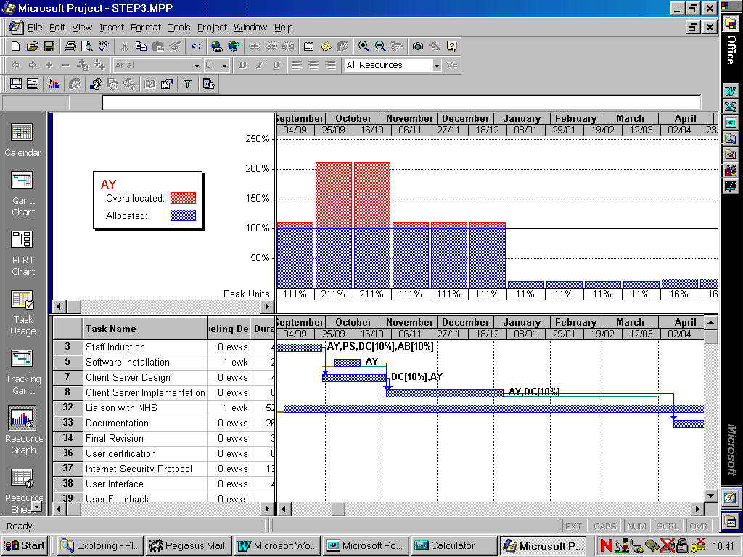
Resource Histograms in MS Project

Slide 33
The Control Loop
Set Standard
Continue Unchanged
Take Corrective Action
to Improve Performance
Revise the Standard
Decision
Measure Performance
Compare Performance
with Standard

Slide 34

Measuring Project Objectives
Time
Resources
Quality
??

Slide 35
Measuring Cost
Keep accounts and compare with budget
Two Important statistics
BAC (Budgeted at Completion) =
The total cost of the project derived from the project plan before any work began
EAC (Estimated at Completion) =
The estimated cost today, derived from the actual costs to date plus the scheduled costs remaining

Slide 36
Measuring Staff Time/Costs
Use timesheets and reporting to collect time spent and 'to go'
Beware 90/90 rule:
'It takes 90% of the time to complete the first 90% of the task, and 90% of the time to complete the last 10% of the task'
By
  Honest approach - explain exact use of data
  Minimum staff effort - small and simple data
  Feedback - show staff current project progress
  Questioning 'to go' - require justification
  Setting measurable objectives & small tasks

Slide 37
Project Quality Objectives
What you want – functional specifications
How well you want it – non-functional or QOS specifications
  QOS is the most difficult of the 3 project objectives to specify and measure
  We will have a separate lecture devoted to quality management

Slide 38
Corrective Action
Improving Staff Performance
Motivation - Hertzberg etc.
Staff Training and Development
Additional Staff
Discipline
Better quality controls

Slide 39
Corrective Action
Resetting The Standard
Only when absolutely necessary e.g.
  Unexpected events make target unobtainable
  Staff are not skilled enough
  Leader is inadequate
  Circumstances render it obsolete
Because
  Removes a motivation to try harder
  De-motivates staff who already tried hard
  Staff ignore constantly changing standards

Slide 40
Management by Walking About (MBWA)
FINALLY
Don’t forget to wander about in the project area, talking to staff, getting them to demo things
You will learn a lot about the project and its progress, how staff feel etc. from this
You will also uncover problems very early on, before things go too badly wrong

Slide 41
Any Questions??????
gabriella.calderari@uniroma1.it
d.w.chadwick@kent.ac.uk

