Slide 1
SERBIA ON THE ROAD OF IMPLEMENTATION OF ENERGY EFFICIENCY IN BUILDINGS
MINISTRY OF CONSTRUCTION AND URBANISM
JASMINKA PAVLOVIĆ
jasminka.pavlovic@mgu.gov.rs
Belgrade , 1st October, 2013

Slide 2

STEPS ON THE ROAD OF IMPLEMENTATION OF ENERGY EFFICIENCY IN BUILDINGS
OBJECTIVES
TECHNICAL STANDARDS
(EU – SERBIA)
STRANDARD
OF LIVING
❶
❸
LEGISLATION AND
REGULATIONS
DATA
AND FINANCIAL
RESOURCES
❷
EDUCATION AND
INFORMATION
ON
THE ECONOMIC
POTENTIALS

Slide 3

















THE ROAD TO ENERGY EFFICIENCY IN BUILDINGS
IN SERBIA
INTENDED
Eta towns –public exhibitions and debates on energy efficiency
Campaign on Social Networks
– energy dialogue in Serbia
National database on the energy efficiency in buildings in
Serbia
Rulebook implementation through the project of first energy passports
National image campaign for the promotion of the energy passport
Public Exhibition – Energy Atlas
of Belgrade
Regional conference on the
TABULA catalogue
Rulebook amendment and improvement procedure
Preparation of professional publications – A Handbook on issuing of energy passports
Events and press conferences – energy efficiency in buildings in Serbia
Public discussion on the financial models of rehabilitation of residential buildings in the field of EE
❶
❷
❸
LEGISLATION AND REGULATIONS
EDUCATION AND INFORMATION
DATA AND FINANCIAL RESOURCES
THE LAW ON PLANNING AND CONSTRUCTION
(Official Gazette of RS, no .72/09, 81-09, 64/10-US I 24/11 )
Training and education of engineers on energy efficiency
Eta towns – Forming of the association of 30 towns in Serbia in order to implement the project of energy certification of constructions
Statistical data – Catalogization of Buildings in Serbia
(technical data and market potentials)
COMPLETED
THE RULEBOOK ON THE ENERGY EFFICIENCY OF BUILDINGS
(Official Gazette of RS, no . 61/2011)
Program of the seminar: Techniques, Technologies and Products regarding Energy Efficiency
In Buildings
Draft concept of a public discussion on the possible financial models
The Rulebook on the conditions, content and way of issuing of the certificates on the energy performances of buildings
((Official Gazette of RS, no . 69/2012)

Slide 4




Further Steps in the Implementation of the Regulations on Energy Efficiency in Buildings
Intended for professionals
Involves: A single national database and information on: the process and methodology of certification; issued EE certificates; training materials and programs; laws and bylaws; catalogization and typologization of the building stock in Serbia; market potentials
Benefits: Enables information management and quality communication with donors.
Aimed at stimulating the activities of local governments in the implementation of legislation and projects in the field of energy efficiency
Contents: Forming of the association of 30 cities in which the project of energy certification of buildings is implemented. After piloting the certification process a professional and public debate on EE is initiated.
Benefits: Taking steps towards the realization of the potential of EE independently.
Designed for professional circles and general public
• Content: A campaign focused on creating the awareness of the benefits of energy certification and the image of the energy passport quality
• Benefits: Energy passport that becomes the driving force of development of the construction industry in Serbia and a market instrument for regulating the real estate.
Intended to promote public dialogue amongstprofessional circles and the general public on energy efficiency in buildings.
Content: Creation of a Web site, Facebook profile, LinkedIn profile, Twitter profile and internet forums in order to create an "energy network of Serbia“
Benefits: Creation of a positive climate in terms of energy efficiency in buildings.

Slide 5
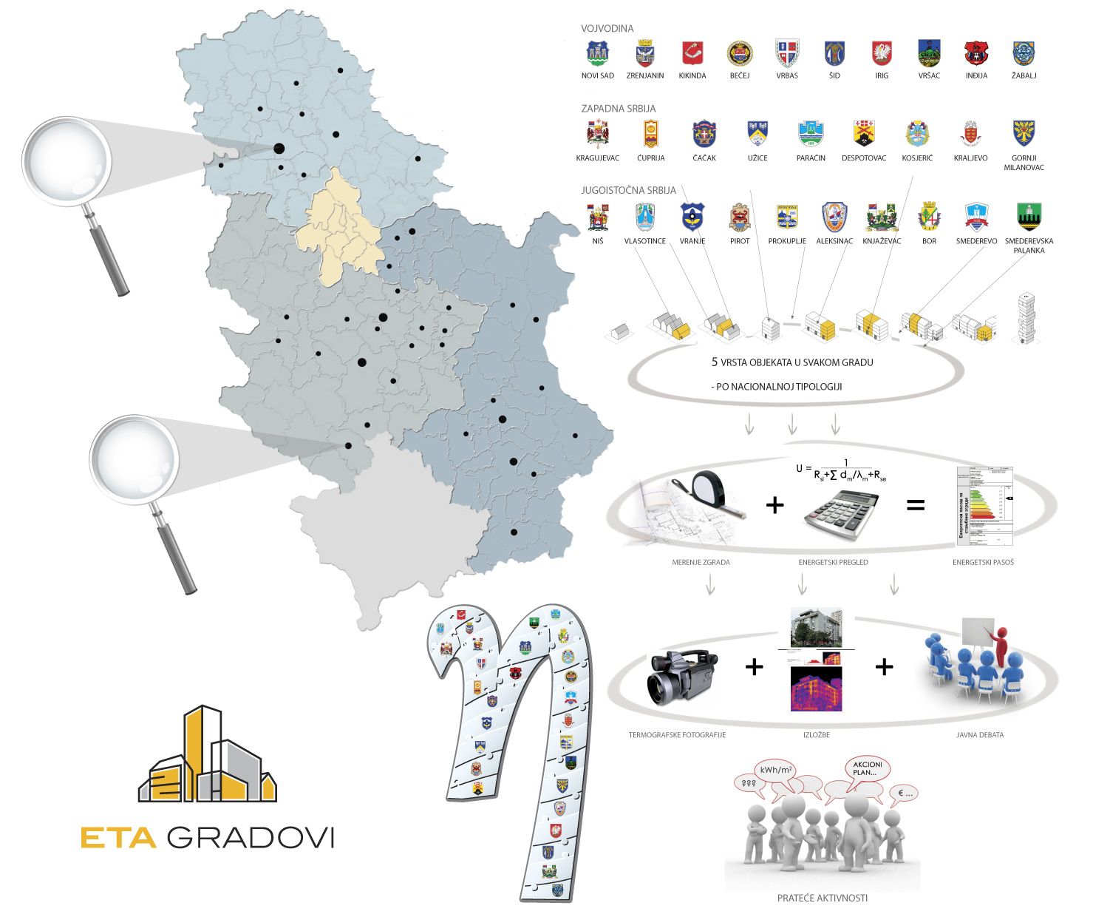



Slide 6
Key to a Successful Implementation of the EE program
Information management
WB
Ministry of Constructionand Urbanism
Ministry of Energy
Energy Agency
IPA
Professional Circles
Certifiers
Investors
Companies
Real Estate Companies
Local Governments
Public sector
GIZ
REGULATIVE ZAKON INVESTICIJE PROIZVODI PROJEKTI FINANSIJSKI MODELI TRŽIŠTE DONACIJE INVESTICIJE SERTIFIKATI PROGRAMI OBUKE PRIRUČNICI PRAVILNICI KONTROLA STANDARDI TABULA KATALOGIZACIJA EKONOMSKI POTENCIJAL

Slide 7



THE NATIONAL BASE
ENERGY EFFICIENCY IN BUILDINGS
STRUCTURE
STATISTICAL DATABASE– TYPOLOGIZATION AND CATALOGIZATION OF CONSTRUCTIONS IN SERBIA
THEORETICAL MODELS OF CALCULATION OF ENERGY EFFICIENCY
REGISTRIES OF LAWS, REGULATIONS, RULE BOOKS AND BYLAWS ON ENERGY EFFICIENCY IN BUILDINGS
The Ministry of Construction and Urbanism
REGISTRY OF ISSUED ENERGY CERTIFICATES
PROCEDURES AND CALCULATIONS OF ENERGY EFFICIENCY FOR THE ISSUING OF ENERGY CERTIFICATE
TRAINING MATERIALS AND PROGRAMS
GUIDE BOOKS AND OPERATION MATERIALS ON ENERGY CERTIFICATION

Slide 8




THE NATIONAL BASE
ENERGY EFFICIENCY IN BUILDINGS
NECESSARY RESOURCES
✓
HARDWARE
‒
DBA - SA
Database administrator
System administrator
12 MONTHS
‒
SOFTWARE
4-10 MONTHS
‒
DMS
Data management system
1-2 MONTHS

Slide 9





THE NATIONAL BASE
ENERGY EFFICIENCY IN BUILDINGS
BENEFITS
TIME SAVING
LESS HUMAN RESOURCES NEEDED
LESS FINANCIAL RESOURCES NEEDED
MORE QUALITY INFORMATION
MORE INVESTMENT
POSITIVE IMAGE

