Slide 1
Wild type poplar (Populus tremula x P. alba) of the INRA female clone 717 1-B4 and its
172 transgenic line ggs28 overexpresing the bacterial gene gshI
Lead uptake increases drought tolerance of wild type and
transgenic poplar (Populus tremula x P. alba) overexpressing gsh 1
Article Type: Research Paper
Keywords: Pb; water deprivation; ROS; re-watering; glutathione;
phytoremediation.
Sladjana Samuilov; Friedericke Lang; Matilda Djukic;
Danijela Djunisijevic-Bojovic; Heinz Rennenberg
Abstract: Growth and development of plants largely depends of their
adaptation ability in a changing climate. This is particularly true on
heavy metal contaminated soils, but the interaction of heavy metal stress
and climate on plant performance has not been intensively investigated.
The aim of the present study was to elucidate if transgenic poplars
(Populus tremula x P. alba) with enhanced glutathione content possess an
enhanced tolerance to drought and lead (Pb) exposure (single and in
combination of both) and if they are good candidates for phytoremediation
of Pb contaminated soil. Lead exposure reduced growth and biomass
accumulation only in above-ground tissue of wild type poplar, although
most of lead accumulated in the roots. Mild drought caused a decline of
the water content rather than reduced biomass production, while Pb
counteracted this decline in the combined exposure. Apparently, metals
such as Pb possess a protective function against drought, because they
interact with abscisic acid dependent stomatal closure. Lead exposure
decrease while drought increase glutathione content in leaves of both
plant type. Lead accumulation was higher in the roots of transgenic
plants, presumably as a result of chelation by glutathione. Water
deprivation enhanced Pb accumulation in the roots, but Pb was subject to
leakage out of the roots after re-watering. Transgenic plants showed
better adaptation under mild drought plus Pb exposure partially due to
improved glutathione synthesis. However, the transgenic plants cannot be
considered as a good candidate for phytoremediation of lead, due to its
small translocation to the shoots and its leakage out of the roots upon

Slide 2
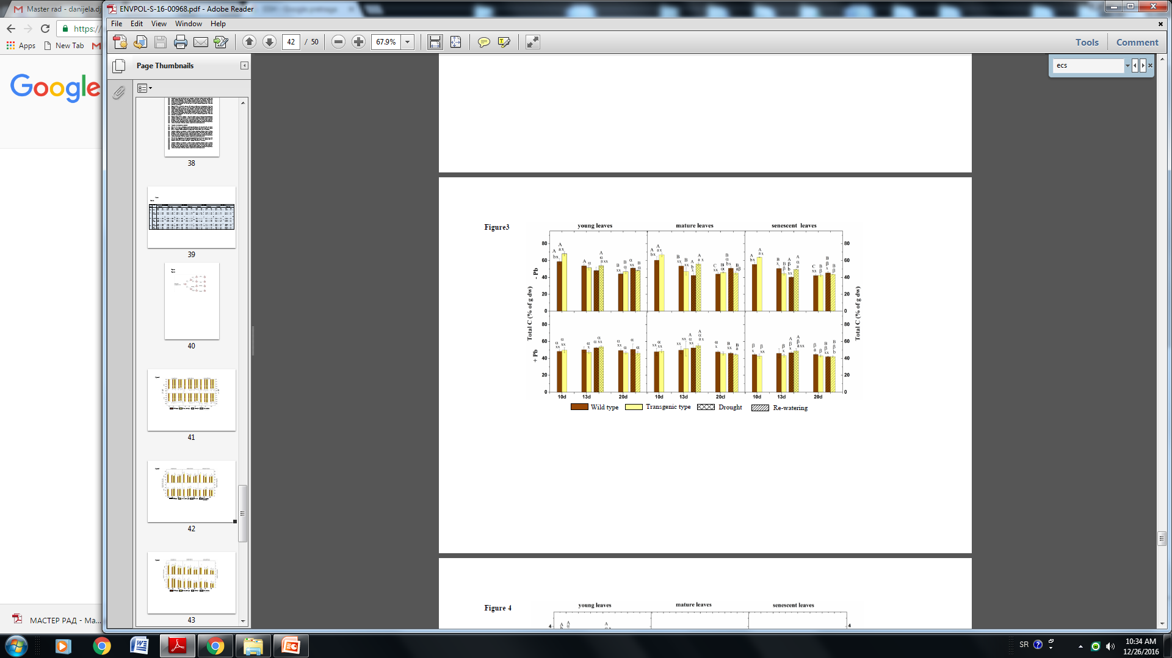
Figure 3. Effect of Pb and drought on total carbon content in wild type and transgenic line.
Significant differences are indicated at p<0.05. X indicates significant differences between different
treatments within the same plant type and at the same time point. Small letters indicate significant
differences between different plant types within the same treatment and at the same time point.
Capital letters indicate significant differences between different time points within the same plant type
and the same treatment. Greek letters indicate significant differences between different type of leaves
within same plan type and same treatment. All values are means ± standard deviation of 3 plants each.

Slide 3
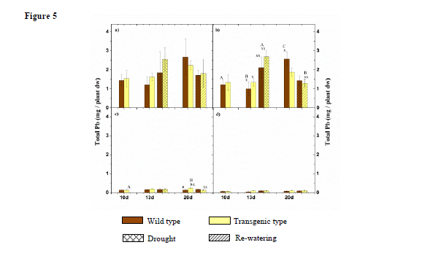
Figure 5. Effect of drought and re-watering on total Pb content on total plant level (root + stem +
leaves) (a) and total root (b), stem (c), leaves (d) of wild type and transgenic line. Significant
differences are indicated at p<0.05. X indicates significant differences between different treatments
within the same plant type and at the same time point. Small letters indicate significant differences
between different plant types within the same treatment and at the same time point. Capital letters
indicate significant differences between different time points within the same plant type and the same
treatment. All values are means ± standard deviation of 3 plants each.

Slide 4
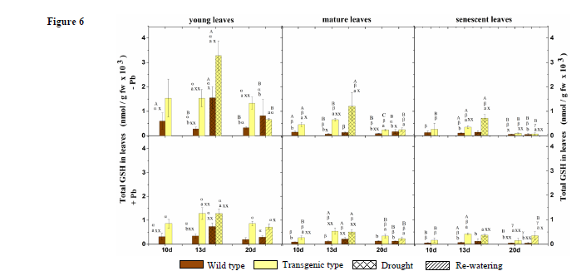
Figure 6. Effect of Pb and drought on total glutathione content in wild 822 type and transgenic line.
Significant differences are indicated at p<0.05. X indicates significant differences between differenttreatments within the same plant type and at the same time point. Small letters indicate significant
differences between different plant types within the same treatment and at the same time point.
Capital letters indicate significant differences between different time points within the same plant type
and the same treatment. Greek letters indicate significant differences between different type of leaves
within same plan type and same treatment. All values are means ± standard deviation of 3 plants each.

